Slide 1
Driver Theory Traffic Signs
Work Zone Signs

Slide 2
Work Zone
Work Zone Signs are usually diamond shaped, like warning signs, but they are orange instead of yellow.
These signs identify maintenance, construction or utility areas where workers or equipment mat be on or near the roadway.

Slide 3
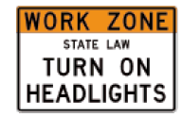
Work Zone Signs
Turn on your headlights when traveling through a work zone, no matter what time of day.
This is the law for ALL posted work zones, not just for active ones.
Using your headlights makes your car more visible to other traffic as well as construction workers.
If you are pulled over for a traffic violation in a work zone and if you do not have your light on, you will be fined an additional $25.00

Slide 4
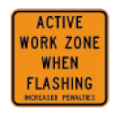
Work Zone Signs
Signs are placed at the beginning and end of an active work zone.
An active work zone is the portion of the work zone where construction, maintenance or utility workers are on or near the roadway.

Slide 5
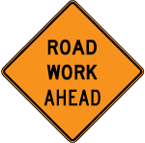
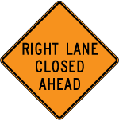
Work Zone Signs
Road Work Ahead informs you there is road work ahead also it cautions you to slow down.
Workers Ahead informs you workers may be on or very close to the roadway, so take special care when traveling through the area.
Lane Closed Ahead tells you a particular lane will be closed, usually at a certain distance.

Slide 6
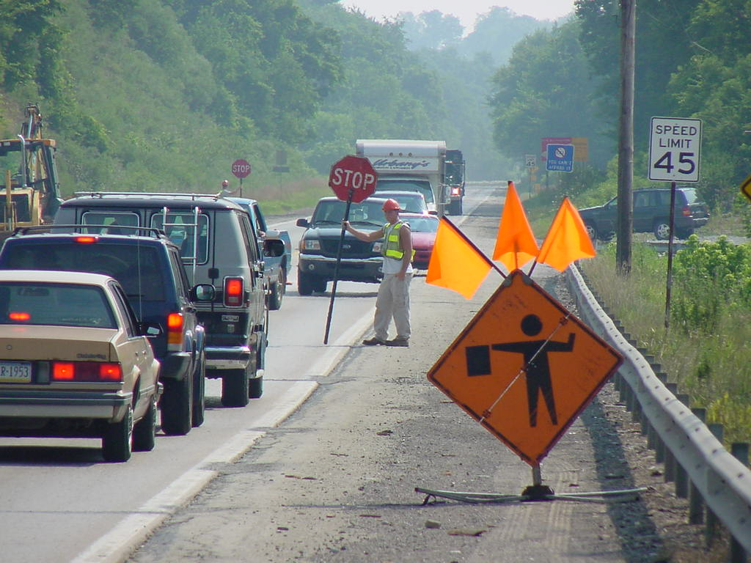
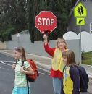
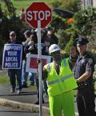
Work Zone Signs
Flagger Ahead
The sign shows a flagger is controlling traffic ahead. Flagger use STOP and SLOW paddles or a red flag to signal you to stop or slow down.
Pay special attention to flaggers when approaching and traveling through a work zone.

Slide 7
Work Zone Signs
Electric Arrow Panels
Large electronic flashing arrow panels placed in the roadway advise approaching motorist of lane closures.
Begin your merge well in advance of the sign.
Move/Merge Left
Move/Merge Right
Caution

Slide 8
Work Zone Signs
Channeling Devices
Barrels, tubes, cones, and vertical panels are all devices used in work zones to guide you through changing traffic patterns and keep you away from hazards associated with road work.

Slide 9
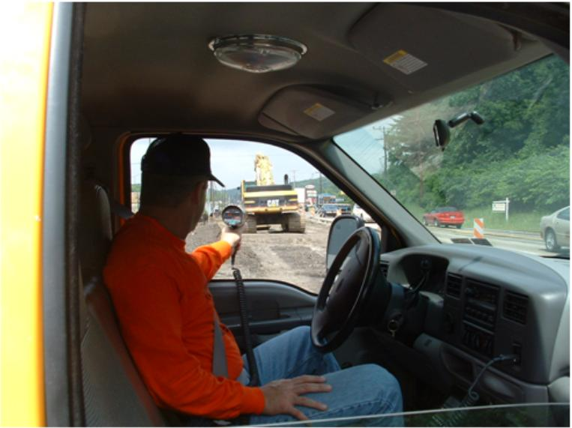
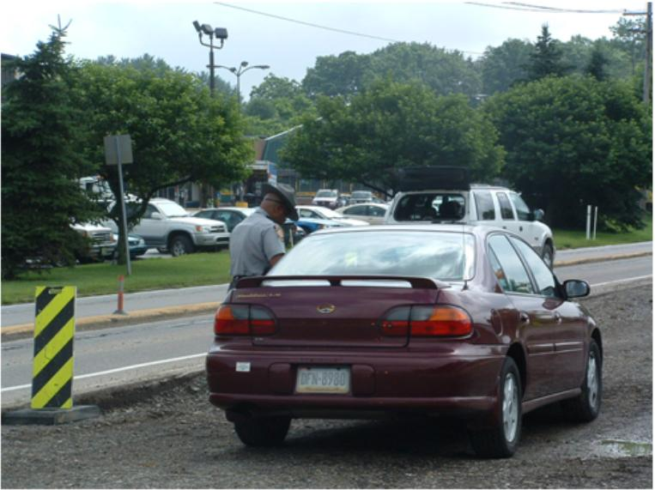
Penalties in Work Zones
The penalty for driving without lit headlights in a posted work zone is $25. This is a secondary law; therefore individuals are subject to the fine only if convicted for another violation of the vehicle code.
Fifteen-Day Loss of License for Driving Dangerously. Motorists caught driving 11 miles per hour or more above the posted speed limit in an active work zone, or who are involved in a crash in an active work zone and are convicted for failing to drive at a safe speed, automatically will lose their license for 15 days.
Fines Doubled/Jail Time Increased. Fines for certain traffic violations – including speeding, driving under the influence, and failure to obey traffic devices – are doubled for active work zones. Also, the law provides for up to five years of additional jail time for individuals convicted of homicide by vehicle for a crash that occurred in an active work zone.

Slide 10
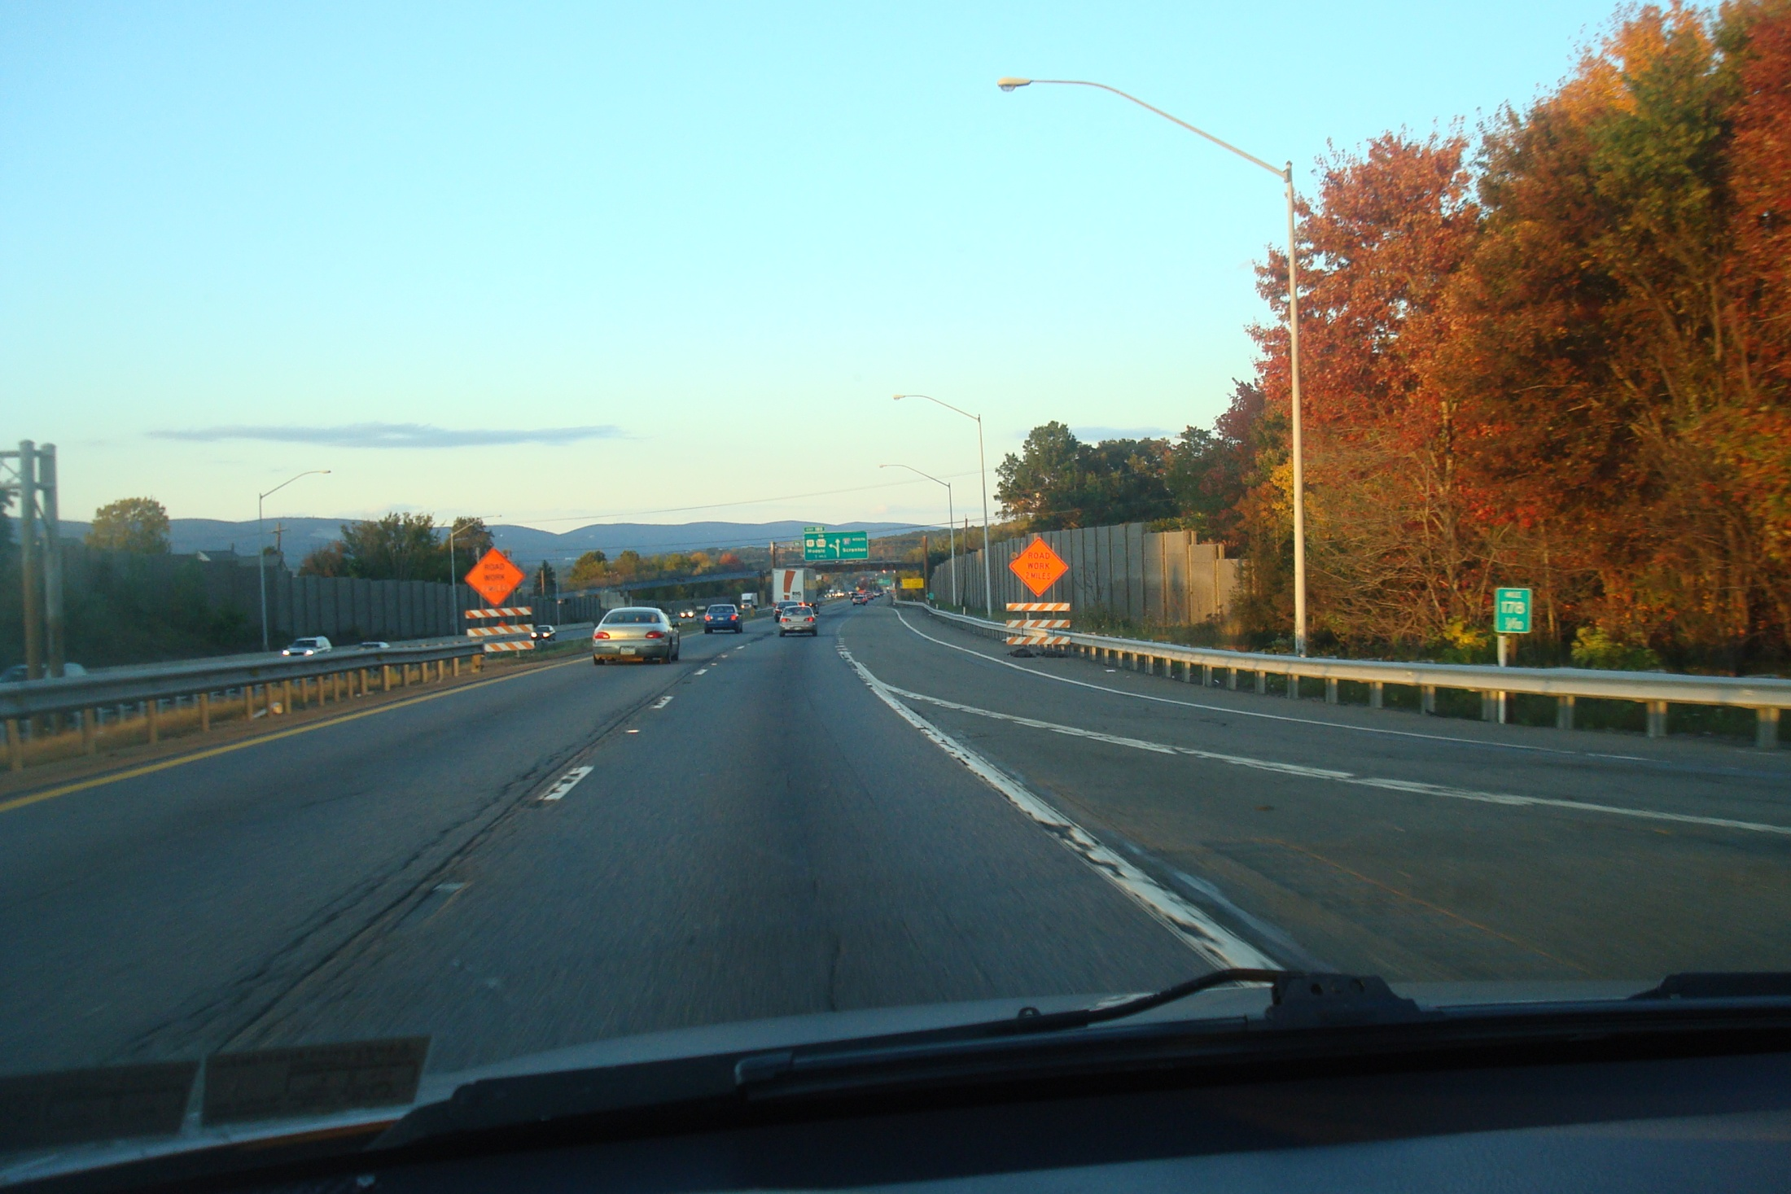

Slide 11
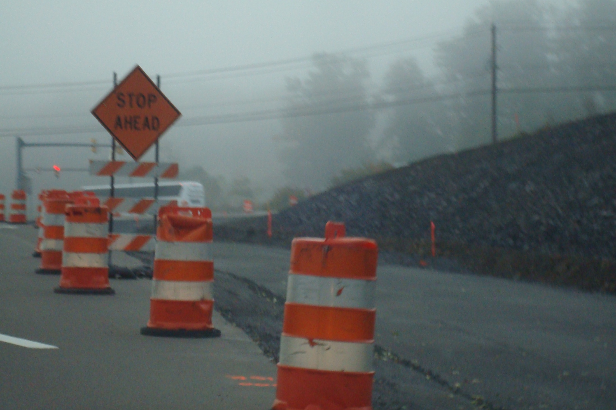

Slide 12
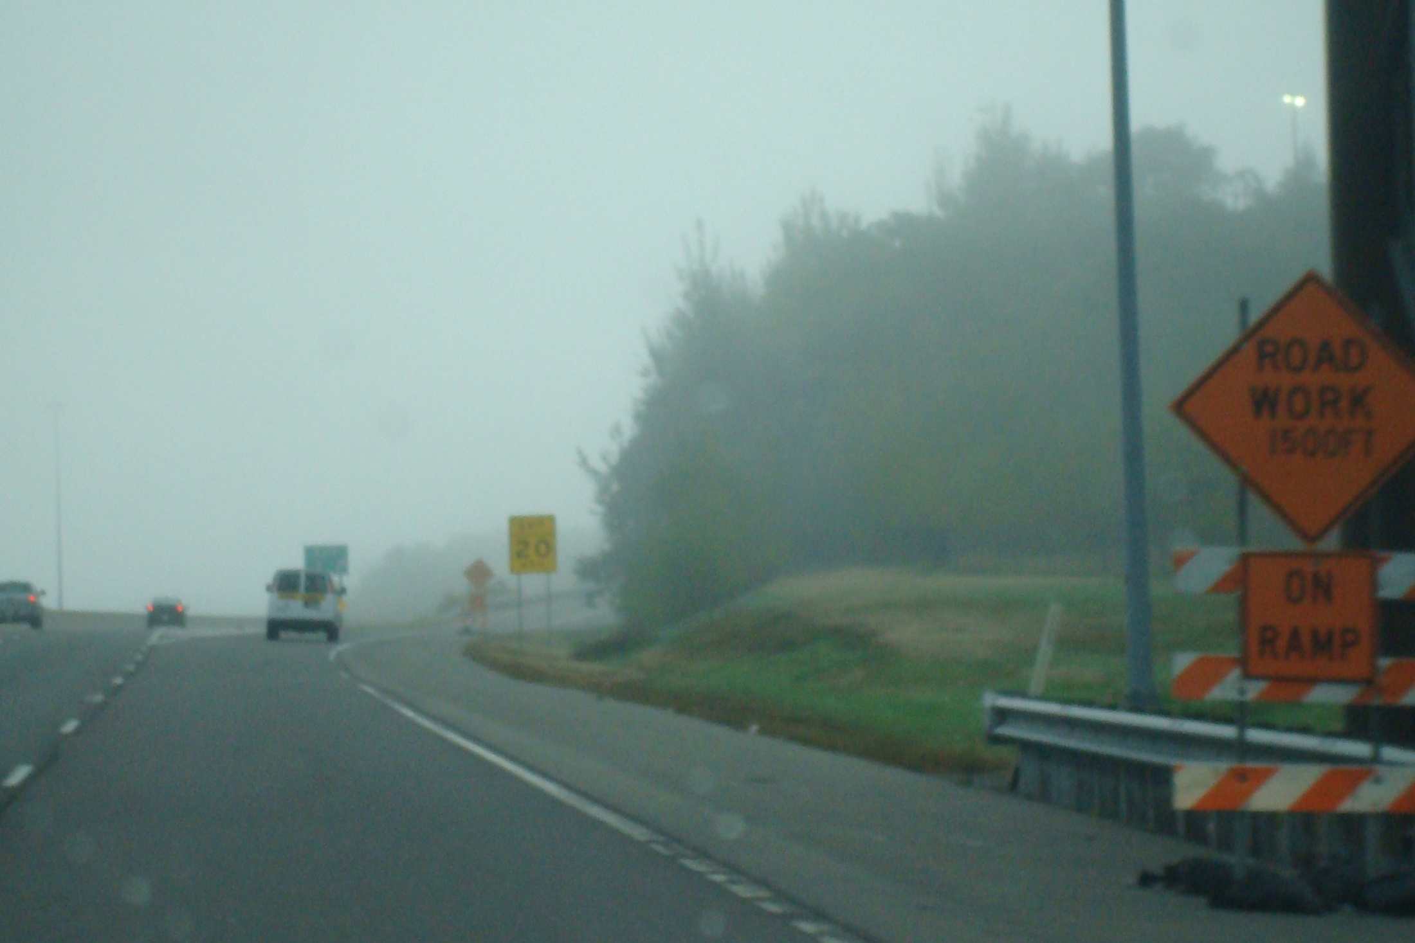

Slide 13
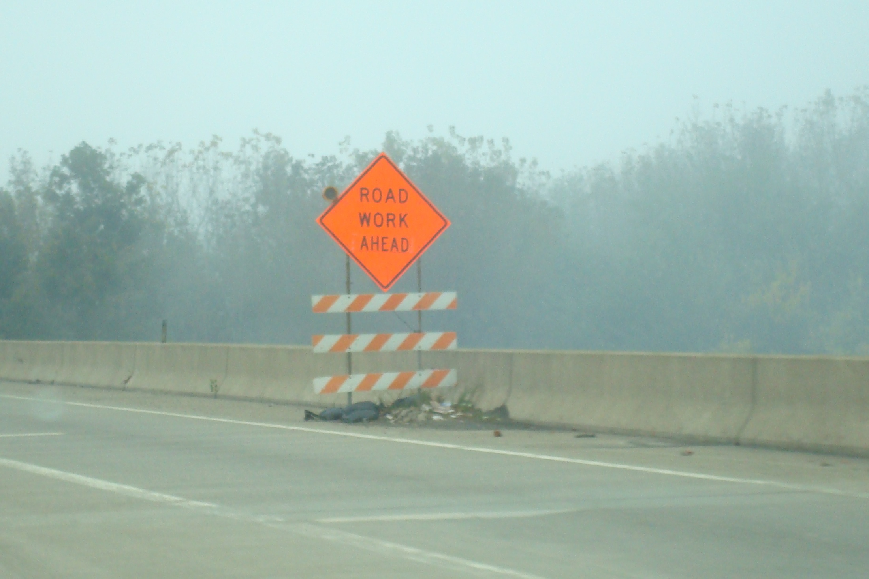

Slide 14
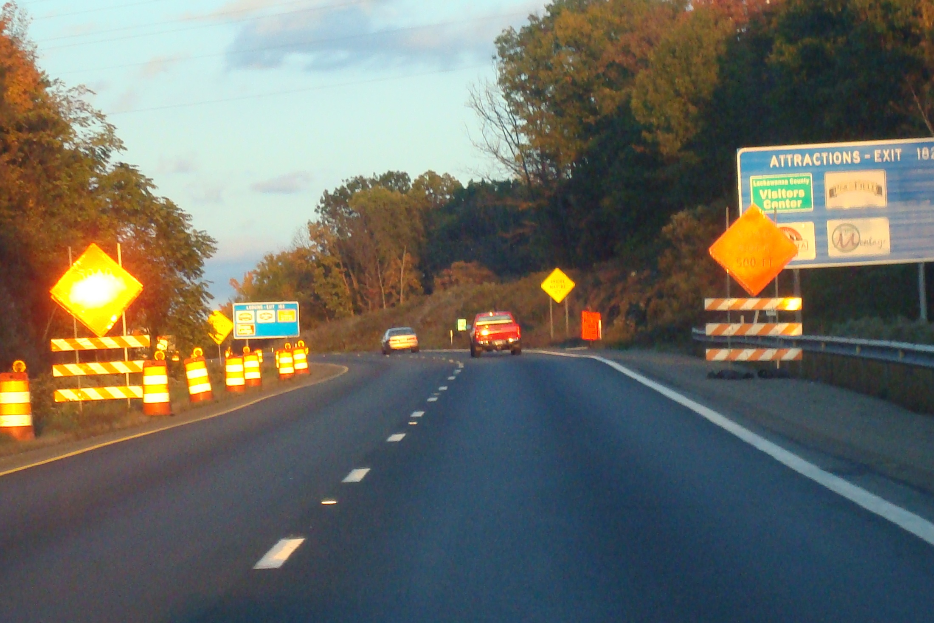

Slide 15
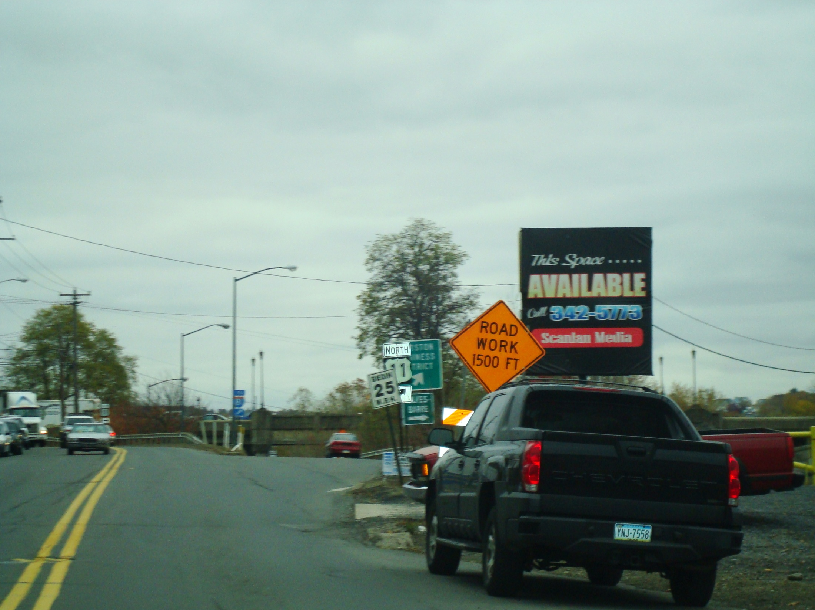

Slide 16
The End

