Slide 1
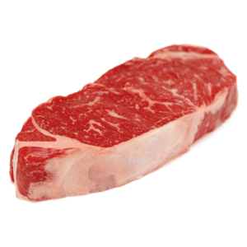
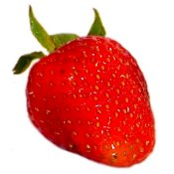
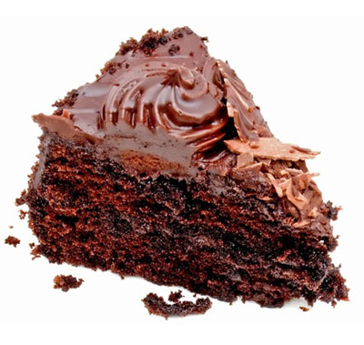
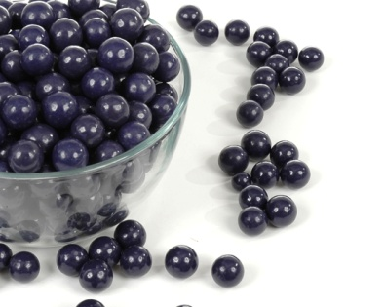
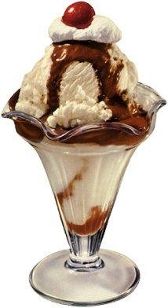
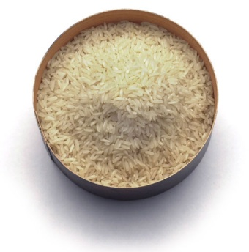
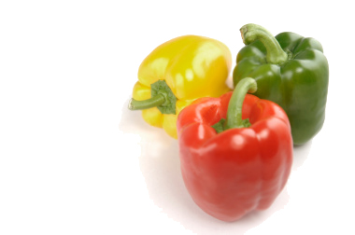
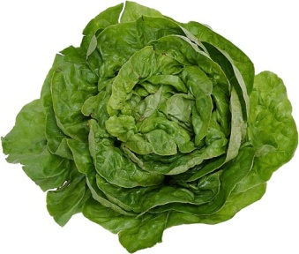
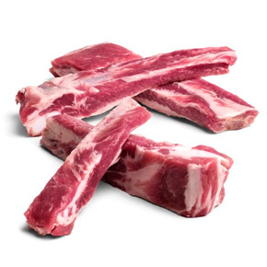
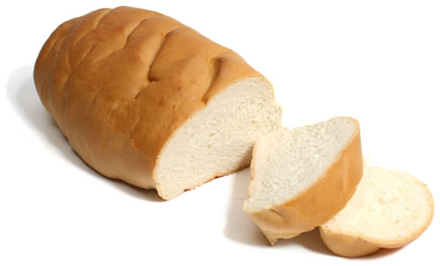

Slide 2
People who are starving see food as a means of survival.
People who are proud of their culture consider traditional foods to be part of their heritage.
Members of some faiths regard certain foods as religious symbols
People who are entertaining guests see food as a sign of hospitality.

Slide 3
Started with eating food raw.
Eventually started controlling fire
Hunters -> Gatherers
Started planting seeds -> Farming
Trading Food

Slide 4
“Have you ever tried studying for a test when you were hungry? You may have found it hard to concentrate. This is because food is one of your most basic physical needs.”
“Your body needs food to provide the energy required to maintain vital functions, such as keeping your heart beating. You also need energy from food to move your muscles so you can perform tasks like walking, sitting and climbing. Your body needs substances from food to build and repair tissues.”

Slide 5
When your body senses the need for a fresh supply of materials that food provides it sends a message from your digestive track to your brain known as HUNGER.
Hunger is the physical need for food.
This hunger signal sends a message from your brain to your stomach to start “hunger pangs.”

Slide 6
Appetite- psychological desire to eat
You choose how to respond to these signals. You can eat, which will relieve your hunger and the pangs in your stomach. If you choose not to eat, the pangs are likely to become more intense. If you continue to ignore the signal you might start to experience headaches and dizziness.
Your appetite has a greater influence of your food choices, because any food will suffice hunger but only certain foods will satisfy your appetite.

Slide 7
Wellness-state of being in overall good health, which involved mental, social and physical health
Sensible food choices affect all areas of wellness (not just physical)

Slide 8
Food helps you grow normally
It can help you avoid developing certain diseases

Slide 9
One good sign of mental health and overall wellness is an ability to handle stress.
Stress- mental tension caused by change
Food can help you manage stress, because when you eat the foods your body needs your are less likely to get sick which is a major cause of stress
Eating well can also give you the strength to face stressful situations with they arise.

Slide 10
Social health- the health of your relationships with other people.
Eating healthful foods can help you feel strong and energetic, which will give you confidence to be more outgoing as you interact with others.
Food is also a major part of social gatherings.

