Slide 1
WellSAT: 3.0 Wellness School Assessment Tool
Betsy Cashen – CDC 1 Program Coordinator
District Operations – March 2021

Slide 3
Agenda
Overview of WellSAT (Wellness School Assessment Tool)
What is it?
Why use it?
What do ratings mean?
What do scores mean?
Online WellSAT run-through
Create log-in
Complete one section
Review available resources

Slide 4
Objectives
By the end of this session, attendees will be able to:
Describe what the WellSAT is and why it can be a useful tool to evaluate district wellness policies.
Develop a clear understanding of the ratings and how your score can help support and strengthen existing wellness policies.
Identify where to access and how to use the WellSAT to use in your district.
Identify where to locate useful resources to support WellSAT use.

Slide 5
Comfort Level
Use the Annotate tool to indicate your comfort level with using the WellSAT.
0
1
2
3
4
Never heard of the WellSAT
I could do this presentation
Notes:
Welcome and Introductions, depending on number of participants

Slide 6
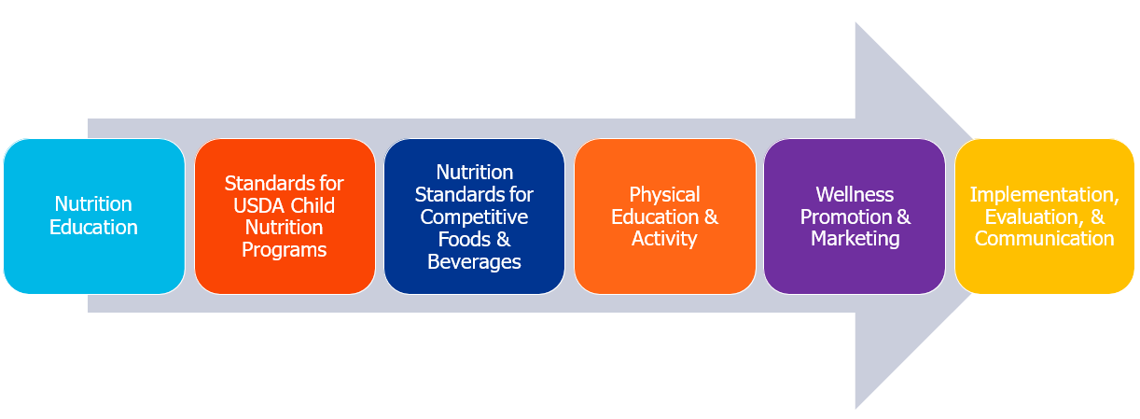
What is the WellSAT?
WellSAT 3.0 is an online tool to evaluate a district wellness policy.
School wellness policies are evaluated based on the degree to which they address 67 policy items.
Items are broken into 6 sections:
Notes:
All WellSAT items reflect the federal law or best practices.
Final Rule:
This final rule requires all local educational agencies that participate in the National School Lunch and School Breakfast Programs to meet expanded local school wellness policy requirements consistent with the requirements set forth in section 204 of the Healthy, Hunger- Free Kids Act of 2010.
The final rule requires each local educational agency to establish minimum content requirements for the local school wellness policies, ensure stakeholder participation in the development and updates of such policies, and periodically assess and disclose to the public schools' compliance with the local school wellness policies.
These regulations are expected to result in local school wellness policies that strengthen the ability of a local educational agency to create a school nutrition environment that promotes students' health, well-being, and ability to learn. In addition, these regulations will increase transparency for the public with regard to school wellness policies and contribute to integrity in the school nutrition program.

Slide 7
Why use the WellSAT?
WellSAT provides a feedback report and resources to support and strengthen weak areas of the policy.
This allows districts to self monitor progress in written and enacted policies.
Notes:
School Districts: WellSAT is a self-monitoring tool that provides districts with feedback reports to measure progress and connect to resources to support and strengthen weak areas of the policy – it also allows districts to self monitor progress in written and enacted policies.
State Government: WellSAT can support state governments (DOE) to:
- Identify districts that need assistance and need targeted resources
- Identify specific variables that are associated with stronger policies
Policy Makers and Researchers: can use WellSAT to:
- Identify areas of improvement at the state level
- Identify and allocate resources based on districts needs
- Recognize districts for outstanding performance
- Compare data results to test scores, BMI data, district size, free and reduced

Slide 8
What do the ratings mean?
0
1
2
Item was NOT addressed
Item was addressed in a vague unclear manner
Item was addressed in a clear specific manner

Slide 9
Rate as 1 when:
Words often used in statements rated as a "1" are: may, can, could, should, might, encourage, suggest, urge, some, partial, make an effort, and try.
The policy will be hard to enforce because the statement is vague, unclear, or confusing.
Statements are listed as goals, aspirations, suggestions, or recommendations.
There are loopholes in the policy that weaken enforcement of the item.
The policy mentions a future plan to act without specifying when the plan will be established.

Slide 10
Rate as 2 when:
Words often used in statements rated as a “2” are: shall, will, must, have to, insist, require, all, total, comply and enforce. The policy will be hard to enforce because the statement is vague, unclear, or confusing.
Strong language is used to indicate that action or regulation is required .
The item is described with concrete plans or strategies for implementation.
Notes:
Expert tip: One method for deciding between assigning a rating of “1” or”2” is to is to consider the scenario of a parent approaching a school districts Board of Education to discuss an issue. If the policy is ambiguous on how the school should handle the issue, assign the item a rating of “1.” If the written policy gives clear guidance about how to decide whether the school is compliant with the policy, assign the item a rating of “2.”

Slide 11
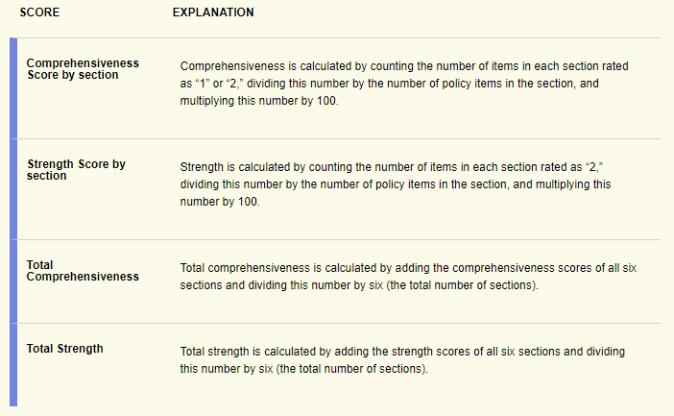
Scores
Users will receive 2 types of scores:
Comprehensiveness:
The percent of items that are addressed in some way in the district wellness policy.
Strength:
The percent of items that are required in the district wellness policy.
Notes:
Comprehensiveness: scores the percentage of items addressed in someway in the district wellness policy.
Strength: scores the percentage of items required in then district wellness policy.
These scores are also provided for each of the 6 topic areas and the overall wellness policy.
Score cards provide links to resources for each section.

Slide 12
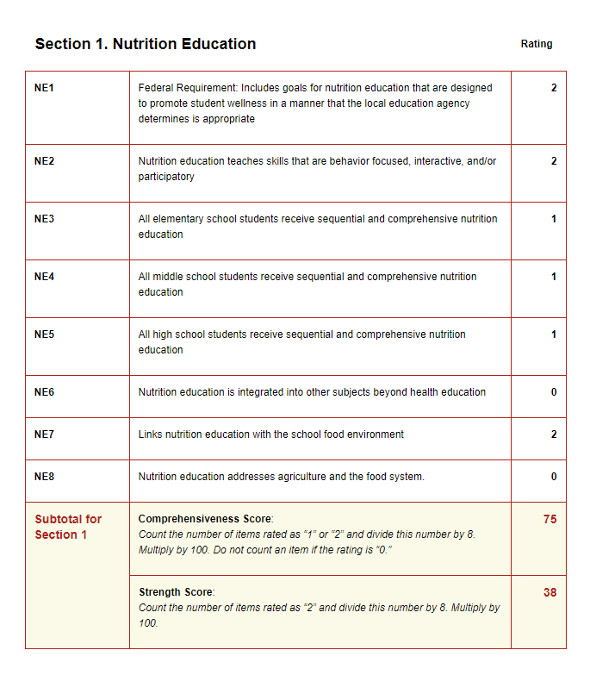
Sample Score Card

Slide 13
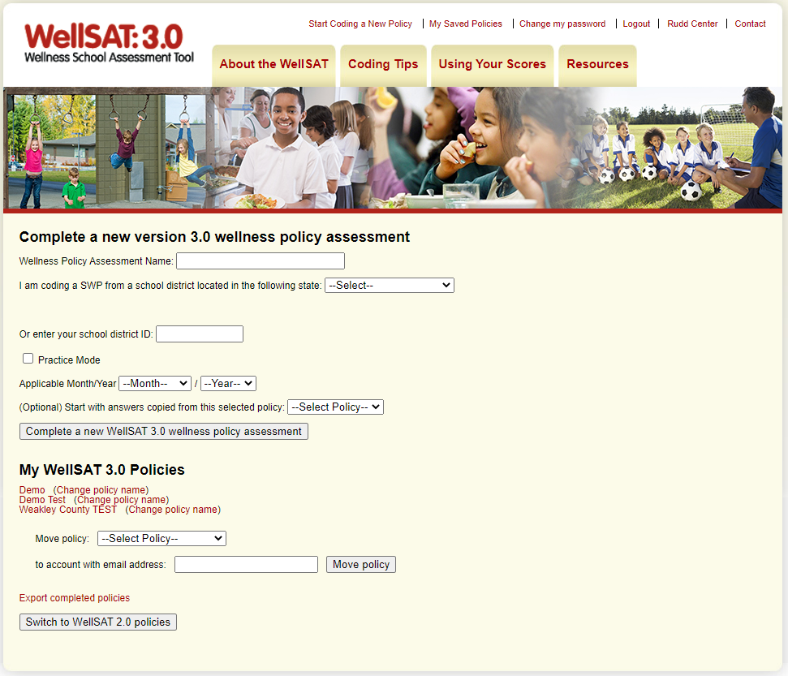
Set Up Account
http://www.wellsat.org/
Notes:
Login to WellSAT and create profile. Be sure to click “Practice Mode” and call it Demo or Test.
Type “done” in chat when you have your account set up.

Slide 14
Score a Sample Wellness Policy
http://www.wellsat.org/
Notes:
We will spend 10-15 minutes scoring a section and provide feedback (low-high) on comfort level for understanding how to use the tool, usefulness of the tool, and how meaningful it is to encourage change.
Put Disney School District wellness policy in chat for participants.

Slide 15
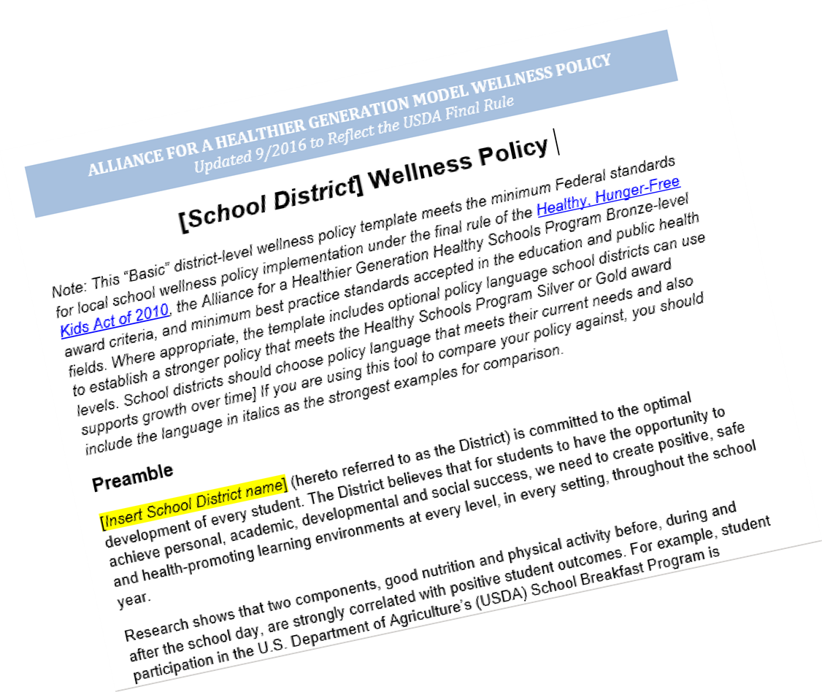
Model Wellness Policy
Can be used:
as a resource to strengthen language
To understand the key components included
To identify how schools can comply to the components through best practices and programs offered

Slide 16
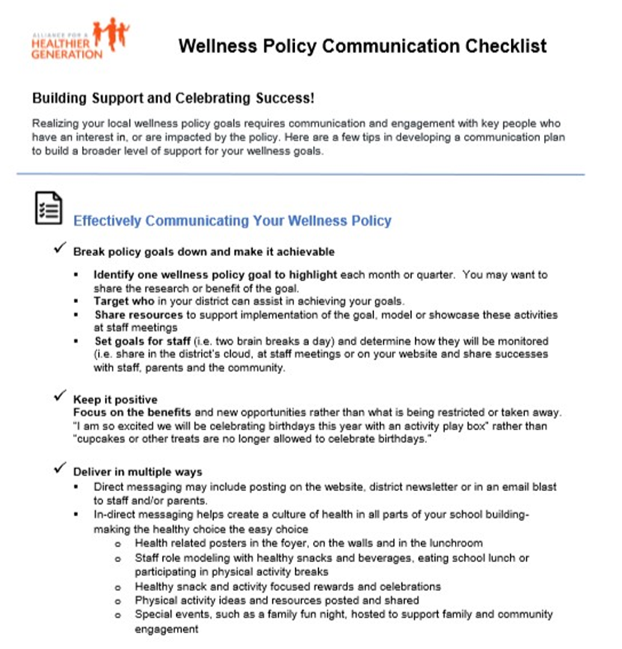
Wellness Policy Communication Checklist
https://www.healthiergeneration.org/sites/default/files/documents/20180209/a73e193f/AHG-Communication-Checklist--Building-Support-and-Celebrating-Success.pdf
Notes:
Alliance for a Healthier Generation has a communication checklist resource that provides best practices for reporting and informing the public about the wellness policy and progress achieved.
https://www.healthiergeneration.org/sites/default/files/documents/20180209/a73e193f/AHG-Communication-Checklist--Building-Support-and-Celebrating-Success.pdf

Slide 17
What’s Next?
After completing the assessment, the next step is analyzing the results by using the score card to set goals and plan for action.
Notes:
After completing the assessment, the next step is analyzing the results by using the score card to set goals and plan for action!
HG has an action planning template to use alongside scorecard, but this can also be a tool to help guide your CSH action plans.

Slide 18
Resources
USDA: Local School Wellness Policy Outreach Toolkit
CDC Putting Local School Wellness Policies into Action: Stories from School Districts and Schools

Slide 19
Additional Resources
WellSAT: http://www.wellsat.org/
USDA Wellness Policy Resources: https://www.fns.usda.gov/tn/local-school-wellness-policy
CDC Parents for Healthy Schools Guide and Promotion Kit: https://www.cdc.gov/healthyschools/parentsforhealthyschools/p4hs.htm?CDC_AA_refVal=https%3A%2F%2Fwww.cdc.gov%2Fhealthyschools%2Fparentengagement%2Fparentsforhealthyschools.htm
Healthier Generation’s Policy Resources: https://www.healthiergeneration.org/resources/policy-environment
HG’s School Wellness Committee Toolkit: https://www.healthiergeneration.org/sites/default/files/documents/20190714/de571b40/School%20Wellness%20Committee%20Toolkit%20final.pdf

Slide 20
Questions?
Notes:
Now that I have covered all of the material I have intended to cover, what expectations have not been met?
What did you learn? Was the implication of that learning? What will you do now as a result?

Slide 21
Betsy Cashen
CDC 1 Program Coordinator
Betsy.R.Cashen@tn.gov
(615) 626-3053

