Slide 1
Tobacco – Behind the Smoke. . .
The dangers of tobacco, cigarette smoking, passive smoke and the diseases that are caused by using tobacco.

Slide 2
What is tobacco?
Tobacco seed to plant
In order to grow, plants draw nutrients from the soil, air and water.
They also need sunlight as a source of energy.
Tobacco is a plant from the Solanaceae family, better known as Nicotiana (genus).
The Solanaceae family comprises some 2,000 species, including herbaceous plants, bushes, trees and vines. Several fruits and vegetables are from this family. Here are a few members of the vast family of the Solanaceae:
Tobacco
Petunias
Hot and sweet peppers
Potatoes
Eggplants
Tomatoes

Slide 3
Tobacco Plant
All plants are composed of chemicals:
Spinach » iron, chlorophyll, etc.
Lettuce » water, vitamin C, etc.
Wheat » vitamin B, starch, etc.
Coffee, tea » caffeine, sugars, etc.
Tobacco plants are composed of many chemicals, including:
Nicotine
Chlorophyll
Water
Sugars
Minerals
and many more...

Slide 4
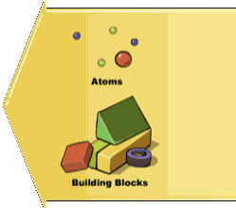
What is a chemical?
A chemical is a combination of many atoms. Atoms can be compared to building blocks.
Examples:
Carbon (C)
Nitrogen (N)
Hydrogen (H)
Oxygen (O)
A chemical can be compared to a combination of building blocks. Any vegetable, animal or mineral matter is composed of chemicals.

Slide 5
Chemical
Nicotine, a chemical naturally present in the tobacco plant and responsible for tobacco addiction, is composed of C, H and N. Its chemical formula is C10H14N2.
True or False?
All chemicals are created by humans (artificial).
False. Some are created by humans, while others are created by nature. The chemicals, whether natural or artificial, are not all harmful to health. Vitamin C and calcium are examples of chemicals that have a beneficial effect on health.

Slide 6
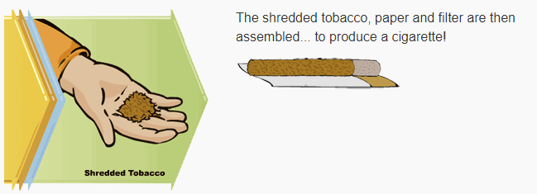
From tobacco plant to cigarette – what happens?
The tobacco plant is harvested when it is ripe – when the leaves begin to turn yellow. Then they are dried or ‘cured’. Once cured, the leaves are sold to a processor and are then shredded, which is the tobacco found in cigarettes.

Slide 7
What happens when tobacco burns?
When a cigarette burns, the tobacco is changed. The formation of ash and smoke is the proof of this change. Burning is also called ‘combustion’. Matter is changed by combustion.
COMBUSTION MODIFIES THE ORDER AND ORGANIZATION OF ATOMS IN CHEMICALS.
Did you know . . . ?
When smoked a cigarette can reach a temperature as high as 900*C – 1,652*F !!!

Slide 8
When a cigarette burns. . .
. . . the chemicals in the tobacco are changed into new chemicals. Many of these new chemicals are toxic.
Chemicals found in a tobacco plant:
Sugars
Minerals
Water
Nicotine
Proteins
Chlorophyll
and more. . .
Chemicals found in dried tobacco:
Sugars
Minerals
Nicotine
Proteins
and more . . .

Slide 9
Uh oh. . .
There are more than 2,500 chemicals in tobacco. During combustion, these are transformed into more than 4,000 chemicals, over 70 of which are carcinogenic. These new chemicals are formed because of combustion (burning).
Due to COMBUSTION, there are over 4,000 chemicals in tobacco smoke including:
Hydrogen Cyanide
Tar
Formaldehyde
Benzene
Carbon Monoxide
Nicotine
and more. . .
There are more than 2,500 chemicals in tobacco. During combustion, these are transformed into more than 4,000 chemicals, over 70 of which are carcinogenic. These new chemicals are formed because of combustion (burning).
True or False?
Tobacco free herbal cigarettes (made from cloves for example) are also harmful to health.
TRUE. Toxic chemicals are formed during combustion. Tobacco and the herbs used to make herbal cigarettes are all plants.

Slide 10
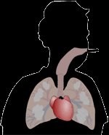
Did you know. . . ?
Two-thirds of the tobacco smoke is not inhaled by the smoker but is found in the air surrounding him or her.
There are many ways of being exposed to the chemicals from tobacco smoke.
Mainstream Smoke
Second-hand Smoke
Once absorbed through the lungs, the toxic chemicals are transferred to the bloodstream. Then they are distributed to the entire body by the heart’s pumping action.

Slide 11
Health effects from smoking. . .
Lung Cancer
Bladder, pancreatic and other forms of cancer
Emphysema and other respiratory diseases
Heart diseases, strokes and other cardiovascular diseases
Premature death
True or False?
The health effects caused by smoking only occur after long-term exposure to cigarette smoke.
False:
The health effects linked to cigarette smoke can manifest themselves at any time, both immediately and in the longer term. What’s more, smoking affects the entire body (skin, hair, etc.).

