Slide 1
Health Screening Mini-Sessions: Spotlight on Hearing Screenings
Hilary Davis, AuD, CCC-A
Brittany Day, AuD, CCC-A

Slide 2
Rationale for Hearing Screenings
Hearing loss is the most common congenital sensory impairment, with 1-3 in 1000 live births having some degree of hearing loss.¹
Approximately 30% of infants that fail the newborn hearing screening are lost to follow-up²
An additional 1-3 children per 1000 will develop late-onset or progressive permanent hearing loss by the time they reach kindergarten.¹

Slide 3
Otitis media with effusion(OME – an ear infection) affects approximately 80% of all children by 10 years of age³
Up to 60% of children with OM may show hearing loss due to OME⁴
Degradation of speech signal
Can be temporary or long-standing
Can affect communication and learning
Can cause continued auditory processing issues, especially in background noise⁵

Slide 4
Effects of Hearing Loss
Speech and language development
Vocabulary, articulation, idioms, social language
Behavior
Zoning out, not paying attention
Classroom learning
Fatigue⁶
Listening effort
Social interactions⁷

Slide 5
Purpose of Hearing Screenings
Identify students with hearing loss to refer for diagnosis and management.
School entry is the first opportunity to catch some children with hearing loss
Progressive (passed at previous screening, HL now developed)
Transient (middle ear fluid, cerumen impaction)
And the second opportunity to catch those…
Lost to follow up
Slight or mild hearing loss (does not mean minimal impact!)

Slide 6
Classroom Listening and Learning

Slide 7
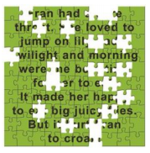
Listening-Related Fatigue
Fran had a sore throat. She loved to jump on lily pads and twilight and morning were the best times for her to eat. It made her happy to get big juicy flies. But it hurt Fran to croak.
“My child will withdraw at the end of a long day of listening.”
- Parent of a child with hearing loss
“Trying harder to listen and understand drains me and makes me feel down.”
- Student with hearing loss

Slide 8
Spelling Words through Simulated Hearing Loss above 1000 Hz
1.
125
250
500
1000
2000
4000
8000
2.
0
3.
10
20
z
v
4.
30
40
j
mdb
l
5.
HEARING LEVEL (dB HL)
n
o
a
ng
r
50
e i
6.
u
60
70
7.
80
8.
90
100
9.
110
120
10.
AUDIOGRAM OF FAMILIAR SOUNDS
FREQUENCY IN CYCLES PER SECOND (HZ)
Notes:
Presenters will inform participants that they will be taking a spelling test with no hearing for frequencies above 1000 Hertz. Hearing, but not understanding due to lack of clarity of speech sounds

Slide 9
125
250
500
1000
2000
4000
8000
1.
Shoe
0
2.
Tree
10
z
v
f th
3.
20
p
s
Math
30
h
g
4.
ch
Desk
j
mdb
l
sh
40
n
o
a
ng
r
5.
e i
Snack
50
u
HEARING LEVEL (dB HL)
60
6.
Miss
70
7.
Test
80
8.
Thumb
90
9.
100
Fish
110
10.
Spill
120
AUDIOGRAM OF FAMILIAR SOUNDS
FREQUENCY IN CYCLES PER SECOND (HZ)
Notes:
Participants will compare their answers to the answers of the test.

Slide 10
Signs of Hearing Difficulty
Listening Symptoms
easily distracted or frustrated in a group
does not respond consistently to his/her name or live voice.
cannot understand you when his/her back is turned.
has difficulty finding the source of a sound.
needs verbal instructions repeated several times before he/she understands.
consistently turns up the volume of the television, music, or computer.

Slide 11
Signs of Hearing Difficulty
Behavioral Symptoms
does not particularly like listening to music or television or listening activities such as rhymes, sound games, etc.
is very inattentive during story time
watches your face and eyes for visual cues of meaning
depends on visual cues to successfully complete simple verbal tasks
has a short attention span for his/her age
Speech/Language Symptoms
has poor or delayed language development
has poor articulation of speech sounds
has poor sentence structure and speech patterns
talks in an extremely loud voice or extremely soft voice

Slide 12
Signs of Hearing Difficulty
Medical Symptoms
unpleasant odor or smell from the ear
repeated bouts of upper respiratory infections, runny nose, chronic cough, or ear infections
pulls, rubs or digs in his/her ears
outer ear looks red or feels warm
seems off-balance or falls frequently
strong family history of hearing loss (parents, grandparents, cousins, aunts, or uncles)

Slide 13
Tennessee recommendations for School Screenings
Pre-K
K
2nd
4th
6th
8th
At least one year of high school
New students
Students with suspected hearing issues
Exceptions:
Known hearing loss or coded as Deaf/Hard of Hearing
Unable to test – school personnel should ensure hearing screening is performed by an external specialist and documented in the student’s record
Notes:
Any student enrolled who is unable to respond, for any reason, to screening procedures. The
school nursing personnel should follow these students to ensure that they are receiving periodic evaluations and/or care as determined by their hearing care specialist. Documentation of these evaluations should become part of the cumulative health record (CHR) or in the electronic student management system.

Slide 14
Conventional Hearing Screening

Slide 15
“Do Nots” of Hearing Screening
Audibly cueing child to presentation:
“Did you hear that one?”
Visually cueing child
Incorrect headphone placement
Predictable presentation of tones
Prolonged duration of tones
When in doubt…
do NOT pass.

Slide 16
Conditioned Play Audiometry (CPA)
Useful when child cannot raise hand or verbally respond to the stimulus
Involves playing a game by completing a task when the sound is heard
i.e., put the block in the bucket, put the peg on the board, etc.
Requires conditioning of the child to the task
Screener should be competent and comfortable with this procedure if performing
Do not prompt the child to respond beyond the conditioning phase

Slide 17
Conditioned Play Audiometry (CPA)

Slide 18
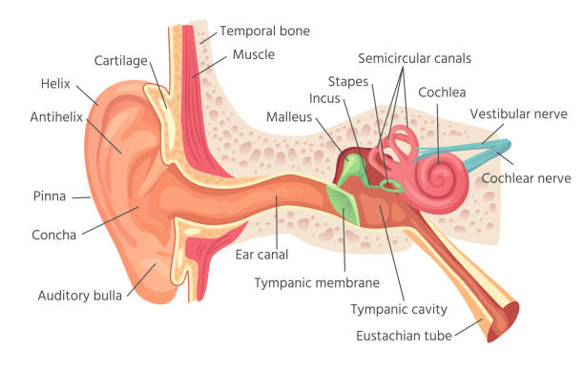
Otoacoustic Emissions (OAEs)
Can be useful for children unable to perform behavioral testing
Objective measure that screens function of hearing organ, not specifically a hearing screen

Slide 19
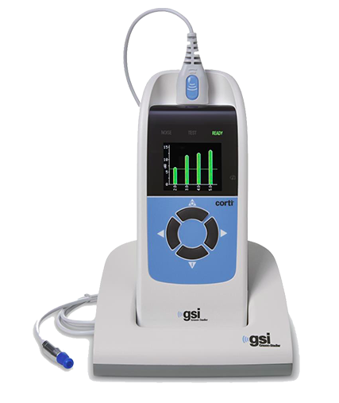
OAE Screening Procedure
Visually inspect the ear for drainage or abnormalities
Place OAE probe in the ear canal
Start the automated screen
Equipment will provide “pass” or fail/refer” result
Student must be relatively still to utilize this procedure

Slide 20
Case Study #1
Kindergartener referred bilaterally on screening
No follow-up completed by family (difficulty accessing health care)
Completed screening 1 year later
Referred. Completed tympanometry to reveal middle ear fluid bilaterally
Helped family obtain medical support

Slide 21
Case Study #2
2nd grader, teacher noted she had difficulty hearing
Parents reported she had problems with cerumen
Cerumen was removed, continued to refer on screening
Completed tympanometry and OAEs
Diagnosed with profound SNHL
Education to teacher about preferential seating and support

Slide 22
Case Study #3
4th grader did not pass school screening
Inconsistent responses (borderline hearing loss)
Diagnosed with bilateral, mild SNHL
Received hearing aids and a 504 plan for accommodations

Slide 23
Case Study #4
Deaf educator, physical prior to graduate school
Never received screenings prior to this
Extreme effort and fatigue reported
Now utilizes hearing aids and captioning

Slide 24
Contact Info
Hilary Davis, AuD, CCC-A
Pediatric & Educational Audiologist | Vanderbilt University Medical Center
Email: hilary.davis@vumc.org
Brittany C. Day, AuD, CCC-A
Pediatric Audiologist & Consultant| Vanderbilt University Medical Center
Email: brittany.day@vumc.org

Slide 25
References
Mehra S, Eavey RD, Keamy DG Jr. The epidemiology of hearing impairment in the United States: newborns, children, and adolescents. Otolaryngol Head Neck Surg. 2009;140(4):461-472. doi:10.1016/j.otohns.2008.12.022
Centers for Disease Control. Hearing loss in children. https://www.cdc.gov/ncbddd/hearingloss/2020-data/08-no-diagnosis-reasons.html. September 2022. Retrieved November 3, 2022.
Robb PJ. Otitis Media With Effusion. In: Graham JM, Scadding GK, Bull PD, editors. Pediatric ENT. Heidelberg: Springer; 2007. pp. 413–420.
Gravel JS, Wallace IF. Effects of otitis media with effusion on hearing in the first 3 years of life. J Speech Lang Hear Res. 2000;43:631-644.
Gravel JS, Wallace IF, Ruben RJ. Auditory consequences of early mild hearing loss associated with otitis media. Acta Otolaryngol. 1996;116:219-221.
Davis H, Schlundt D, Bonnet, K, Camarata, S, Hornsby, B, Bess, FH. Listening-related fatigue in children with hearing loss: Perspectives of children, parents, and school professionals. Am J Aud. 2021;30(4): 929-940. doi.org/10.1044/2021_AJA-20-00216
Hoffman MF, Quittner AL, Cejas I. Comparisons of social competence in young children with and without hearing loss: a dynamic systems framework. J Deaf Stud Deaf Educ. 2015;20(2):115-124. doi:10.1093/deafed/enu040
http://www.asha.org/public/hearing/Prevalence-and-Incidence-of-Hearing-Loss-in-Children/
TN School Health Screening Guidelines packet

Slide 26
SCREENING PROTOCOL RESOURCE

Slide 27
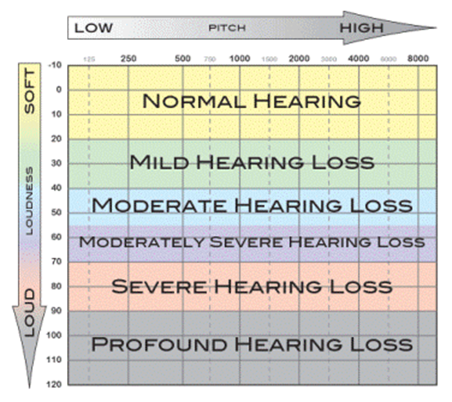
Hearing Screening Procedure
Screen under headphones using 1000, 2000, and 4000 Hz tones at 20 dB HL
Testing at 500 Hz problematic due to ambient noise in the screening environment- resulted in unnecessary referrals

Slide 28
Hearing Screening Set Up
Volunteer training as needed
Ensure equipment is working (listening check) and calibrated
Quiet room (avoid air conditioning units)
Set up where child cannot see audiometer buttons
Student Set-Up
Inspect the ear for drainage or abnormalities
Instruct the child of the task (raise hand, say yes, etc.)
Place headphones over ears (red – right; blue – left)

Slide 29
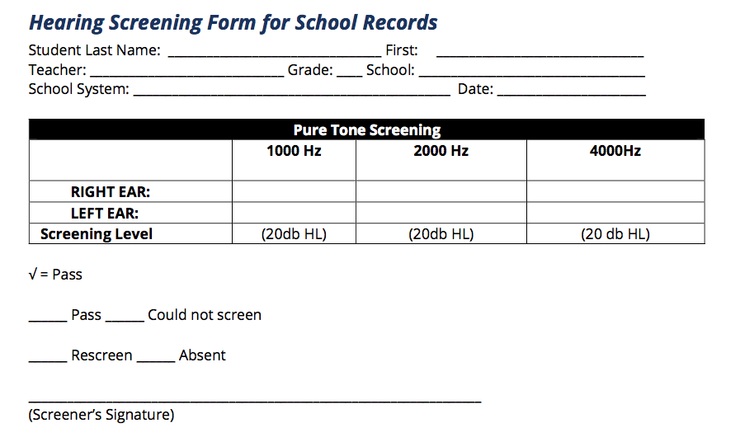
Hearing Screening Procedure
1-2 second presentation of 20 dB tone (1000, 2000, and 4000 Hz)
Child must respond to at least 2 of 3 presentations at each frequency
Practice at 50 dB if needed (child does not respond initially)

Slide 30
Pass Criteria
Pass: Student reliably responds to at least two of three presentations at each frequency in both ears
Fail: Student misses two of three presentations at any frequency in either ear

Slide 31
Rescreens
Rescreen any child who fails one or more frequencies in one or both ears
Rescreen should be completed same day ideally by a different screener or on an alternate piece of equipment, if possible
Children who fail same-day rescreen should be rescreened a final time 6-8 weeks later
A final fail result should result in a referral letter home
Teacher should also be notified

