Slide 1
STAFF TRAINING
BY
MADHURI SRINIVASAN, RN, BSN, MS, MSN
SCHOOL NURSE
DOGWOOD ELEMENTARY

Slide 2
SEVERE ALLERGY
It is a severe allergic reaction to a allergen
Anaphylactic reactions usually happen fast within 3 to 30 minutes of exposure
It causes a sudden drop in BP and heart rate leading to shock

Slide 3
SYMPTOMS

Slide 4
HOW DOES THE EPI-PEN HELP?
EPI-PEN TIGHTENS BLOOD VESSELS.
Increases heart rate and BP, reduces swelling
Relaxes the muscles around the airways in the lungs

Slide 5
EPI-PEN

Slide 6
ASTHMA
Asthma is a chronic condition that causes your airways to get inflamed and narrow and makes breathing difficult.
Severe asthma can make it hard to talk or be active.

Slide 7
SYMPTOMS

Slide 8
DIABETES
Type 1 diabetes or juvenile diabetes is a chronic condition
The pancreas produces little or no insulin.
Insulin is a hormone needed to allow sugar (glucose) to enter cells to produce energy.

Slide 9
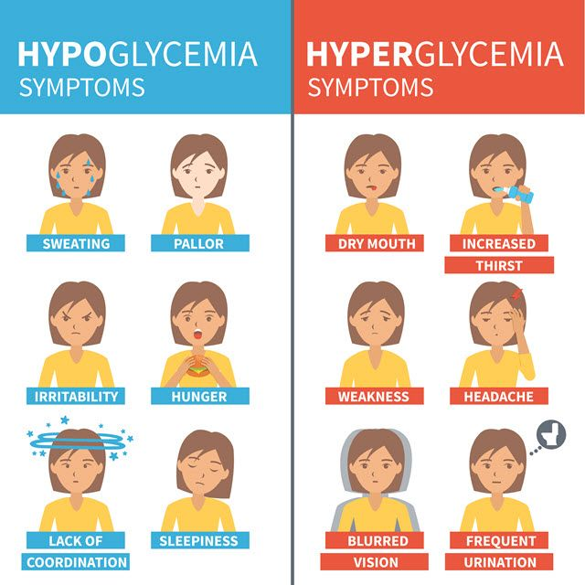
SYMPTOMS

Slide 10
SEIZURES
A seizure is a sudden, uncontrolled electrical disturbance in the brain.
Most seizures last from 30 seconds to 2 minutes.
A seizure that lasts longer than 5 minutes is a medical emergency.

Slide 11
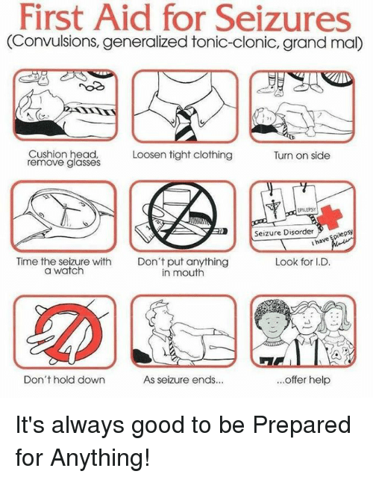
SEIZURE FIRST-AID

