Slide 1
The Relationship of School Safety and School Climate
Kimberly Daubenspeck Safe Schools Coordinator

Slide 3
Objectives
At the end of this workshop, participants will:
  Be familiar with the fundamentals of school climate and why it is important.
  Understand the pivotal role of school climate in the threat assessment process.
  Know the best practices to improve school climate and reduce threats of violence or harm in schools.

Slide 4

Activity:
What is School Climate?
Why is School Climate Important?

Slide 5
What is School Climate?
The learning conditions and quality of the school environment that affect attitudes, behaviors, and performance of both students and staff.
“School climate is like the air we breathe…it tends to go unnoticed until it becomes toxic.” - J. Freiberg

Slide 6
Positive School Climate is Important
Strengthening school climate and conditions for learning can help districts, schools, and teachers meet key goals, including:
  Boosting student achievement and closing achievement gaps
  Increasing high school graduation rates
  Decreasing teacher turnover and increasing teacher satisfaction
  Turning around low-performing schools

Slide 7
Negative School Climate
Negative school climate is linked to poor attendance, as well as decreased student achievement and graduation rates.
Negative school climate can contribute to or exacerbate violence, bullying, and even suicide.

Slide 8
TN School Climate Model
Engagement
Supportive Relationships
School Connections and Learning Supports
Safety
Physical Safety
Emotional Safety
Environment
Academic Challenge
Supportive Discipline
Parental Involvement
Freedom from Substance Use
Freedom from Bullying
Acceptance of Differences
Approval of the Physical Environment

Slide 9
Perceptions of Safety
Students feel safer in schools with high-quality relationships between students and teachers and teachers and families.
Teachers also feel safer in schools with high-quality relationships.

Slide 10
2018-19 High School Student School Climate Survey
Out of 22,237 high school students surveyed:
  56% feel they are safe at their school.
  20% strongly agree or agree that students at their school carry guns or knives to school.
  37% strongly agree or agree that students at their school threaten to hurt other students.
  61% strongly agree or agree that if students hear about a threat to school or student safety, they would report it to someone in authority.

Slide 11
2018-19 Middle School Student School Climate Survey
Out of 29,055 middle school students surveyed:
  66% feel they are safe at their school.
  9% strongly agree or agree that students at their school carry guns or knives to school.
  34% strongly agree or agree that students at their school threaten to hurt other students.
  67% strongly agree or agree that if they hear about a threat to school or student safety, they would report it to someone in authority.

Slide 12
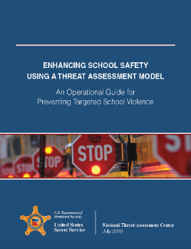
8 Steps of Building a Threat Assessment Program
Step 1: Establish a Multi-disciplinary team
Step 2: Define prohibited and concerning behaviors
Step 3: Create a central reporting mechanism
Step 4: Define threshold for law enforcement intervention
Step 5: Establish threat assessment procedures
Step 6: Develop risk management options
Step 7: Create and promote safe school climates
Step 8: Conduct training for all stakeholders

Slide 13
Pathway to Violence
Implementation
Preparation
Planning
Ideation

Slide 14
Prevention is Possible
Threat assessment involves asking:
  Is this person on a pathway to violence?
  If so, how can we guide this person off the pathway to violence?
  How can we help them solve their problem, fix their situation, or address their condition in a non-violent way?
Threat assessment is most effective when it is non-adversarial and focused primarily on support and problem solving.

Slide 15
Step 7: Create and Promote Safe School Climates
Assess current school climate:
  Administer surveys to students, staff, and parents
  Share results with all stakeholders
  Identify resources available in the community
  Identify resources available remotely (e.g. tele-medicine)
  Identify resources for staff and students
Enhance current school climate:
  Use survey findings to identify areas to address
  Involve students in developing and implementing solutions
Strengthen students’ connectedness:
  Feeling connected to an adult they can trust is a powerful protective factor
  Strategies can be no-cost and easy to implement

Slide 16
Best Practices for a Safe School Climate
Break down “codes of silence”
  Help students feel empowered to come forward and share concerns and problems with a trusted adult.
Encourage teachers and staff to build positive, trusting relationships with students.
Help students feel more connected with their classmates at the school.
Students have a role to play in fostering relationships and connectedness among the student body.

Slide 17
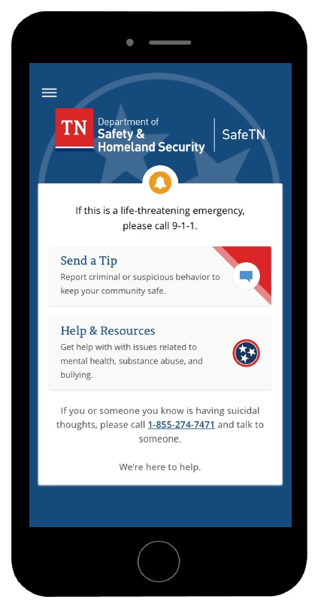

SafeTN Reporting App
Anonymously report suspicious activity, safety concerns, observed threats, behaviors or actions.
The Tennessee Department of Safety and Homeland Security will review, assess, and then send all submissions to law enforcement, mental health crisis response teams, and/or administrators for intervention based on the information received.

Slide 18
Advisory to Create a Safe Space for Student Voice

Slide 19
Question?
What best practices to improve school climate do you see?

Slide 20
Making Connections in the Community

Slide 21
Question?
Does the community have an impact on school climate?

Slide 22
Student-Led School Climate Crew

Slide 23
Question?
What has your school(s) done to improve school climate?

Slide 24
Questions
Kimberly Daubenspeck
Safe Schools Coordinator
Kimberly.Daubenspeck@tn.gov
615-970-2418

