Slide 1
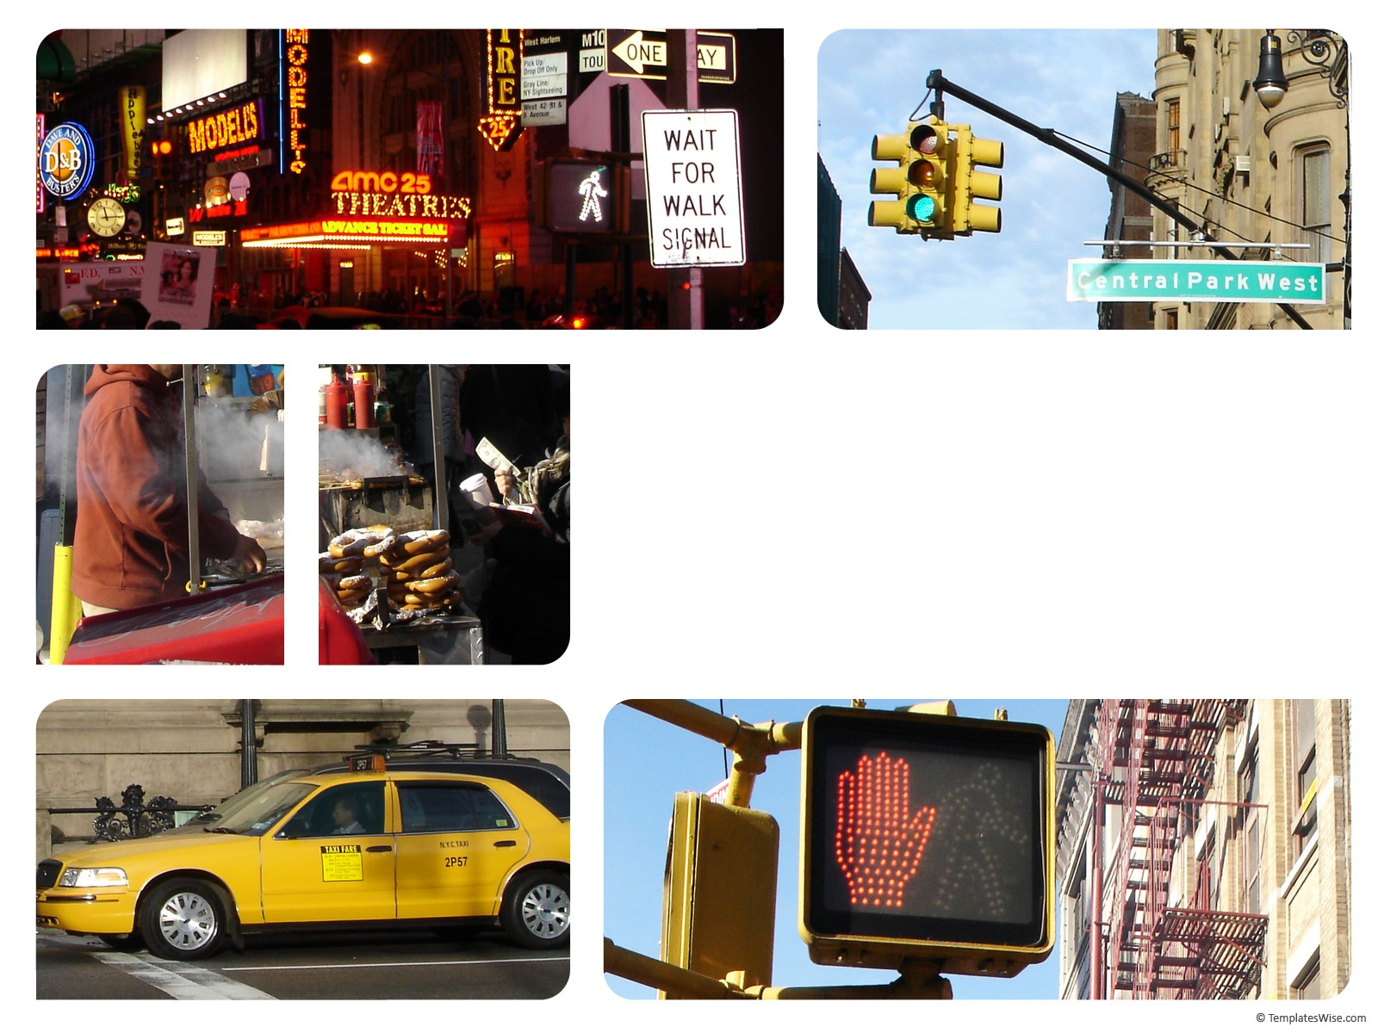
Parking
Driver Theory

Slide 2
If the street you are on has a curb, park as close to it as you can, but no more than 12 inches away. If it has no curb, pull as far off of the roadway as possible.
Always park in the direction traffic moves.
Set your parking brake and shift to “Park,” if your vehicle has an automatic shift or to “Reverse” or “First,” if your vehicle has a manual shift.
If you are parked on a hill, turn your wheels.
When parking your vehicle on a downhill with or without a curb, you should turn your steering wheel so your wheels are completely to the right.

Slide 3
Except in emergencies or unless a police officer tells you to do so, never stop, stand or park your vehicle
at the following places:
• On the roadway side of a vehicle already stopped
or parked along the edge or curb of the street
(double parking).
• On the sidewalk.
• Within an intersection.
• On a crosswalk.
• Along or opposite any street digging or work area.
• On any bridge or other elevated structure,
or in a highway tunnel.
• On any railroad tracks.
• Between roadways of a divided highway, including
crossovers.
• Within 50 feet of the nearest rail at a railroad
crossing.
• At any place where official signs prohibit parking.
• At any place where official signs prohibit stopping.
• In front of a public or private driveway.
• Within 15 feet of a fire hydrant.
• Within 20 feet of a crosswalk at an intersection.
• Within 30 feet of any flashing signal, stop sign, yield
sign or traffic control device located at the side of a
roadway.
• Within 20 feet of a driveway entrance to a fire
station.
• Where your vehicle would prevent a streetcar from
moving freely.
• On a limited access highway, unless official traffic
control devices indicate you are allowed.

Slide 4
Parallel Parking
Video 1 (normally)
Video 2
(expensive)
Video 3
Video 4
Video 5 ( nontraditional)
Video 6
Video 7
Video 8
What do you think? Real or Not

