Slide 1
Physical Education Portfolio
Resources and Links To Aid In Completing Your State Mandated Portfolio

Slide 2
Elementary Portfolio 2nd Grade
Required Skills:
-Locomotor = 2nd Grade
Optional Skills:
Underhand Throw
Underhand Catch
Combine UH Throw & Catch
Jump Rope
Balance Skills
Kick w/ Running Approach
Dribble w/ Hands
https://coachmartinpe.weebly.com/pe-portfolio.html

Slide 3
Elementary Portfolio 5th Grade
Required Skills:
OH Throw
Optional Skills:
Overhead Volley
Forehand Striking
Invasion Game Task
Edu Gymnastics Routine
https://coachmartinpe.weebly.com/pe-portfolio.html

Slide 4
Elementary Portfolio Resource Guide
https://coachmartinpe.weebly.com/uploads/3/1/1/1/31119283/pe-k-5-team-portfolio-resource-guide.pdf

Slide 5
Elementary Grading Rubrics (K-2 & 3-5)
https://coachmartinpe.weebly.com/uploads/3/1/1/1/31119283/k-2-physical-education-rubric.pdf
https://coachmartinpe.weebly.com/uploads/3/1/1/1/31119283/3-5-physical-education-rubric.pdf

Slide 6
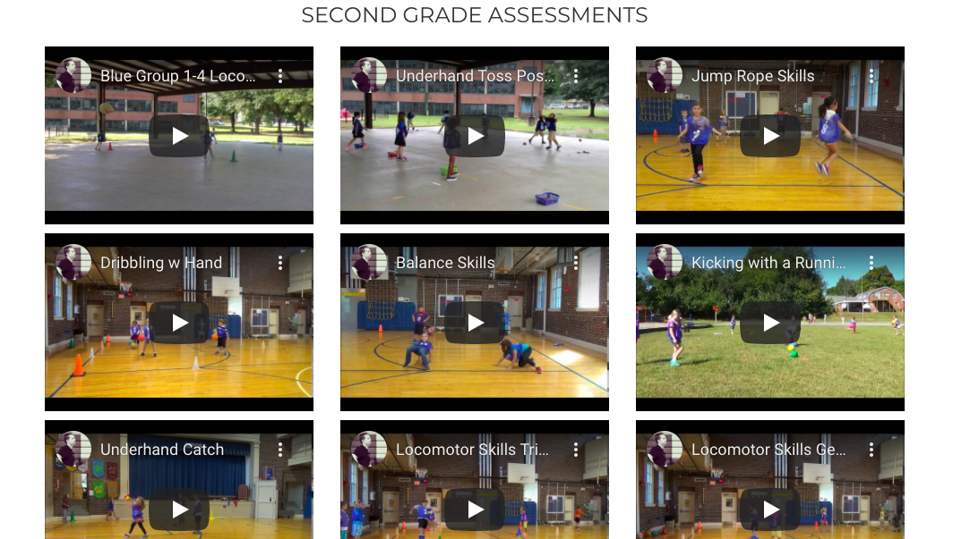
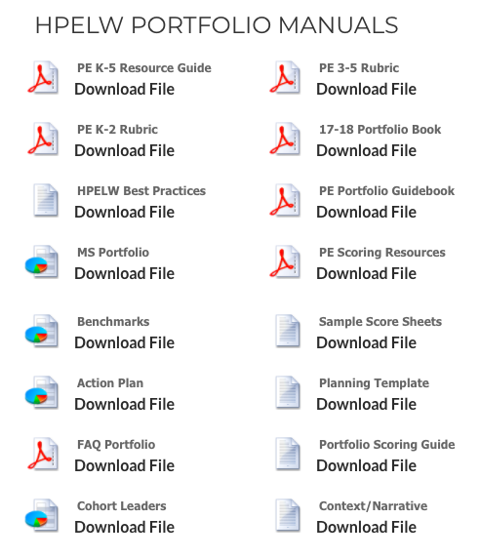
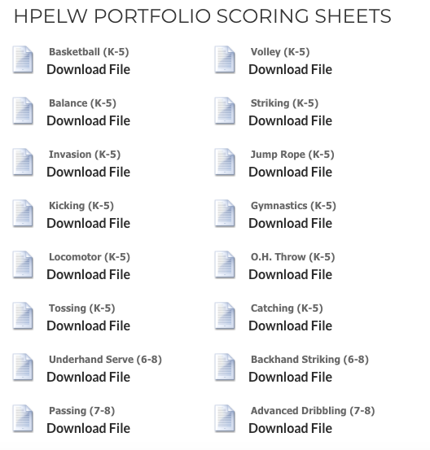
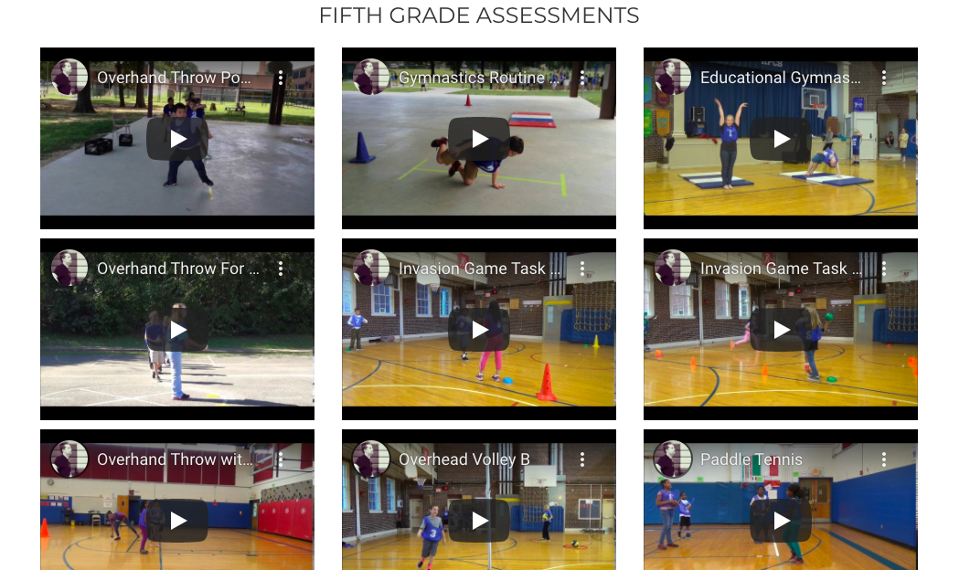
Resources: Manuals, Rubrics, Scoring Sheets, Video Examples
https://coachmartinpe.weebly.com/pe-portfolio.html

Slide 7
Additional Resources
Locomotor Skills Resources: https://coachmartinpe.weebly.com/locomotor-skills.html
https://tngov.webex.com/recordingservice/sites/tngov/recording/play/640d19e6632f4c9e9bcd1f9ffab4ec17

