Slide 1
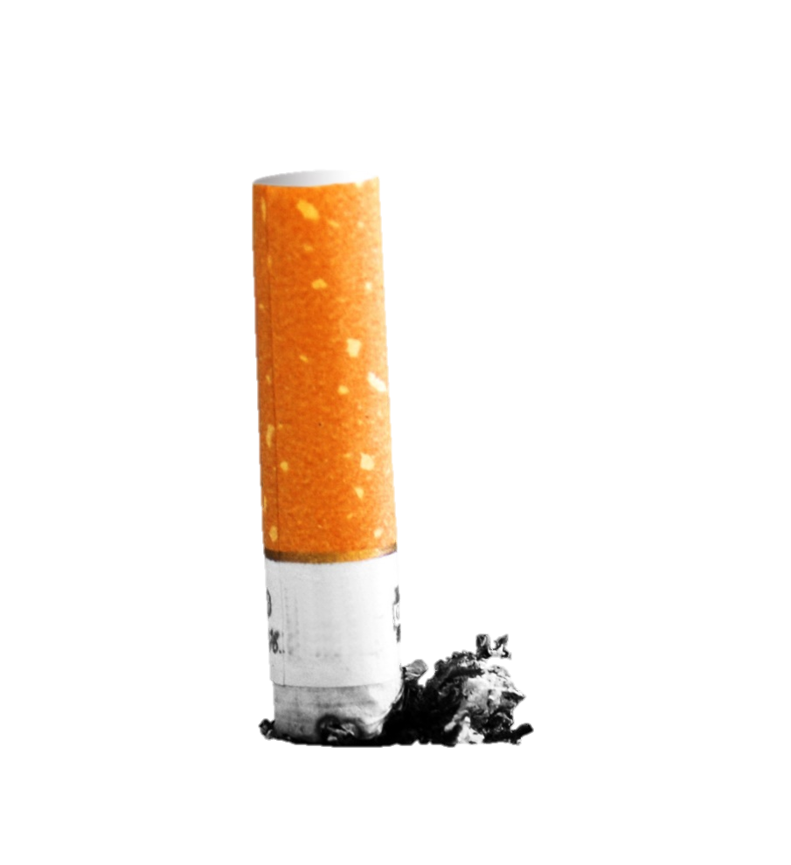
Tobacco
Identifying Tobacco
Products Part 1
Copyright © 2015 JB Promotions LLC

Slide 2
Critical Thinking
What do you think about the current usage of tobacco among teens?
Do you think tobacco use is becoming more popular?

Slide 3
Tobacco Facts
What percentage of high school students use tobacco?
* Data according to a 2012 CDC report

Slide 4
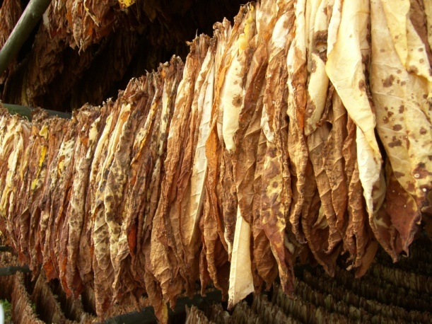
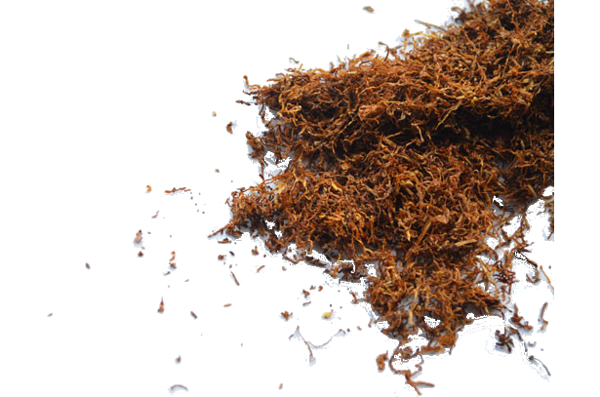
Identifying Tobacco
Tobacco is a plant that contains the drug nicotine.
What is tobacco?
The plant is dried and turned into various products that people smoke, dip, or snuff.

Slide 5
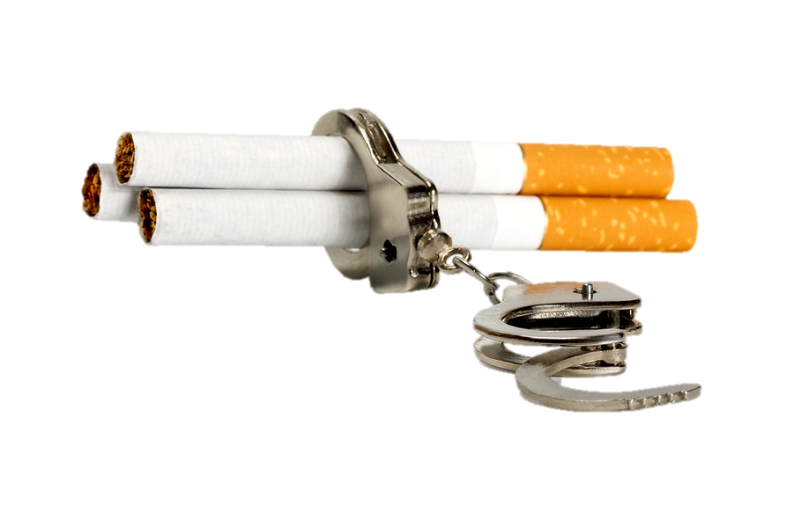
Identifying Tobacco
Nicotine is the chemical in tobacco that causes addiction.
It gives users a short term buzz that leaves the user craving more and more.

Slide 6
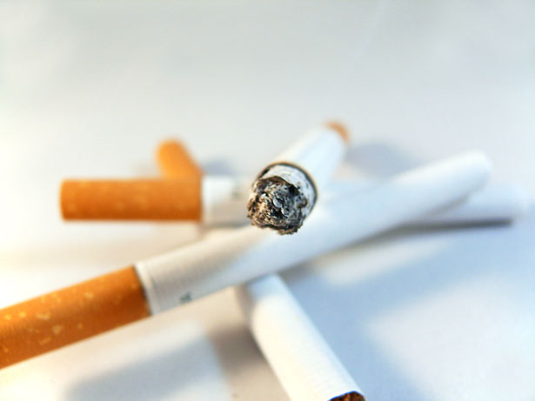
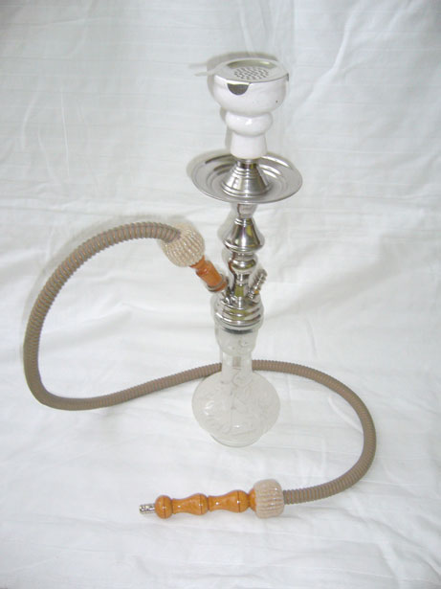
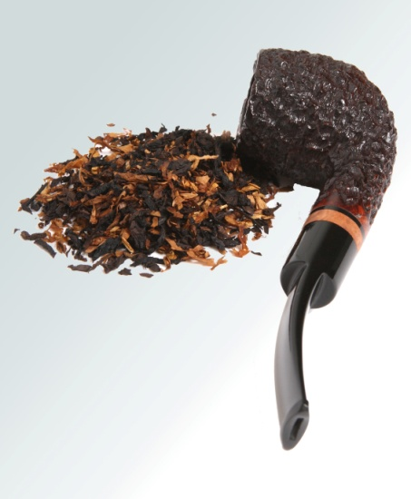
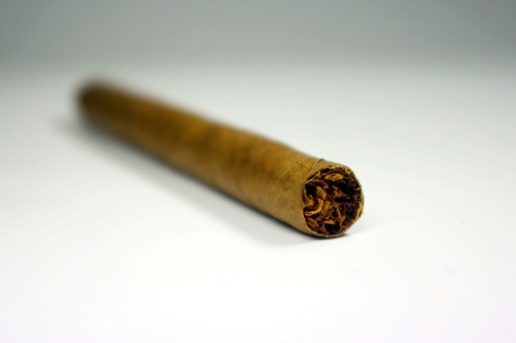
Tobacco Products
Can you name these common tobacco products?
Products That are Smoked
Cigars
Cigarettes
Hookah
Pipes

Slide 7
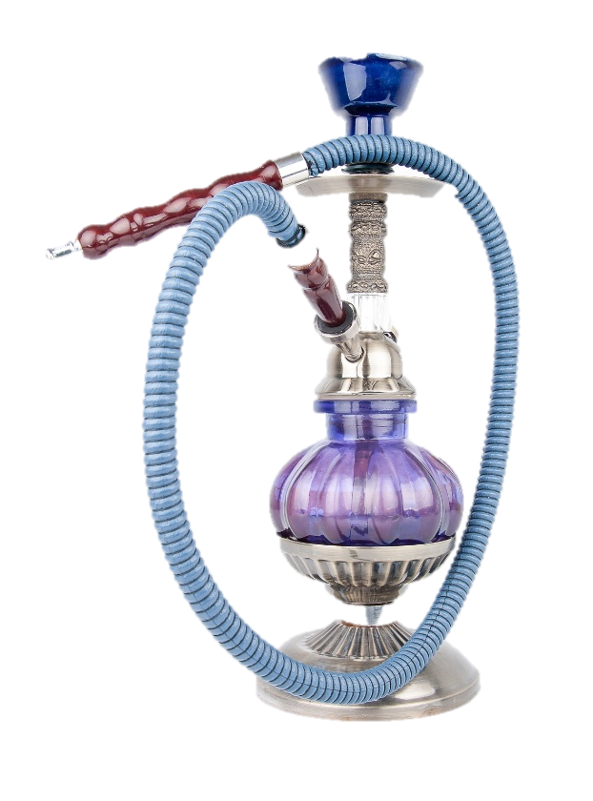
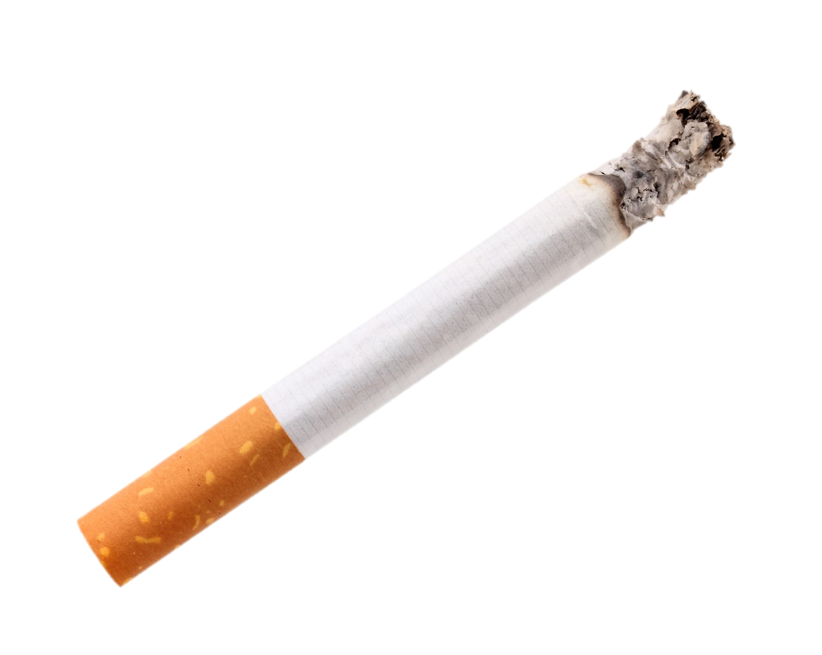
Tobacco Products
A Hookah is a pipe that contains water to cool the smoke and has a long tube through which smoke is inhaled.
A cigarette is a short stick of rolled tobacco that usually contains a filter

Slide 8
Tobacco Products
How does the nicotine from cigarettes or hookah enter the body?
Cigarettes and hookah are inhaled through the respiratory tract via the mouth.
Nicotine from a cigarette or hookah enters the body primarily through the lungs but can also enter through the mouth even if not inhaled.

Slide 9
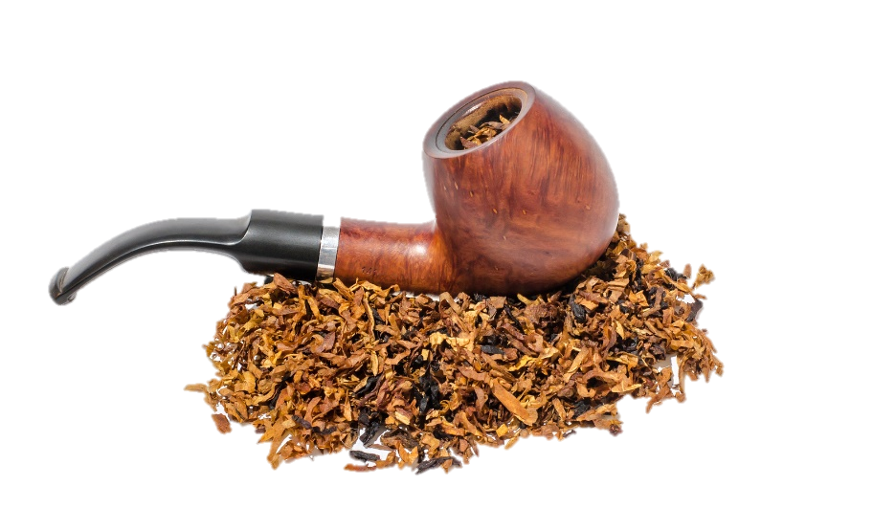
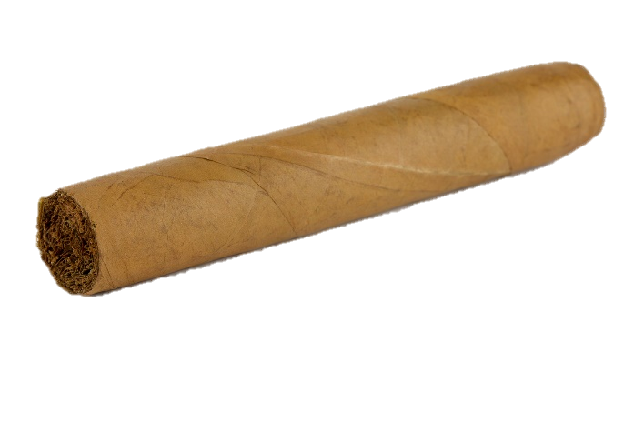
Tobacco Products
A cigar is dark colored stick of rolled tobacco that usually contains no filter
A pipe is a bowl with a tube attached. Tobacco is inserted into the bowl and smoked through the tube.

Slide 10
Tobacco Products
Cigars and pipes are puffed and not inhaled, however, they still possess health risks such as oral cancers.

Slide 11
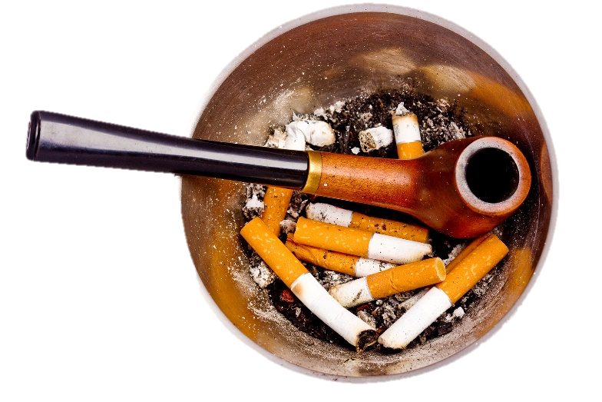
Tobacco Products
If cigars or pipes are not inhaled how do you think nicotine enters the body?
Nicotine from a cigar or pipe enters the body through the mucus membranes of the oral cavity such as the gums or lining of the mouth.

Slide 12
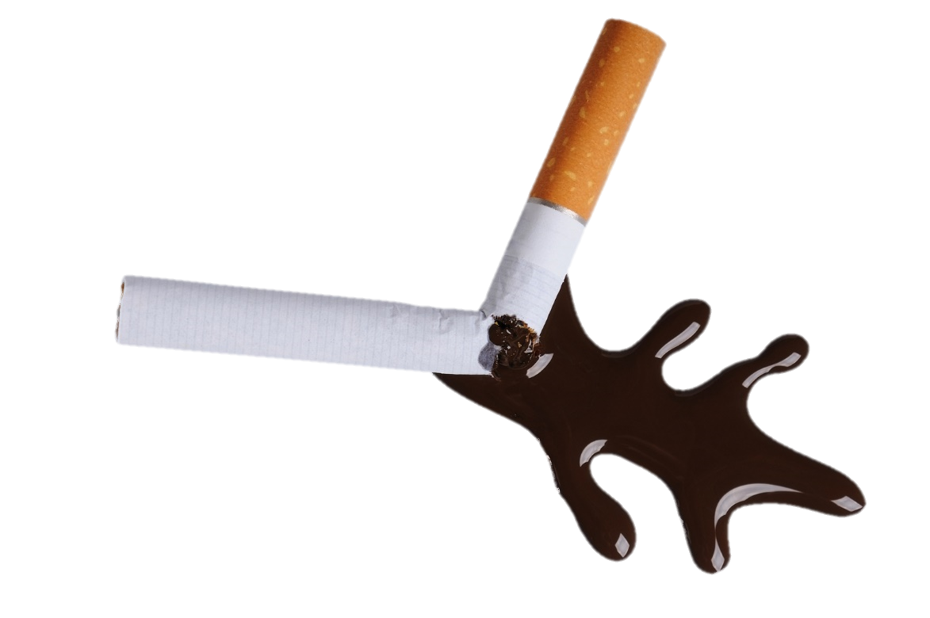
Tobacco Chemicals
Aside from the chemicals already in tobacco, smoking produces many harmful chemicals from the tobacco burning.
Tar, produced from smoking, is a dark viscous residue that contains many harmful chemicals.

Slide 13
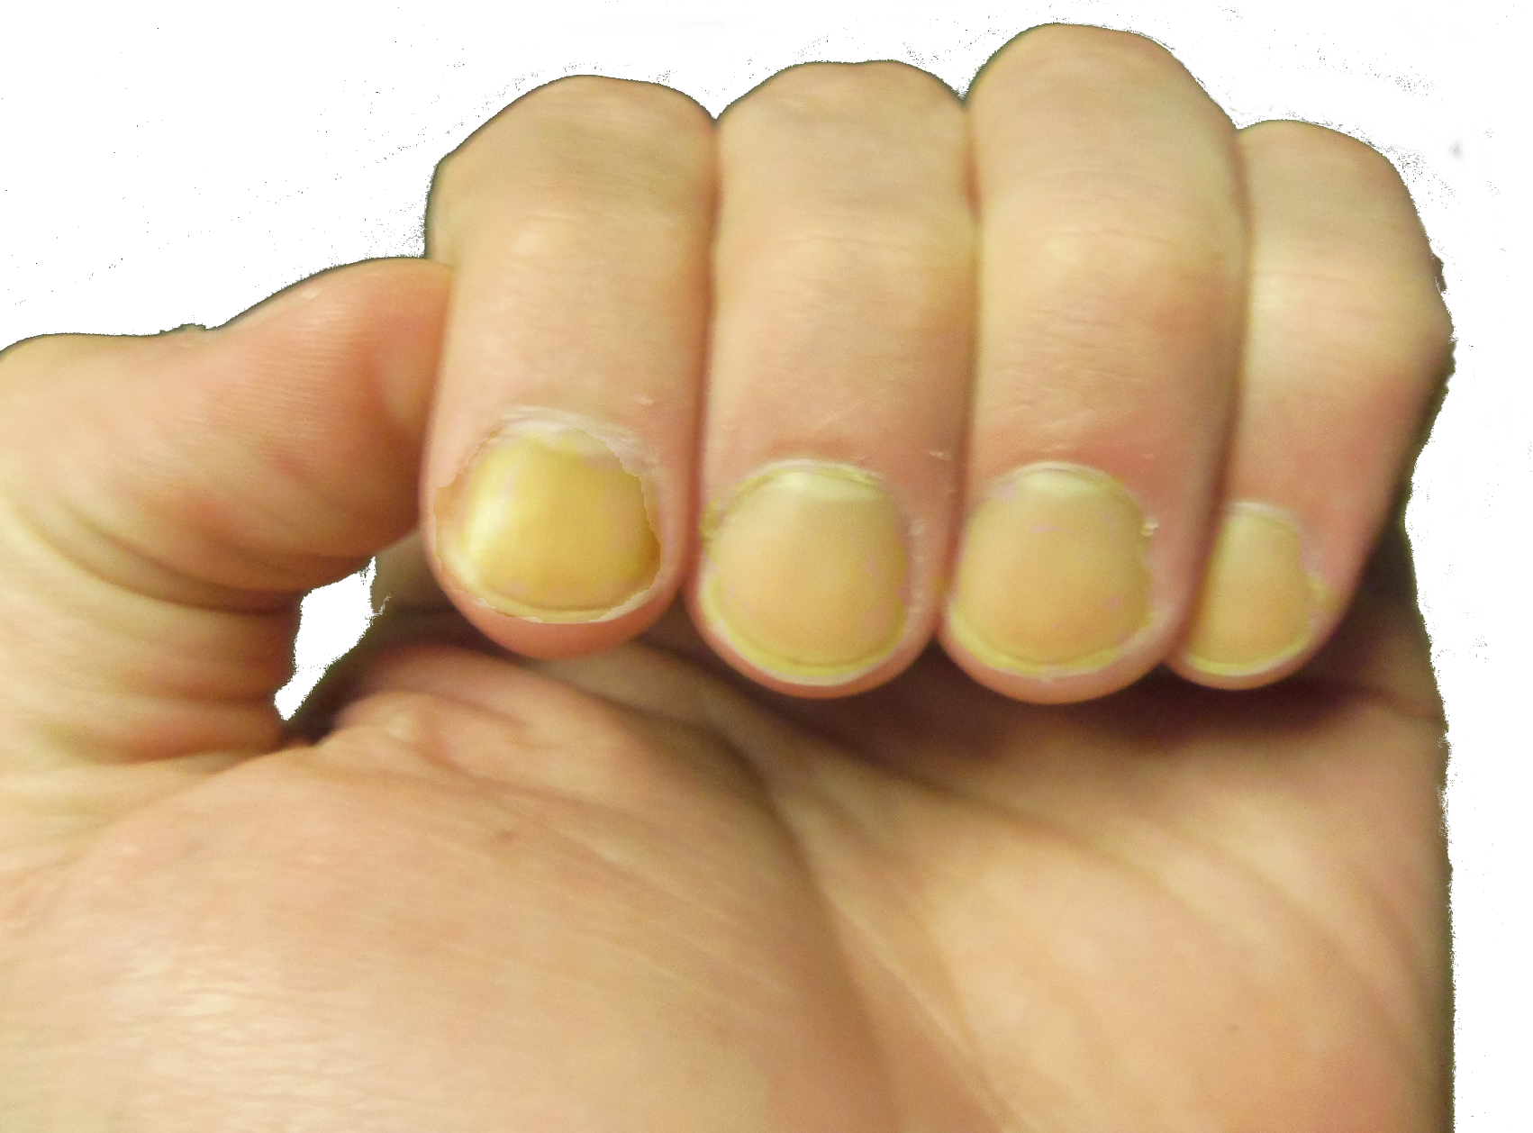
Tobacco Chemicals
Over time tar stains the teeth, fingernails, and damages the lungs

Slide 14
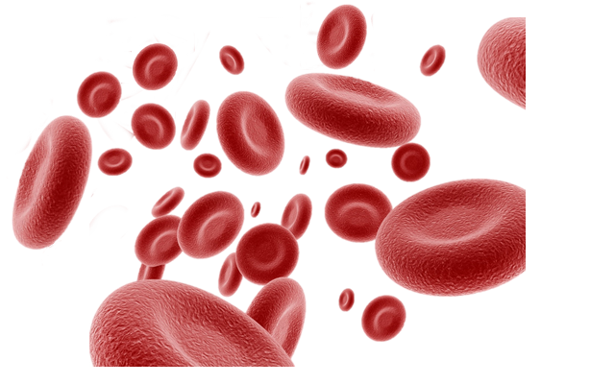
Tobacco Chemicals
Another chemical produced from smoking is carbon monoxide.
Carbon monoxide (CO)
prevents the red
blood cells from
carrying oxygen.

Slide 15
Tobacco Chemicals
What happens when the brain and other organs are deprived of oxygen?
When the brain and other organs are deprived of oxygen they cannot perform as efficiently.

Slide 16
Tobacco Chemicals
A smoker will have less oxygen in their blood because of carbon monoxide making it more difficult for them to perform certain tasks.
Can you think of any physical tasks that a smoker might find more difficult?

Slide 17
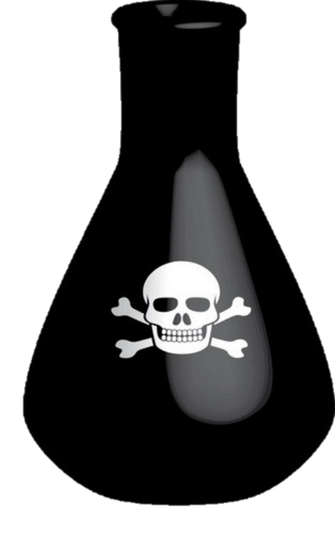
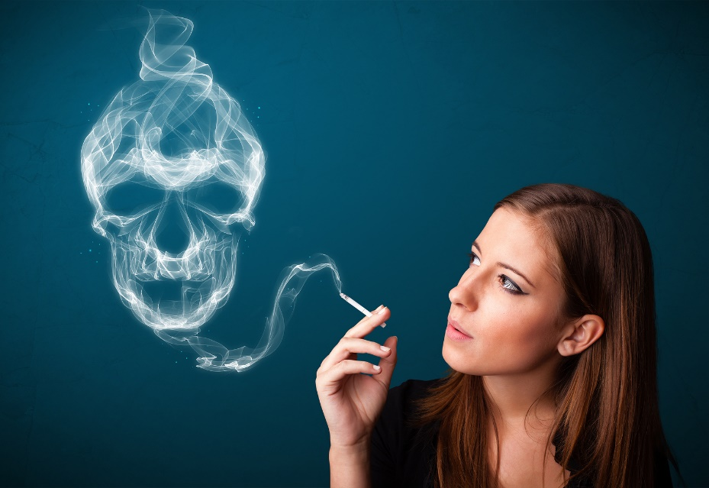
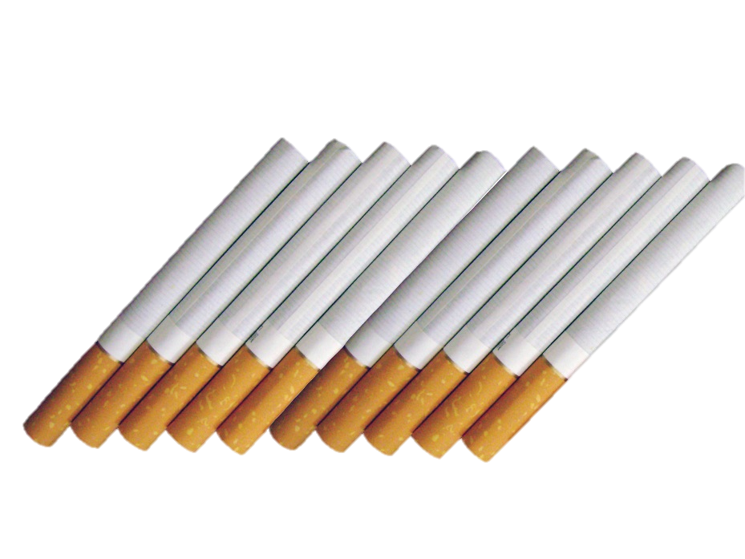
Tobacco Chemicals
Tobacco smoke contains more than 7,000 chemicals, 70 of which cause cancer.
How many chemicals do you think tobacco smoke contains?

Slide 18
Tobacco Chemicals
Some chemicals include:
Arsenic - An ingredient in pesticides
Ammonia - An additive in household cleaners
Formaldehyde - Embalming fluid for dead bodies
Polonium - A Radioactive element
Cadmium - Found in batteries

Slide 19
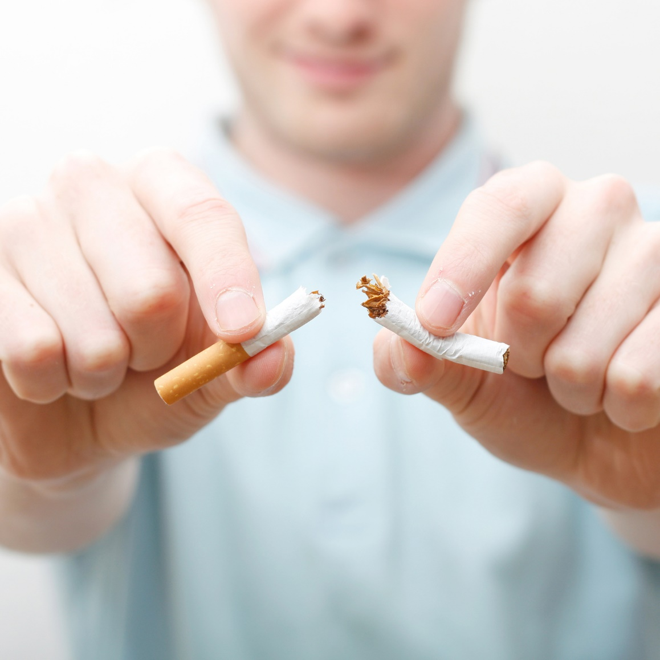
Activity

Slide 20
Assessment
1.
What is tobacco?
2.
Name two tobacco products that are smoked.
3.
What are 2 harmful chemicals found in tobacco smoke?

