Slide 1
The Governor’s Foundation
for Health and Wellness
Notes:
Thank host for having you; introduce yourself

Slide 2
State of the State
Tennessee consistently ranks among
the 10 least healthy states in the nation
  Type 2 diabetes and hypertension are at near epidemic levels
  The rate of obesity has increased from 10 percent to 34 percent since 1988
  1 in 4 adult Tennesseans smokes; 1 in 5 Tennessee high school students smokes
  Our children now have a shorter life expectancy than their parents
  Tennessee spends an estimated $6 billion a year on treatment and cure of behavior-related diseases
Notes:
As Tennesseans, I believe most of us feel like this is one of the best places in America to live and work, and in many ways it is. But, what many of us don’t know or fully understand, is that for the past 20 years, our state has ranked among the 10 least-healthy states in the nation.
The ranking is discouraging, not just because we’re in the bottom 10, but because that means the rates of chronic, behavior-based disease such as hypertension and stroke, type 2 diabetes, heart disease, and several types of cancer are at near epidemic levels in our state.
We are spending an estimated $6 billion every year for treatment and cure of these behavior-related diseases. But, most alarming, for the first time in our state’s history, our children have a shorter life expectancy than their parents.

Slide 3
Governor’s Foundation for Health & Wellness
Governor Haslam has made improving the health of Tennesseans a top priority of his administration
The Governor’s Foundation was launched to encourage and enable Tennesseans to lead healthier lives
It brings together a statewide coalition of employers, hospital systems, insurers, local governments, schools, and community organizations to effect measurable change
Healthier Tennessee is the Foundation’s primary initiative
Notes:
Shortly after Governor Haslam took office in 2010, he began looking at the state’s rising healthcare costs and what could be done to improve our overall health. He appointed a taskforce to evaluate and make recommendations on how to tackle these issues in the coming years and over the long-term.
After receiving the recommendations of the taskforce, Gov. Haslam asked Foundation CEO Rick Johnson to begin looking at the best course of action for Tennessee. It was determined that a non-profit corporation, supported by a true public, private coalition, should be established and tasked with enabling and encouraging Tennesseans to lead healthier lives.
The Governor’s Foundation for Health and Wellness was launched in August 2013 and has assembled an impressive statewide coalition of employers, health insurers, hospital systems, government leaders, faith communities, school systems and civic organizations to effect positive, measurable change.
Healthier Tennessee, the Foundation’s primary initiative, is focused on changing three key behaviors to improve the health of Tennesseans.

Slide 4
Three key behavior changes
Healthier Tennessee is dedicated to improving the health of Tennesseans through three key behavior changes
Increased physical activity
Healthier eating
Cutting out tobacco use
Notes:
The Foundation’s Healthier Tennessee initiative is focused on three key behavior changes to improve the health of Tennesseans: increased physical activity, healthier eating, and cutting out tobacco use.
What do we mean when we say eat healthier? Eating more fresh fruits and vegetables – controlling portion size – eating less fried foods, and drinking more water and fewer sugary beverages.
We’re asking Tennesseans to get 30 minutes of vigorous physical activity at least five times a week. This could mean walking, biking, swimming, playing tennis, whatever it is that gets your body moving and your heart pumping.
And, don’t use tobacco. If you’re using it, stop. If you haven’t started using it, don’t. It’s that simple.
If we can encourage and engage the majority of Tennesseans to make these simple changes in their daily lives, there’s no doubt we will make Tennessee healthier.

Slide 5
Three key venues
Healthier Tennessee is reaching out to citizens in locations where they gather most often
Workplaces
Places of worship
Schools
Notes:
We’re focused on delivering tools to address the three key behavioral changes in three key venues.
We are reaching out to workplaces, places of worship and schools – the locations where Tennesseans gather most often in the most numbers. These are the places where individuals find community and support, and where they can encourage and enable others.
We also believe that recognition is key to growing and sustaining successful wellness programs, so we have established a recognition program to distinguish employers and congregations that have implemented and maintained wellness initiatives. These organizations can apply to be recognized as Healthier Tennessee Workplaces or Healthier Tennessee Places of Worship.

Slide 6
Small Starts Tools
Small Starts lead to big change
Small Starts are free, online tool kits to help Tennesseans live healthier
        Small Starts
        Small Starts @ Work
        Small Starts @ Worship
Small Starts tool kits are available at healthierTN.com
Notes:
Healthier Tennessee offers free, easily accessible ways to become more active, eat healthier, and quit using tobacco.
The tools, called Small Starts, are available for individuals, workplaces and places of worship at healthiertn.com.

Slide 7
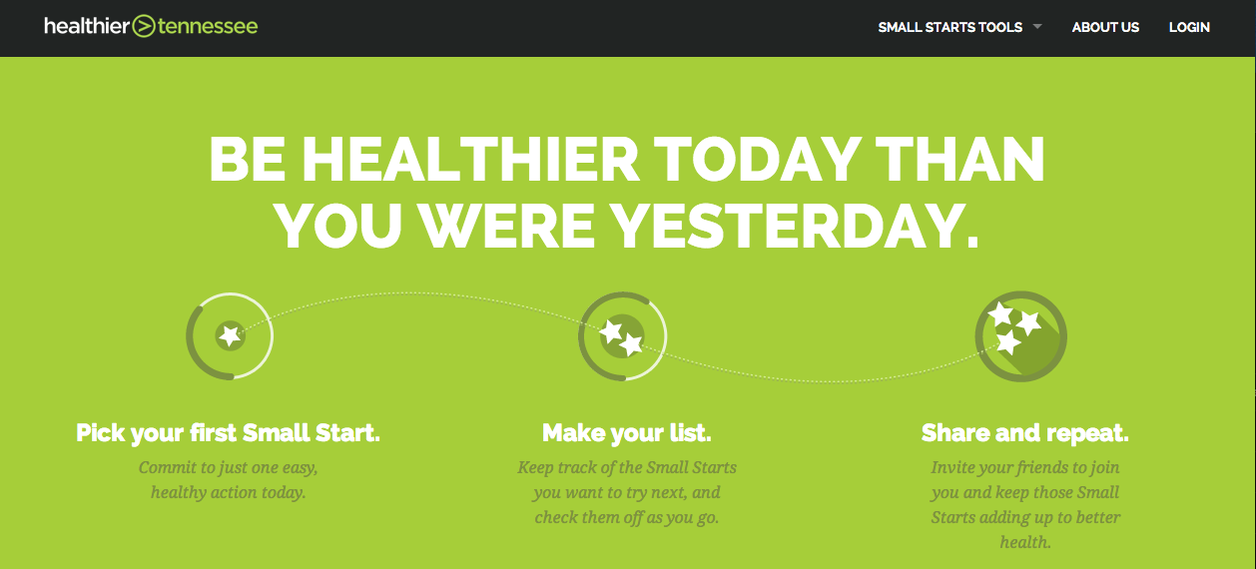
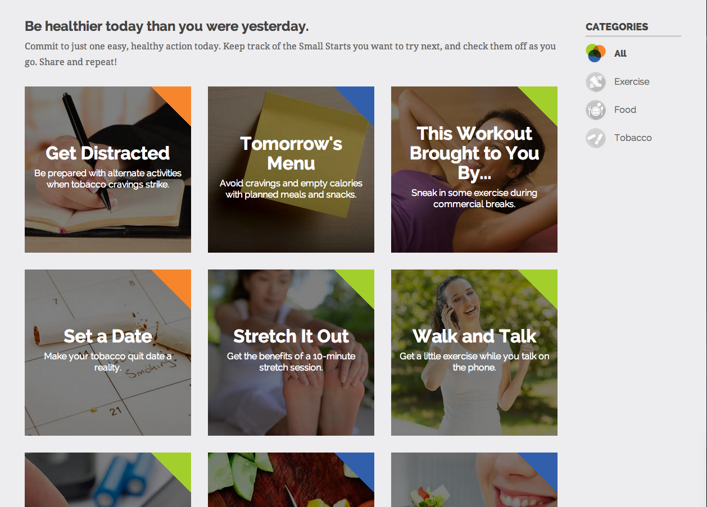
Notes:
Small Starts (for individuals) offers a choice of more than 60 small, personal health challenges that encourage physical activity, healthy eating, and tobacco cessation. Each small change will function as a gateway to bigger change, and over time, to healthier behaviors. Users can track their completed challenges and stats, and share their participation and achievements through social media.

Slide 8
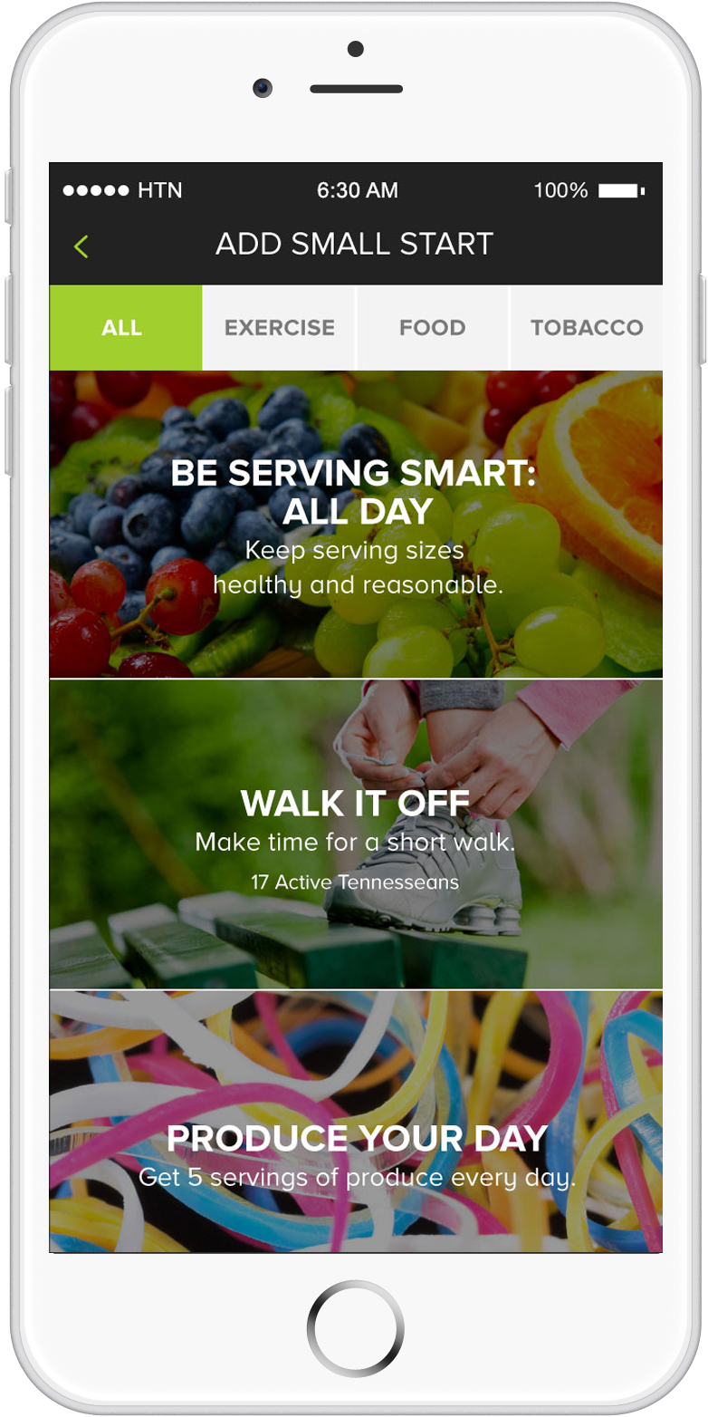
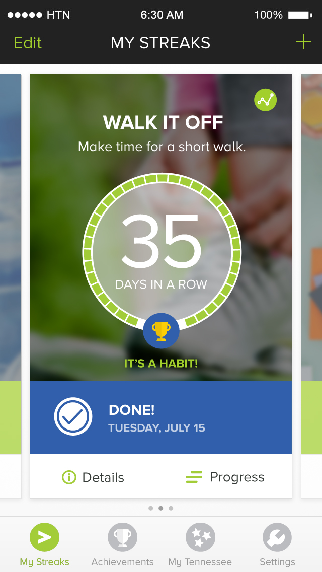
Notes:
We have also developed an app called Streaks for Small Starts that makes it even easier to access the Small Starts tools on the go. The app allows users to track their activities, receive daily reminder messages, and connect with other users to share success and provide motivation. It’s currently available in the Apple store, and an Android version will be available next month.

Slide 9
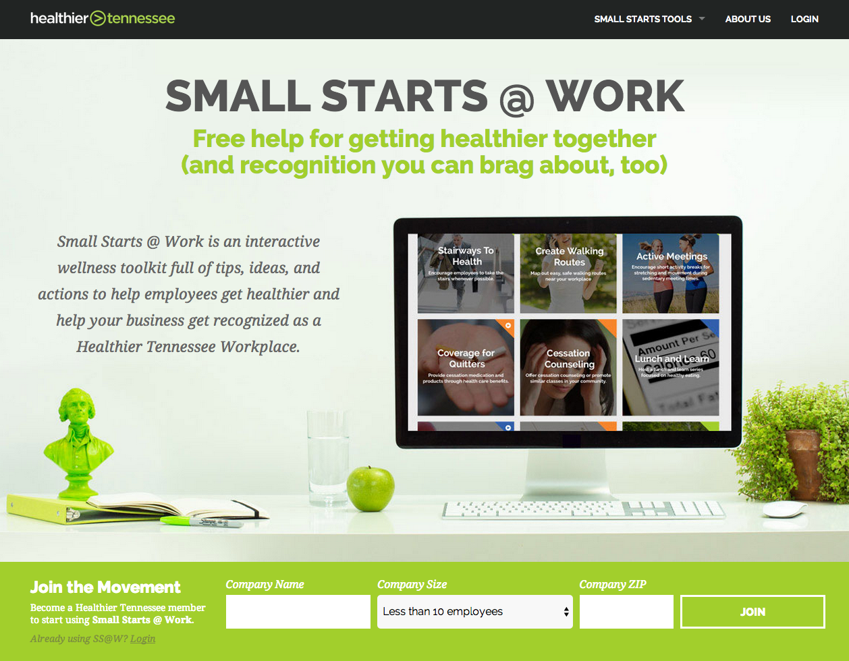
Notes:
Small Starts @ Work is a free wellness toolkit for Tennessee workplaces that provides low or no-cost ways to create healthier work environments and encourage employees to get healthier together. It is easy to use and can be adapted for businesses and organizations of all sizes.

Slide 10
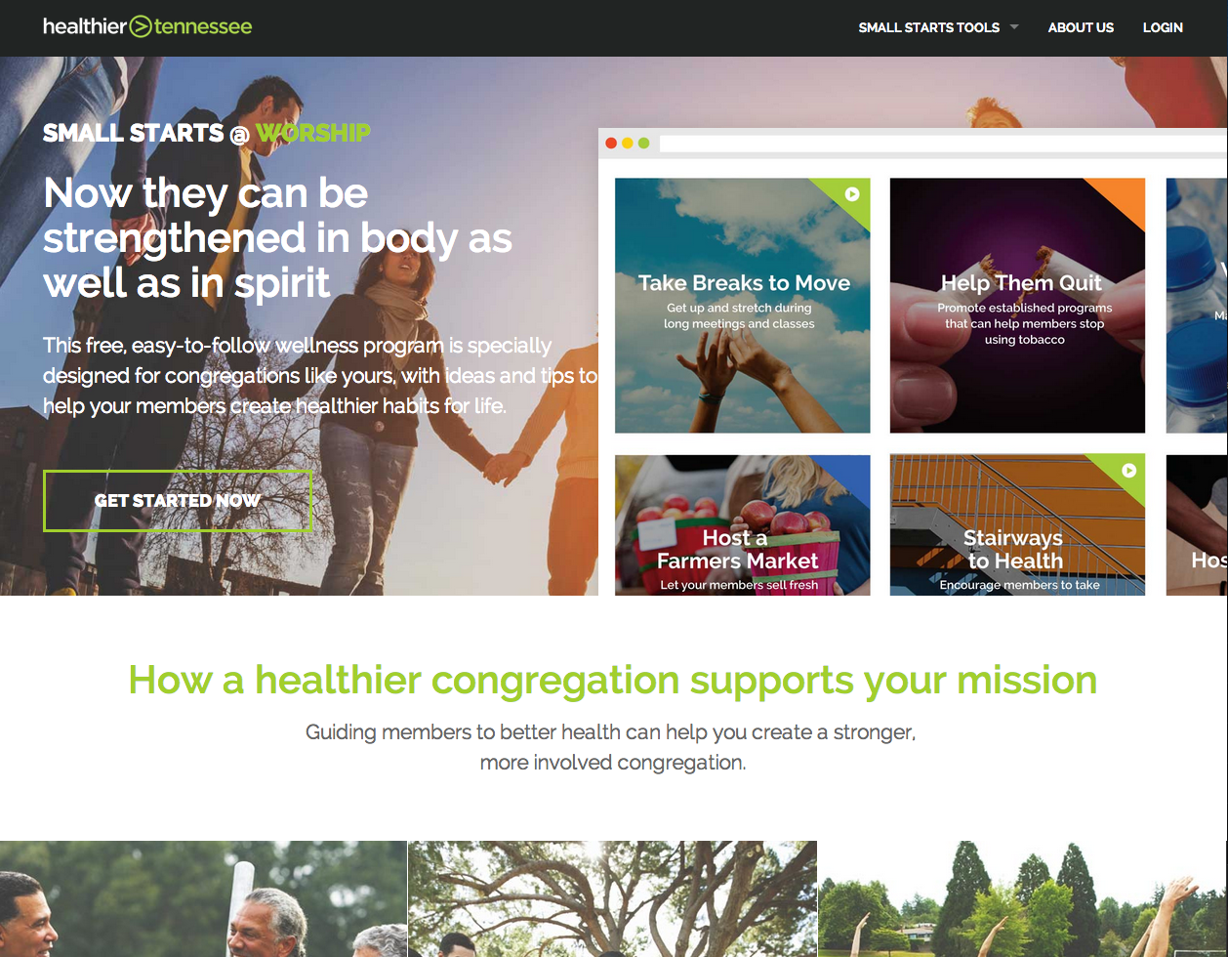
Healthier Tennessee
Small Starts @ Worship graphic
Notes:
Small Starts @ Worship provides faith leaders with tips, ideas and actions to help members get healthier together. It can be adapted for congregations of all sizes.

Slide 11
Partnering with local schools
Integrating physical activity into Extended Learning programs
Encouraging breakfast in classrooms
Training school nutrition staffs on healthy food preparation
Partnering with BlueCross BlueShield and GoNoodle to bring physical activity to elementary school classrooms across the state
Notes:
The Foundation is working with schools across the state in several different ways. In the 2014-15 school year, we are helping to integrate active learning techniques in extended learning programs, encouraging breakfast in the classroom, and providing training for school nutrition staffs about food preparation and presentation. We are also partnering with BlueCross BlueShield to enable increased physical activity during the school day in kindergarten through fifth grade classrooms in Tennessee public schools using an internet-based program called GoNoodle.

Slide 12
We all have a role to play
Utilize Small Starts tools and the Streaks for Small Starts app
Commit to creating a culture of wellness in your organization
Help to implement a wellness program at work or where you worship
Explore other ways to support the work of the Governor’s Foundation
Notes:
As I conclude this portion of your presentation, I want to ask for your help. We must make our health a top priority in this state. We can’t afford not to.
Healthier Tennessee is offering easy and effective ways to start.
I encourage you to join the movement, download Streaks for Small Starts and get on the path to better health.
I also hope you will urge your workplace or congregation to sign up and create wellness programs using the resources available.
Together, I know we can make this a healthier Tennessee.

Slide 13



Stay connected
http://healthierTN.com
Notes:
Please connect with us. Here are the ways.

