Slide 1
Healthy school teams guide
Germantown Municipal School Teams
Comprehensive HST resource guide to increase your school’s health, wellness, and physical activity initiatives.

Slide 2
Understanding the components
School-Site Health Promotion for Staff
Healthy School Environment
Counseling & Social Services
Nutrition Education
Social & Emotional Climate
Health Services
Community Engagement
PE & Physical Activity
Comprehensive Health Education
Family Engagement

Slide 3
Health promotion for staff
Participate in monthly CSH Initiatives that will be sent out from CSH Supervisor and in monthly CSH Newsletters (share newsletters with staff)
Hold school-wide health and activity challenges for students and staff. Collaborate with CSH Supervisor for ideas.
Share Healthy & Active Germantown (discount e-book) with staff. Updates will be sent out periodically with new partnerships and offers.
Promote our staff challenges from CSH, such as: The Fitness Warehouse, Germantown Gets Cooking, Hydrate for Health, Step It Up Challenge, and The Biggest Loser Challenge.

Slide 4
Healthy school environment
Use visual aids and posters to promote an active and healthy environment.
Conduct Safety drills periodically, including AED/CPR Drill.
Consider starting each day with a positive message to promote a healthy learning environment.
Promote positive social and emotional skills (utilize school counselors).

Slide 5
Counseling & social services
Collaborate with School Counselors to promote and support their events and initiatives throughout the year.
Promote the positive messages and lessons that come from School Counselor’s lessons.
Utilize Mental Health Counseling Resources

Slide 6
Nutrition Education
Promote breakfast participation (offer second chance breakfast and grab-n-go breakfast).
Promote CSH initiatives, such Germantown Gets Cooking, Hydrate for Health, and Grab-n-Go Health Projects.
Utilize our Nutrition Ed Resources
Consider starting Fuel-Up to Play 60 club or a student led Nutrition Council (FES has one in place).

Slide 7
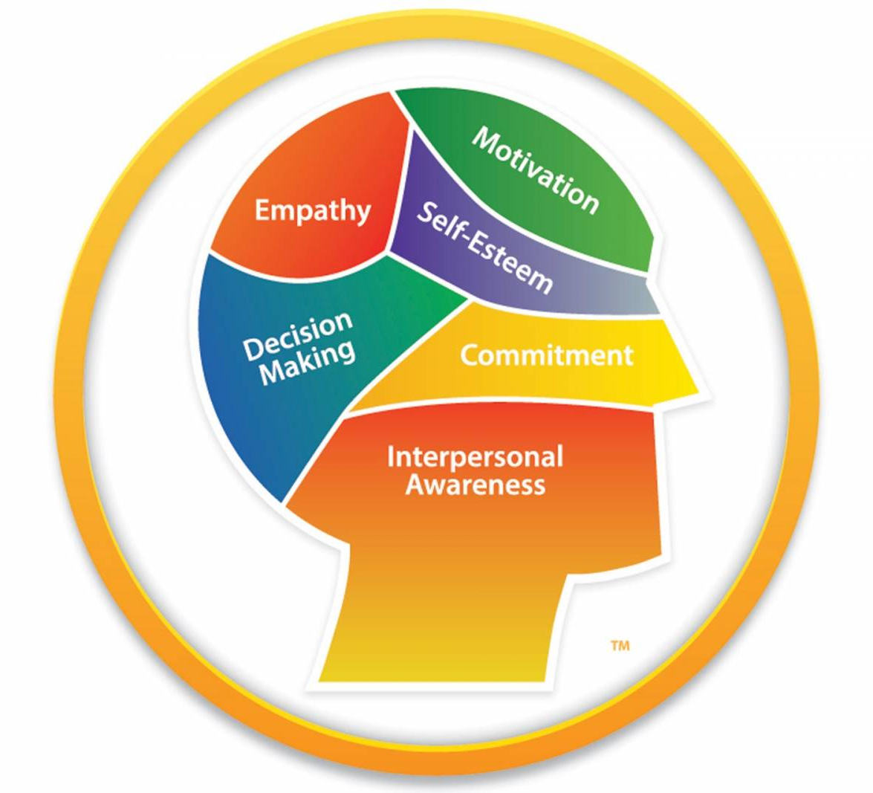
Social & emotional climate
Promote healthy behaviors and choices (visual aids, posters, lessons from counselors).
Utilize our Virtual Calming Room for students and staff.
Consider starting a self-care program (HHS is starting one).
Promote the SWAT program at your schools (RES, HMS, HHS) led by Wes Crump.
Utilize our mindfulness resources.
Promote Yoga sign-ups for students & staff (ask CSH Supervisor for info).

Slide 8
Health services
Collaborate with CSH Supervisor to schedule student health screenings.
Collaborate with CSH Supervisor to schedule staff health screenings (led by CSH Supervisor and lead nurse).
Collaborate with CSH Supervisor to schedule flu shots for staff (other shots can be scheduled as well).
Consider PD opportunities for staff to learn about health concerns for students (ask CSH Supervisor).
Schedule CPR/First-Aid/AED trainings for staff (ask CSH Supervisor)

Slide 9
Community engagement
Consider after school and/or weekend community events to enhance school’s impact on community.
Promote our annual GMSD Stampede event.
Promote our annual Walk Across TN event.
Promote our annual Breast Cancer Awareness virtual run challenge.

Slide 10
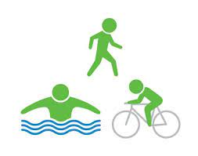
Physical education & Physical activity
Promote the great things taking place in your school’s PE programs. (i.e. bike ed program at DES, FES, and HHS).
Promote CSH initiatives, such as Virtual Run Challenges, Walk Across TN, The Fitness Warehouse, Step It Up Challenge, Marathon Runners of GMSD.
Encourage physical activity brain breaks throughout the day. (consider scheduling a brain break training with CSH Supervisor).

Slide 11
Comprehensive health education
Schedule after school health info sessions for students and parents (ask CSH Supervisor for topics)
Promote our No Smoke November anti-tobacco initiative.
Family Life Instruction will include a large portion of Health Ed topics.
Promote and support Red Ribbon Week.
Consider having weekly/monthly health topics to promote school-wide.

Slide 12
Family engagement
Promote family nights at school
Schedule after school and/or weekend events to promote family engagement.
Collaborate with school counselors for ideas on how to engage the family unit with meaningful ideas and activities.
Consider hosting a Family Fitness night. This can be led by your school’s Physical Education teachers and/or PTO. (ask CSH Supervisor for ideas).
Schedule informative sessions on a variety of health topics (i.e. Anti-Tobacco) for students and parents after school.

