Slide 1


Healthy & Active
Germantown
GMSD Employee Discounts & Special Services

Slide 2

Healthy & active germantown
Healthy & Active Germantown is an initiative founded during the summer of 2020 to aid in increasing the awareness of healthy and physical activity offerings in Germantown and neighboring areas.
Local businesses have partnered with Healthy & Active Germantown to support our mission by providing products, services, and opportunities to GMSD teachers, employees, students, and parents to increase our health and activity awareness.
Our mission is to make Germantown the healthiest and most active city in the state of TN.

Slide 3
Healthy & active germantown gmsd
Components of our model
Components of our model
Physical Fitness
Physical Health
Mental Health
Nutrition
Health & Beauty
Retail Services
Cleanliness & Personal Hygiene
Hormone & Energy Levels
Pain & Discomfort Treatment
Recreational Fitness & Activities
Wellness
Special Services

Slide 4

Get active & fit discounts

Slide 5

Orange theory fitness
9067 Poplar Ave #105, Germantown, TN 38138
All GMSD employees will receive the following special offers when you show proof of employment (I.D. badge):
Unlimited Membership for $149/month (regularly $159/month)
Elite Membership (8 classes/month) for $89/month (regularly $99/month)
Offer valid at Germantown location.

Slide 6
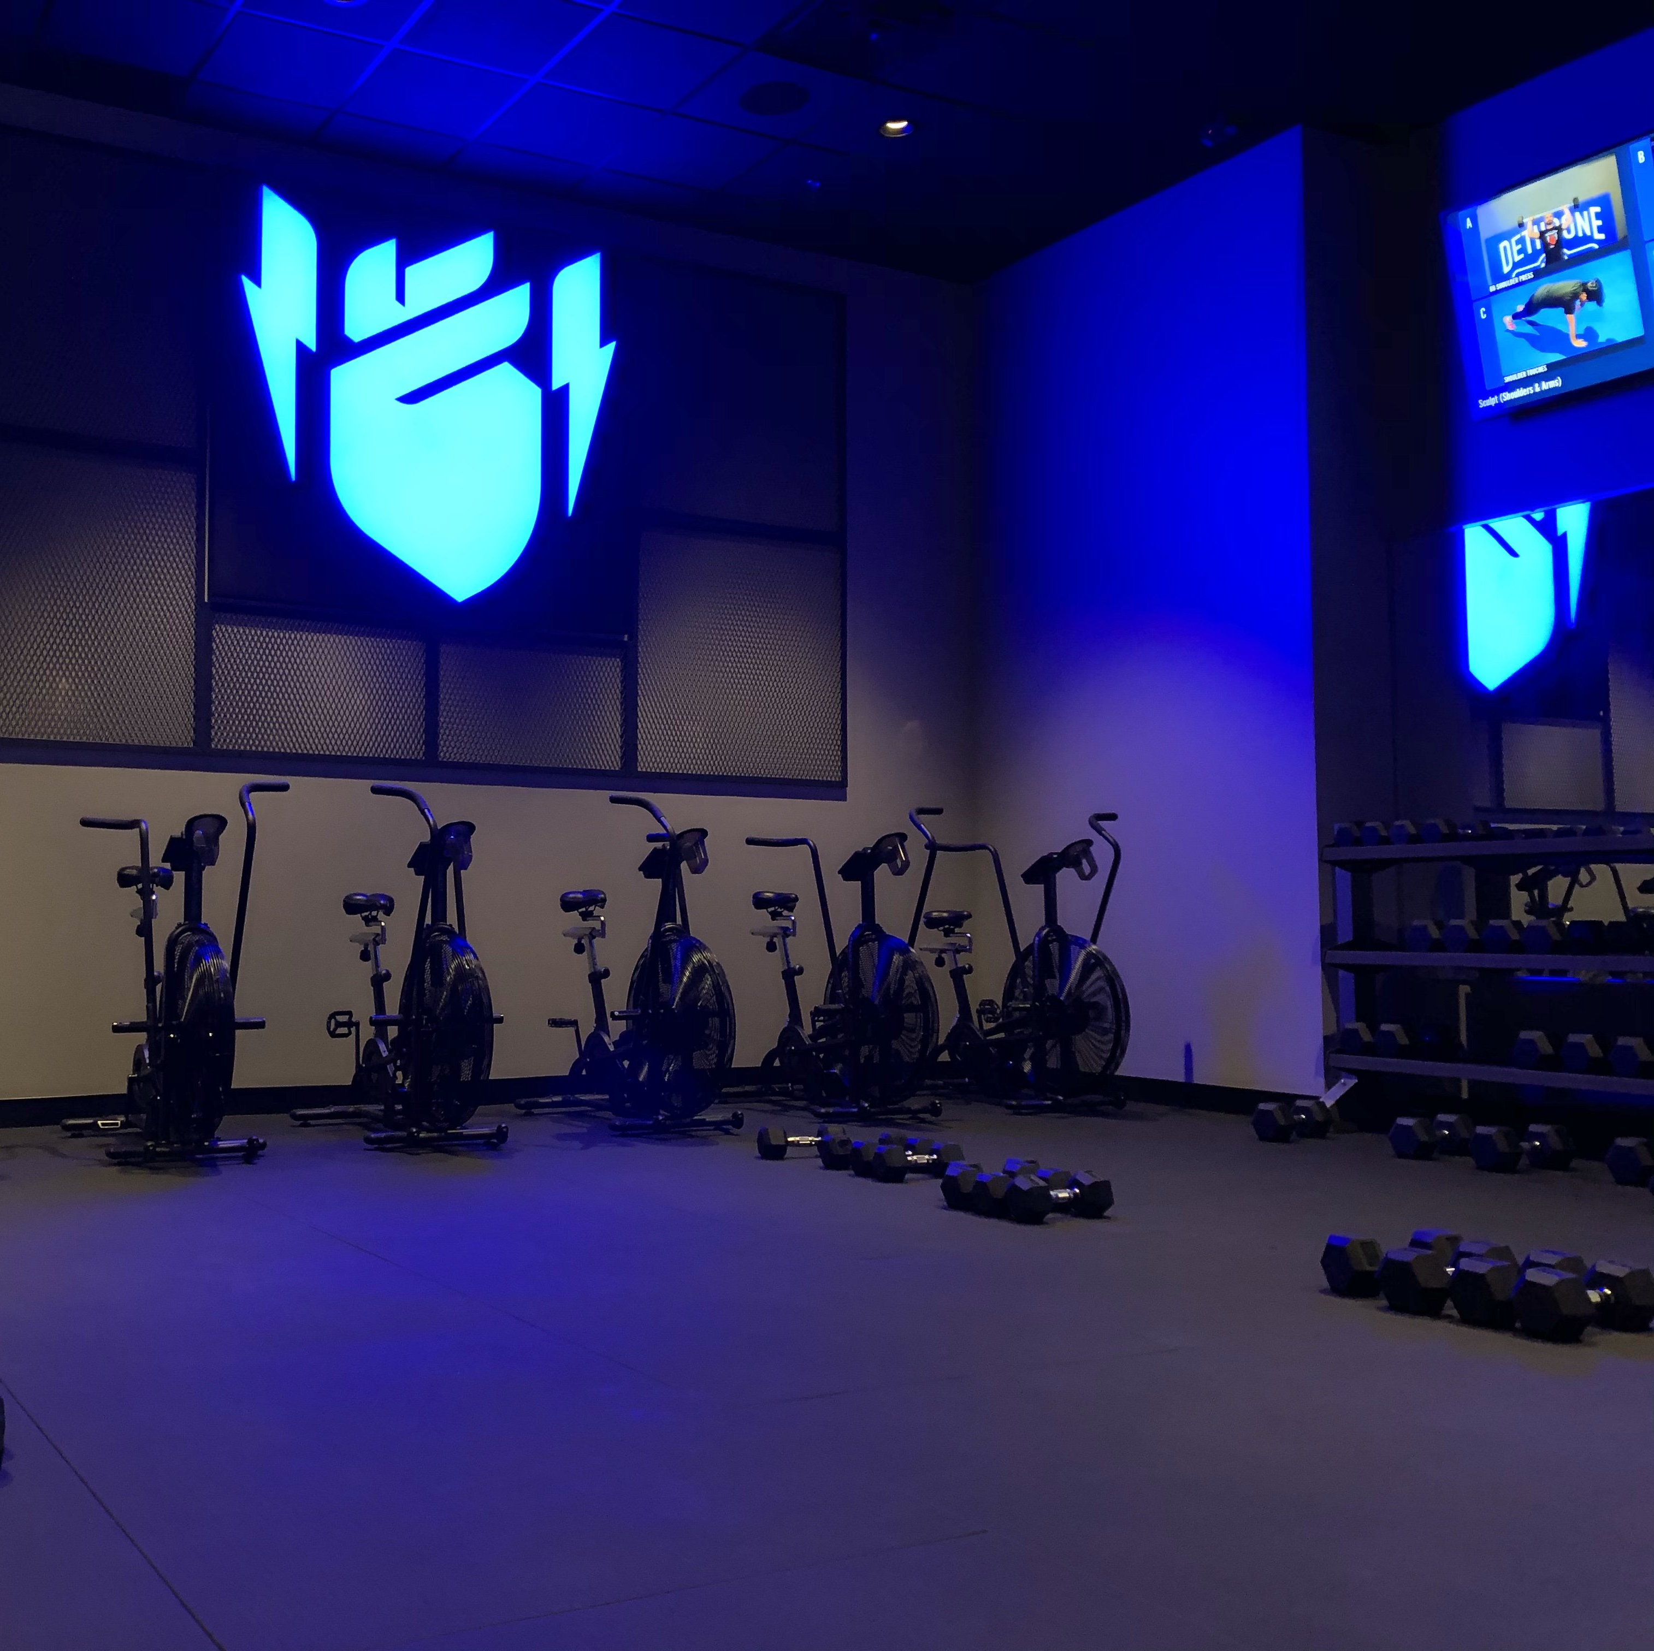
Basecamp fitness
6450 Poplar Ave Suite 115, Memphis, TN 38119
All GMSD Employees will receive an exclusive offer of the following:
2 weeks of membership for FREE (test the experience out).
25% off (lifetime discount) membership after the 2-week free trial.
Must show GMSD ID badge to receive these exclusive offers.

Slide 7

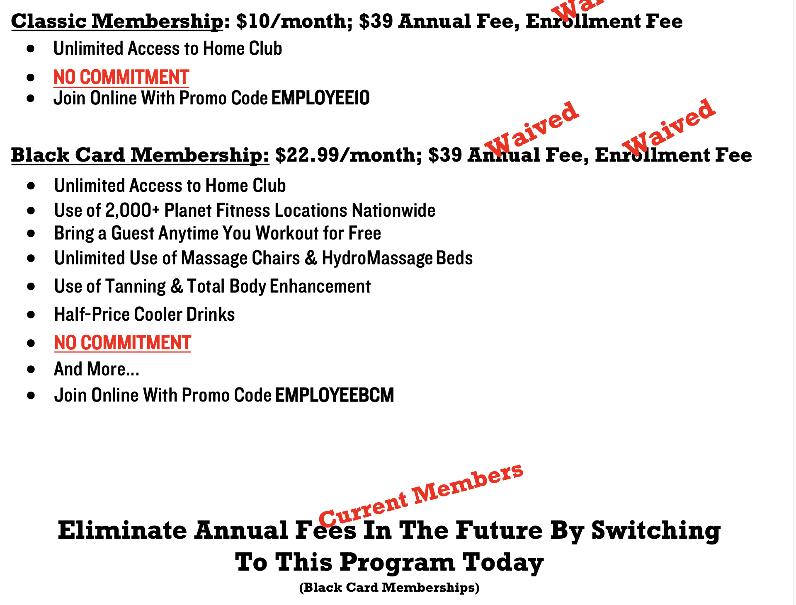
Planet fitness all locations

Slide 8

Highpoint climbing & fitness
21 N Humphreys Blvd, Memphis, TN 38120
All GMSD employees can receive a special membership, discounted to $55.20. (regularly priced at $69)
All GMSD employees must show their ID badge to receive this special offer.

Slide 9
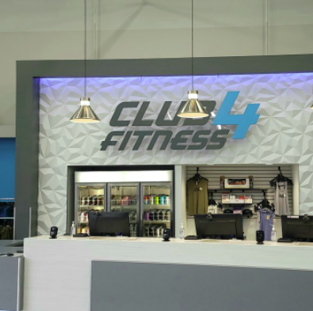
Club 4 fitness
7771 Winchester Road, Memphis, TN 38125
GMSD Employees can receive a 3 day free fitness pass by registering below.
3 Day Pass: https://www.club4fitness.com/free-trial/

Slide 10

Esporta fitness
GMSD Employees can receive a free 3-day fitness pass.
3-day fitness pass: https://www.esportafitness.com/Pages/FreePass.aspx

Slide 11

Shed fitness
1215 Ridgeway Rd, Memphis, TN 38119
ALL GMSD Employees are eligible for a discounted membership.
Membership will be discounted to $99/month for the first two months (exclusive to GMSD).
Must show your GMSD ID badge to receive this offer.

Slide 12

Delta life fitness
Special Teacher Discount available. Receive a special 6-week kickstart program to the #1 place for women to train right!
Call or email: germantown@deltalifefitness.com to find out more about this exclusive offer.
Additional perks include: supervised kid’s corner, 30-minute workouts, no contracts, flexible pricing, and women focused fitness.
Book a FREE class to learn more!
2068 West Street Germantown, TN 38138
(901)-871-1099

Slide 13

The yard 901
6001 Airline Rd, Arlington, TN 38002
All GMSD Employees will receive an exclusive Teacher Discount from The Yard 901-Arlington.
GMSD Teachers are eligible for a $19.99/month membership rate (normal rate is $29.99/month)
Must show GMSD ID badge to receive offer.

Slide 14

Lifetime fitness
3470 S Houston Levee Rd, Collierville, TN 38139
GMSD employees joining package:
1 hour on boarding session with a trainer
1 month free of swim lessons per child
$25 spa credit
1 free smoothie
1 extra 1-hour personal training session
Enrollment fee credited back after being a member for 30 days!

Slide 15

Club pilates
Valid at All 3 locations: East Memphis, collierville and Lakeland
GMSD Employees will receive 10% off any membership package
GMSD Employees will have the enrollment fee waived (Save $59)
GMSD Employees will receive a $15 retail credit (if already a member)
Must show GMSD ID badge to receive offers.
GMSD employees can receive one FREE class by signing up here!

Slide 16

Cycle bar
7685 Farmington Blvd Suite 101, Germantown, TN 38138
GMSD employees & staff will receive a special offer of $99 unlimited/month
Must email Germantown@cyclebar.com and show proof of GMSD employment (picture) in email.

Slide 17

Higher Memphis
70 Flicker St, Memphis, TN 38104
ALL GMSD Employees are eligible to receive a special discounted membership.
Teacher Membership is $109/month (Regularly $189/month)
You must email info@highermemphis.com from you school email account to receive this offer!
You receive two free classes to try this experience out before you buy

Slide 18

Germantown athletic club
1801 Exeter Rd, Germantown, TN 38138
$0 Application fee if you choose to pay for the membership in full for 6 or 12 months.
$25 application fee if you choose to pay for the membership by monthly automatic draft. *Normal application fee is $99

Slide 19

Silver bull fitness
3285 HACKS CROSS ROAD
MEMPHIS, TN 38125
All GMSD employees will receive 20% off the “Fundamental Program”
Fundamental Program required for everyone who has not done CrossFit in the past.
Memberships will be discounted at 16% off. (Excludes all a la carte extras)
Must show your GMSD ID badge to receive this offer.

Slide 20

Power 40 fitness
7950 Club Center Cove, Cordova, TN 38016
ALL GMSD Employees will receive a free fitness training consultation if they join as a member.
Must show GMSD ID badge to receive offer.

Slide 21

Crossfit sopo Germantown
3100 Village Shops Dr #18, Germantown, TN 38138
Beginner Package is 15% off for all GMSD staff and employees (show ID badge to confirm you’re an employee with GMSD).
Unlimited Membership is 15% for all GMSD staff and employees (show ID badge to confirm you’re an employee with GMSD).
Periodic sales and special offerings will come from Cross-Fit SOPO Germantown and will be shared with all GMSD staff.

Slide 22

F45
Germantown
7850 Poplar Ave Suite 20, Germantown, TN 38138
1-week free pass for all GMSD employees

Slide 23

Fred Astaire dance
6645 Poplar Ave #206, Germantown, TN 38138
All GMSD employees will receive 2 private sessions (30 minutes each) for only $50.
Employees that decide to sign up for additional classes will receive a discounted rate

Slide 24

peloton
ALL GMSD employees are eligible to receive a free Essentials Bundle for Educators.
With Bike: Includes shoes, weights, and headphones ($150 value)
With Bike+: Includes shoes, weights, and workout mat ($200 value)
A purchase of a Peloton is required to receive the above bundles.
You must complete a quick verification process via email insidesales@onepeloton.com

Slide 25

Virtual yoga gmsd
Program is available for ALL GMSD students, teachers, staff, and parents.
Kid’s Registration & Adult’s Registration
Programs are customizable based on your needs, such as chair yoga or trauma informed yoga.
Yoga is separated into grade bands: Elementary, Middle, H.S. and Adults

Slide 26

USA Karate
GMSD employees and families will receive the following offers:
1 Free Virtual Class (Adults & Kids)
Try a class for Free (Adults & Kids)
1 week of martial arts for $19.75 (Adults & Kids)

Slide 27

Border martial arts academy
4644 Merchants Park Cir #900, Collierville, TN 38017
GMSD teachers, students, and staff can receive unlimited fitness kickboxing for only $69.99 a month
GMSD will get 50% their jiu-jitsu/self defense program (valid through may)
Show GMSD id badge to receive these special offers

Slide 28

Pure barre
GMSD Employees can test this experience out by signing up for a FREE session!!
Teacher Package for GMSD staff includes: 3 months unlimited for $125/month
7820 Poplar Ave Suite 12, Germantown, TN 38138
Germantown@purebarre.com

Slide 29

Hotworx
9155 Poplar Ave Suite 25A, Germantown, TN 38138
GMSD employees will receive one FREE session & FREE enrollment if they decide to join!
Must show ID badge to receive offer.

Slide 30



Slide 31


Slide 32

Restaurant discounts

Slide 33

Tacos 4 life
All GMSD employees will receive a 10% discount off their entire order.
Show your GMSD I.D. badge when you pay to receive this exclusive offer.
Offer only valid at 3565 S Houston Levee Rd, Collierville, TN 38017

Slide 34

Chicken salad chick
ALL GMSD employees and staff will receive 10% off their order when they visit Chicken Salad Chick.
Must show your GMSD ID Badge to receive this offer.
Offer valid at the Germantown location only.

Slide 35

Vanelli’s deli
7873 Farmington Blvd, Germantown, TN 38138
All GMSD employees will receive 10% off their order.
GMSD employees must show their ID badge to receive this offer.
https://www.vanellisdeli.com/

Slide 36

Great hunter crab
GMSD employees will receive 10% off your order when presenting your ID badge.
(Excludes king crab and lobster tails).

Slide 37

The nutrition hub
All GMSD Employees will receive a 10% discount on their order.
Must show GMSD ID badge to receive offer.
All proceeds go to HHS Pom.

Slide 38

Royal panda
3120 Village Shops Dr #23, Germantown, TN 38138
All GMSD employees will receive a 10% discount.
Must show your GMSD ID badge to receive this offer.

Slide 39

Rock n roll sushi
All GMSD Teachers will receive an educator’s discount of 20% off their order.
Must show your GMSD ID badge to receive educator discount.

Slide 40

Red pier
5901 Poplar Ave. Memphis TN 38119
ALL GMSD Employees will receive 10% off their orders.
Must show your GMSD ID badge to receive this discount.

Slide 41

Wayback burgers
All GMSD employees will receive a 20% discount when making a purchase.
Must show your GMSD ID badge to receive this offer.

Slide 42

Wimpy’s burgers & fries
All GMSD employees will receive 10% off their order when they visit any Wimpy’s location.
Must show GMSD ID Badge to receive this special offer.

Slide 43

Memphis mojo café
7124 US-64 Suite 101, Bartlett, TN 38133
All GMSD employees will receive 15% off their orders.
Must show GMSD ID badge in order to receive this offer.

Slide 44

Texas de brazil
Teachers with valid ID can get a 20% Heroes’ Discount from Texas de Brazil. Discount applies to a maximum of 4 people per table. Not available during holidays (source).
https://texasdebrazil.com/specials/heroes-discount/

Slide 45

Mr. p’s buffalo wings
2075 Exeter Rd Suite 35, Germantown, TN 38138
ALL GMSD Employees will receive a 10% discount for their purchase.
Must show your GMSD ID badge to receive this offer.
Offer only valid at Germantown location.
Each month a special offer will be available for teachers & staff.

Slide 46

Poplar pike wine & liquor
9330 Poplar Pike #103, Germantown, TN 38138
All GMSD Employees will receive 10% off any regular priced bottle of wine.
Must show GMSD ID badge in order to receive discount.
Offer not valid for any liquors.

Slide 47

Smashed eats
ALL GMSD Employees will receive 25% off their orders.
Use their Facebook Page to see where the food truck will be:
https://www.facebook.com/SmashedEats/
Must show GMSD ID badge to receive offer.

Slide 48

Mellow mushroom
9155 Poplar Ave Suite 26, Germantown, TN 38138
ALL GMSD Employees will receive 10% off their order (discount valid for in-store purchases only).
Must show GMSD ID badge to receive offer.
Offer only valid at Germantown location.
Additional offers: Buy 1 get 1 slice (Monday), $3 drafts (Tuesday), and 2 for 1 brunch cocktails (Sunday).

Slide 49

vibe foods
3139 Poplar Ave, Memphis, TN 38111
ALL GMSD Employees will receive 10%
ALL GMSD Employees will receive a free Kombucha or Wellness Shot with any purchase.
You MUST text GMSD to 87338 to be entered into their loyalty program specifically for GMSD Employees!
Details on next slide…

Slide 50

You will get one free instore wellness shot with purchase each time they come in. Here is how it will work:
After you text in, you’ll be added into a specific group in our loyalty program so we can keep track who these individuals are.
We will setup a recurring campaign that can send GMSD group members a voucher for the shot that would be assigned on the first of each month and then expire in 30 days. We will also have this be accompanied with a text/app notification/email letting the you know it was added to your account and what the expiry date would be.

Slide 51

Imagine vegan café
2158 Young Ave, Memphis, TN 38104
ALL GMSD Employees will receive a 15% discount off their order.
Must show your GMSD ID badge to receive this discount.

Slide 52

Pizzeria trasimeno
1350 Concourse Ave Suite 181, Memphis, TN 38104
All GMSD employees will receive a free fountain drink when they purchase a pizza.
Must show you GMSD ID Badge to receive this offer.

Slide 53

Celtic crossing
903 Cooper St, Memphis, TN 38104
ALL GMSD Employees will receive 10% off their order.
Must show GMSD ID badge to receive this offer.
Discount not available for Fish & Chips special on Tuesdays.

Slide 54

Wild beet salad co.
All GMSD staff will receive a 10% discount on orders.
GMSD staff must show ID badge to receive this offer.
Carrefour Shopping Center
6641 Poplar Avenue #106
Germantown, TN 38138
(901) 552-5604

Slide 55

Holiday ham
All GMSD employees will receive 15% off their order.
Must show your GMSD ID Badge to receive offer.
Only valid at Germantown location
7652 Poplar Ave, Germantown, TN 38138

Slide 56

One & only BBQ
All GMSD employees can receive 10% off their order when they visit any of the One & Only BBQ locations.
Simply say you’re a GMSD employee and you’ll receive the 10% off.

Slide 57

The bagel
6698 Poplar Ave, Memphis, TN 38138
ALL GMSD Employees will receive 10% off their orders.
Must show GMSD ID badge to receive this discount.

Slide 58
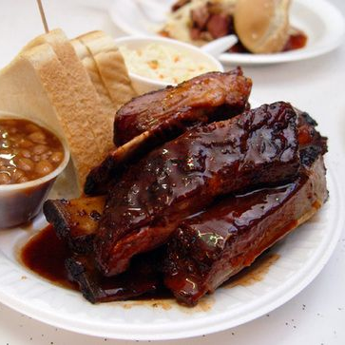
Cozy corner BBQ
735 North Pkwy, Memphis, TN 38105
ALL GMSD Employees can receive 10% off their meals.
Must show your GMSD ID badge to receive this offer.

Slide 59

Mcalister’s deli
7710 Poplar Ave, Germantown, TN 38138
ALL GMSD Employees will receive 10% of their order.
Must show their GMSD ID badge to receive offer.
Only valid at Germantown location

Slide 60

Forest hill grill
9102 Poplar Pike, Germantown, TN 38138
All GMSD employees will receive 10% off their order.
Employees must show their GMSD ID badge to receive offer.

Slide 61

Wiseacre taproom
2783 Broad Ave, Memphis, TN 38112
ALL GMSD teachers will receive 20% off their purchase. (not valid on food purchases)
Must show your GMSD ID badge to receive this offer.

Slide 62

Otherlands coffee bar
641 Cooper St, Memphis, TN 38104
ALL GMSD teachers will receive 10% off their order.
Must show your GMSD ID badge to receive this offer.

Slide 63

Vibe foods
3139 Poplar Ave, Memphis, TN 38111
ALL GMSD Employees will receive 10% off their orders.
GMSD Employees can receive a free kombucha or wellness shot with any purchase.
Must show your GMSD ID badge to receive these offers.

Slide 64

Margie’s 901 ice cream
ALL GMSD employees will receive 10% off any menu item.
ALL GMSD employees will get 1 free “warm ice doughnut” with the purchase of one. (BOGO)
Must show your GMSD ID badge in order to receive these offers.

Slide 65

Dipsticle
694 N Germantown Pkwy ste 60, Cordova, TN 38018
ALL GMSD Employees will receive a 15% discount off their orders.
Must show your GMSD ID badge to receive this offer.

Slide 66

Miccos
9077 Poplar Ave #103, Germantown, TN 38138
ALL GMSD Employees will receive 10% off their orders.
Must show GMSD ID badge to receive discount.

Slide 67
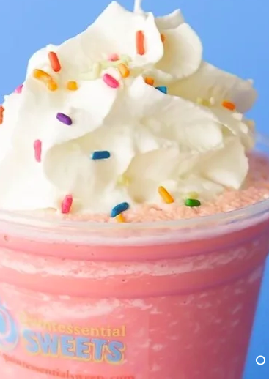
Quintessential sweets
2811 Bartlett Blvd, Bartlett, TN 38134
All GMSD teachers and staff will receive 10% off their orders.
Must present your GMSD ID badge when making a purchase to receive this discount.

Slide 68

Frost bake shop
ALL GMSD Employees will receive 20% off their purchase.
Must show GMSD ID badge to receive offer.

Slide 69

Jin’s donuts
1990 w. poplar ave. #103
ALL GMSD Employees will receive 10% off their order.
Must show your GMSD ID Badge to receive this offer.

Slide 70

Mojo nutrition
2059 S Houston Levee Rd Ste 118, Germantown, TN 38139
All GMSD employees will receive $1 off their order at Mojo Nutrition.
All employees must show their I.D. badge to receive this exclusive offer.

Slide 71

City silo
5101 Sanderlin Ave #104b, Memphis, TN 38117
(901) 729-7687
All GMSD employees will receive 10% off their orders when they present their GMSD ID badge.
Check out their menu:
thecitysilo.com

Slide 72
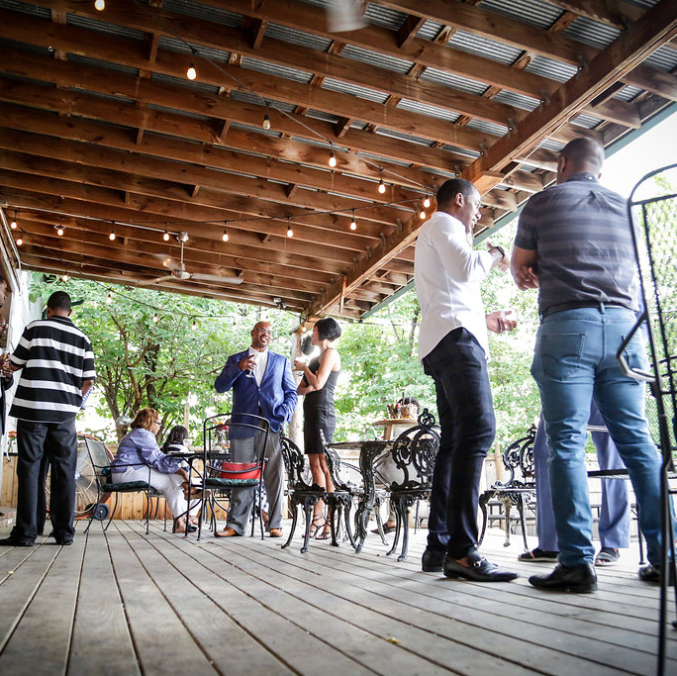
Loflin yard
10% OFF PURCHASE WITH TEACHER ID
https://www.loflinyard.com/8xsx8damzg3l19kmq4nkhq2jn8wq22

Slide 73

Mosaic foods
All GMSD employees will receive $15 off their first two orders when you enter code GMSD30
https://www.mosaicfoods.com/

Slide 74

Home chef
Home Chef is offering a 50% first order discount to teachers, in addition to a 10% discount for subsequent orders. Available for new customers only. Sign in and verify through ID.me (source).
https://www.homechef.com/heroes?utm_campaign=prospecting&utm_medium=cpc&utm_source=facebook

Slide 75

The fresh market
9375 Poplar Ave, Germantown, TN 38138
GMSD Employees can receive a FREE 20 oz cup of coffee from our local The Fresh Market.
Each month The Fresh Market will have new offerings that will be extended to our GMSD community!

Slide 76

Tiger nutrition
3315 Hacks Cross Memphis, TN 38125
Germantown Municipal School District Employees will receive $1 off any of the drinks they order.
(Show your GMSD I.D. badge when making purchase).

Slide 77

Smoothie king
7820 Poplar Avenue, Germantown
901-309-8039
Germantown Municipal School District Employees will get a free Enhancer added to their drink when they purchase a 20 oz or larger smoothie!!
Only valid at this location

Slide 78

Kind snack bars
All GMSD Teachers are eligible to receive 15% off their online order.
Just click the IDMe button to identify yourself while placing your order.

Slide 79

Java café
3133 Forest Hill Irene Rd, Germantown, TN 38138
Feeling Hungry? Need great food for a teacher gathering or administrator’s meeting? Order from java café
Orders over $100 will receive free delivery for GMSD employees only

Slide 80

Mind body & spirit discounts

Slide 81

Stretch zone
2037 Exeter Road Su 9, Germantown, TN 38138
ALL GMSD Employees will receive a 10% discount off a single stretch and/or membership package.
GMSD Employees can get a demo stretch for free to test this experience out.
Must show your GMSD ID badge to receive this offer.

Slide 82

Wellness m.d.
3680 S Houston Levee Rd Ste 104, Collierville, TN 38017
ALL GMSD Employees and their spouses will receive the following offers:
10% off IV Nutrition Therapy
10% off any medical weight loss package
10% off hormone replacement therapy/Low T
Free weight loss or hormone consultation

Slide 83
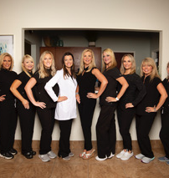
Wellness M.D.
3680 S Houston Levee Rd Ste 104, Collierville, TN 38017
Free Red Light Lipo treatment ($100 value)
Free Body & Facial Assessment and 1 Free Body or Facial Contouring Treatment with the purchase of any face or body package
Must show GMSD ID badge to receive these exclusive offers.

Slide 84

Bikram yoga
Sanderlin Center Ste 125, Memphis, TN 38117
ALL GMSD teachers will receive a special membership offer of $69/month.
Must show your GMSD ID badge to receive this offer for educators.

Slide 85

Nailology salon & spa
ALL GMSD Employees will receive a 10% discount for services.
Must present your GMSD I.D. badge to receive this offer.

Slide 86

Summit yoga
6645 Poplar Ave #208, Germantown, TN 38138
GMSD staff & employees will receive 20% any regular priced class packages

Slide 87

Buff city soap
1730 S Germantown Rd Suite 121, Germantown, TN 38138
GMSD employees will receive a 10% discount at Buff City Soap locations when they show their GMSD ID badge.

Slide 88

Belle fleur https://explorebellefleur.com/
ALL GMSD teachers will receive 25% off their purchase when they visit Belle Fleur’s website to make a purchase.
Enter the promo code “Thank You” at checkout to receive a discount on your purchase.

Slide 89

Ageless men’s health
9067 Poplar Ave #109, Germantown, TN 38138
GMSD employees will receive a FREE evaluation (normally $75)
Must have GMSD ID to receive promotion

Slide 90

Honey spray tans
Mobile Spray Tanning www.thehoneyspraytans.com contact@thehoneyspraytans.com
IG: @honeyspraytans
(901)410-1616
GMSD employees will receive a 10% discount when booking online with GMSD-10 promo code.
Honey Spray Tans is a Memphis-based mobile spray tan provider founded by two sisters to bring you a flawless tan in the comfort and convenience of your own home.
Solutions are all natural, paraben free, and 100% vegan. No orange tones, odor, or sticky feeling!

Slide 91

The Chiro place
3615 S Houston Levee Rd, collierville, TN 38017
(901) 221-7173
GMSD employees will receive a ”New Patient Offer” of Examination, consultation, and x-ray for only $30!
Neck or back aches? Joint pain? Headaches? Sinus problems? Pregnant? Athlete? Come see us!
Call for Appointment: 901.221.7173
www.thechiroplace.net

Slide 92

The chiro place visit any of 3 locations

Slide 93

Fundamental fitness greta Hauberg
699 Oakleaf Office lane, suite 106,
Memphis, tn 38117
(901) 303-8191
“Start a healthy habit” package at a discount: The initial evaluation plus 2 training sessions a week for 4 weeks for $525 (that’s $95 off for GMSD employees ONLY).
“Your first 1 hr massage” for $80 (savings of $20 for GMSD employees ONLY).

Slide 94

Fundamental fitness greta hauberg
Trainings can be done virtually and/or in-person. However, the initial evaluation needs to be done live.
Don’t miss out on this opportunity for excellent massage therapy and personal training at a discounted rate just for you!
Email: gretaheals@yahoo.com

Slide 95

Regel pharmalab
1352 Cordova Cove
Germantown, TN 38138
​
Office (901) 757-9434
Fax (901) 757-1194
FREE Vitamin and Nutrient Consultation to explore any potential deficiencies due to diet, lifestyle and/or medications that can create unintended deficiencies; CALL LOCATION TO SET UP APPOINTMENT
10 % OFF any Vitamin or Supplement for daily dietary supplementation; IN-STORE PURCHASE ONLY
10 % OFF the Immune Booster Pack (Basic, Advanced or Complete) for daily immune protection; IN-STORE PURCHASE ONLY
Must show GMSD ID Badge to receive special offers

Slide 96

Juice plus+ www.EatYourVeggie.NET
With every Adult purchase of our Fruits & Veggie Blend (20 immune building fruits & veggies), you'll receive a FREE ORDER for a child (3yrs up through college) for 4 years, as long as you are on the product!!!
Now through the end of December, receive a bag of our delicious vanilla or chocolate plant protein mix for FREE*!
To get started, contact Miranda Griffin - Wellness Coordinator - 901-859-2410

Slide 97


Slide 98


Slide 99

Cypress Naturals Memphis
Artfully Crafted Bath and Body Products www.cypressnaturalsmemphis.com
It is our pleasure to offer GMSD employees (only) a 25% discount on regularly priced items purchased through our website: www.cypressnaturalsmemphis.com
DiscountCode: drallefoster25
Questions? cypressnaturalsmemphis@gmail.com
local pickup only at our Germantown studio*
Discount good through: Offer valid from October 1- October 30

Slide 100

Tuuwa products
235 Germantown Bend Cove, Cordova, TN 38018
Any purchase made by a GMSD teacher, employee, or parent will help GMSD athletics! A % of funds that come from GMSD purchases will be given back to the district to aid in athletics through the athletics training program.
Products are lotions and oils that aid in reliving pain. Products are 100% natural and are backed by shark tank investor, Kevin Harrington
https://tuuwa.com/
Show GMSD ID badge and/or use following code: GMSD 20-21

Slide 101

Leisure & entertainment discounts

Slide 102

Memphis redbirds
ALL GMSD Employees will receive discounted tickets to Memphis Redbirds games.
Must enter the code “GMSD” before selecting seats for an event.
https://www.milb.com/memphis/tickets/single-game-tickets
$13 seats = Weeknights & Sundays
$16 seats = Fridays & Saturdays

Slide 103

Memphis 901 fc
ALL GMSD Employees will receive discounted tickets to Memphis 901 FC games.
Must enter the code “GMSD” before selecting seats for an event.
https://www.memphis901fc.com/tickets
$17 corner seating access.

Slide 104

Civil axe throwing
3020 Broad Ave #1, Memphis, TN 38112
ALL GMSD employees will receive a 10% discount.
Must show GMSD ID badge to receive discount.
If you book online and just pay the deposit, it can be applied to the remaining balance.
If booking for a group, only GMSD employees in the group will receive the discount.

Slide 105

Go ape!
651 N Pine Lake Dr, Memphis, TN 38134
ALL GMSD Employees can receive a 10% discount on any activity for the Memphis location (Shelby Farms).
Enter the promo code “GMSD22” to receive this discount.
Book online: www.goape.com/book-now/
Or call at: 1.800.971.8271.

Slide 106

Fun quest bowling
440 U.S. 72, Collierville, TN 38017
901-457-7051
*Wednesday Dollar Daze:
-$1 per guest per game
-$1 shoe rental
*Sunday Fun Day:
-Buy one hour, get 1 hr. free
-Shoes not included
*Kid’s Bowl Free Program:
https://www.kidsbowlfree.com/center.php?alley_id=4222

Slide 107

Autobahn indoor speedway & events
6399 Shelby View Dr, Memphis, TN 38134
ALL GMSD Employees will receive 10% off all services at Autobahn Indoor Speedway & Events.
Must show GMSD ID badge to receive this offer.

Slide 108

Paintball park of Memphis
9640 E Davies Plantation Rd, Lakeland, TN 38002
ALL GMSD Employees are eligible to receive discounted packages.
MUST come in a group of 10 or more in order to receive this special.
Package three = $38 (originally $45)
Package two = $30 (originally $35)
Package one = $22 (originally $25)

Slide 109

Jumping world
6161 Shelby Oaks Dr, Memphis, TN 38134
ALL GMSD Teachers are eligible to receive a 10-15% discount.
Must show your GMSD ID badge to receive this offer.
Discount is only for ticket, not food or merchandise.

Slide 110

Memphis symphony orchestra
ALL GMSD employees will receive 20% off their ticket purchase.
Must show GMSD ID badge to receive offer.

Slide 111

Fleet feet
Memphis
ALL GMSD employees are eligible for the following promotion:
Spend $150 in the store and get $15 back for future purchases.
No need to show GMSD ID badge for this promotion.
Available at all Fleet Feet locations.

Slide 112

Bike the planet
8385 US-64 Suite 104, Memphis, TN 38133
All GMSD employees will receive and “educator’s discount” of 10% off any purchase.
You must show your GMSD I.D. badge to receive this special offer.

Slide 113

Party city
ALL GMSD teachers can receive between 10-20% off in-store purchases.
Must provide a signed letter from your school’s administration
Read the details for further info

Slide 114

Family leisure
2120 Whitten Rd, Memphis, TN 38133
(901) 371-9090
GMSD Employees will receive 10% off all in-stock patio furniture
GMSD Employees will receive $500 off in-stock hot tubs.
Must show your GMSD ID badge!

Slide 115

Performing arts of Germantown
7863 Farmington Blvd, Germantown, TN 38138
For any new customers, who are Germantown employees , we would love to waive our $35.00 new student registration fee, and offer a 10% discount for the first month of Dance.
For beginner dancers, this offer is good thru October 2020. For dancers with experience, this offer is good thru September 2021. .
Please call 901-754-0024 for more information.

Slide 116

Ultimate ballroom dancing
7990 Trinity Rd #106, Cordova, TN 38018
GMSD Employees will get a $10 discount on the *above program.
Introductory offer will be $20 off if you mention you’re a GMSD employee

Slide 117

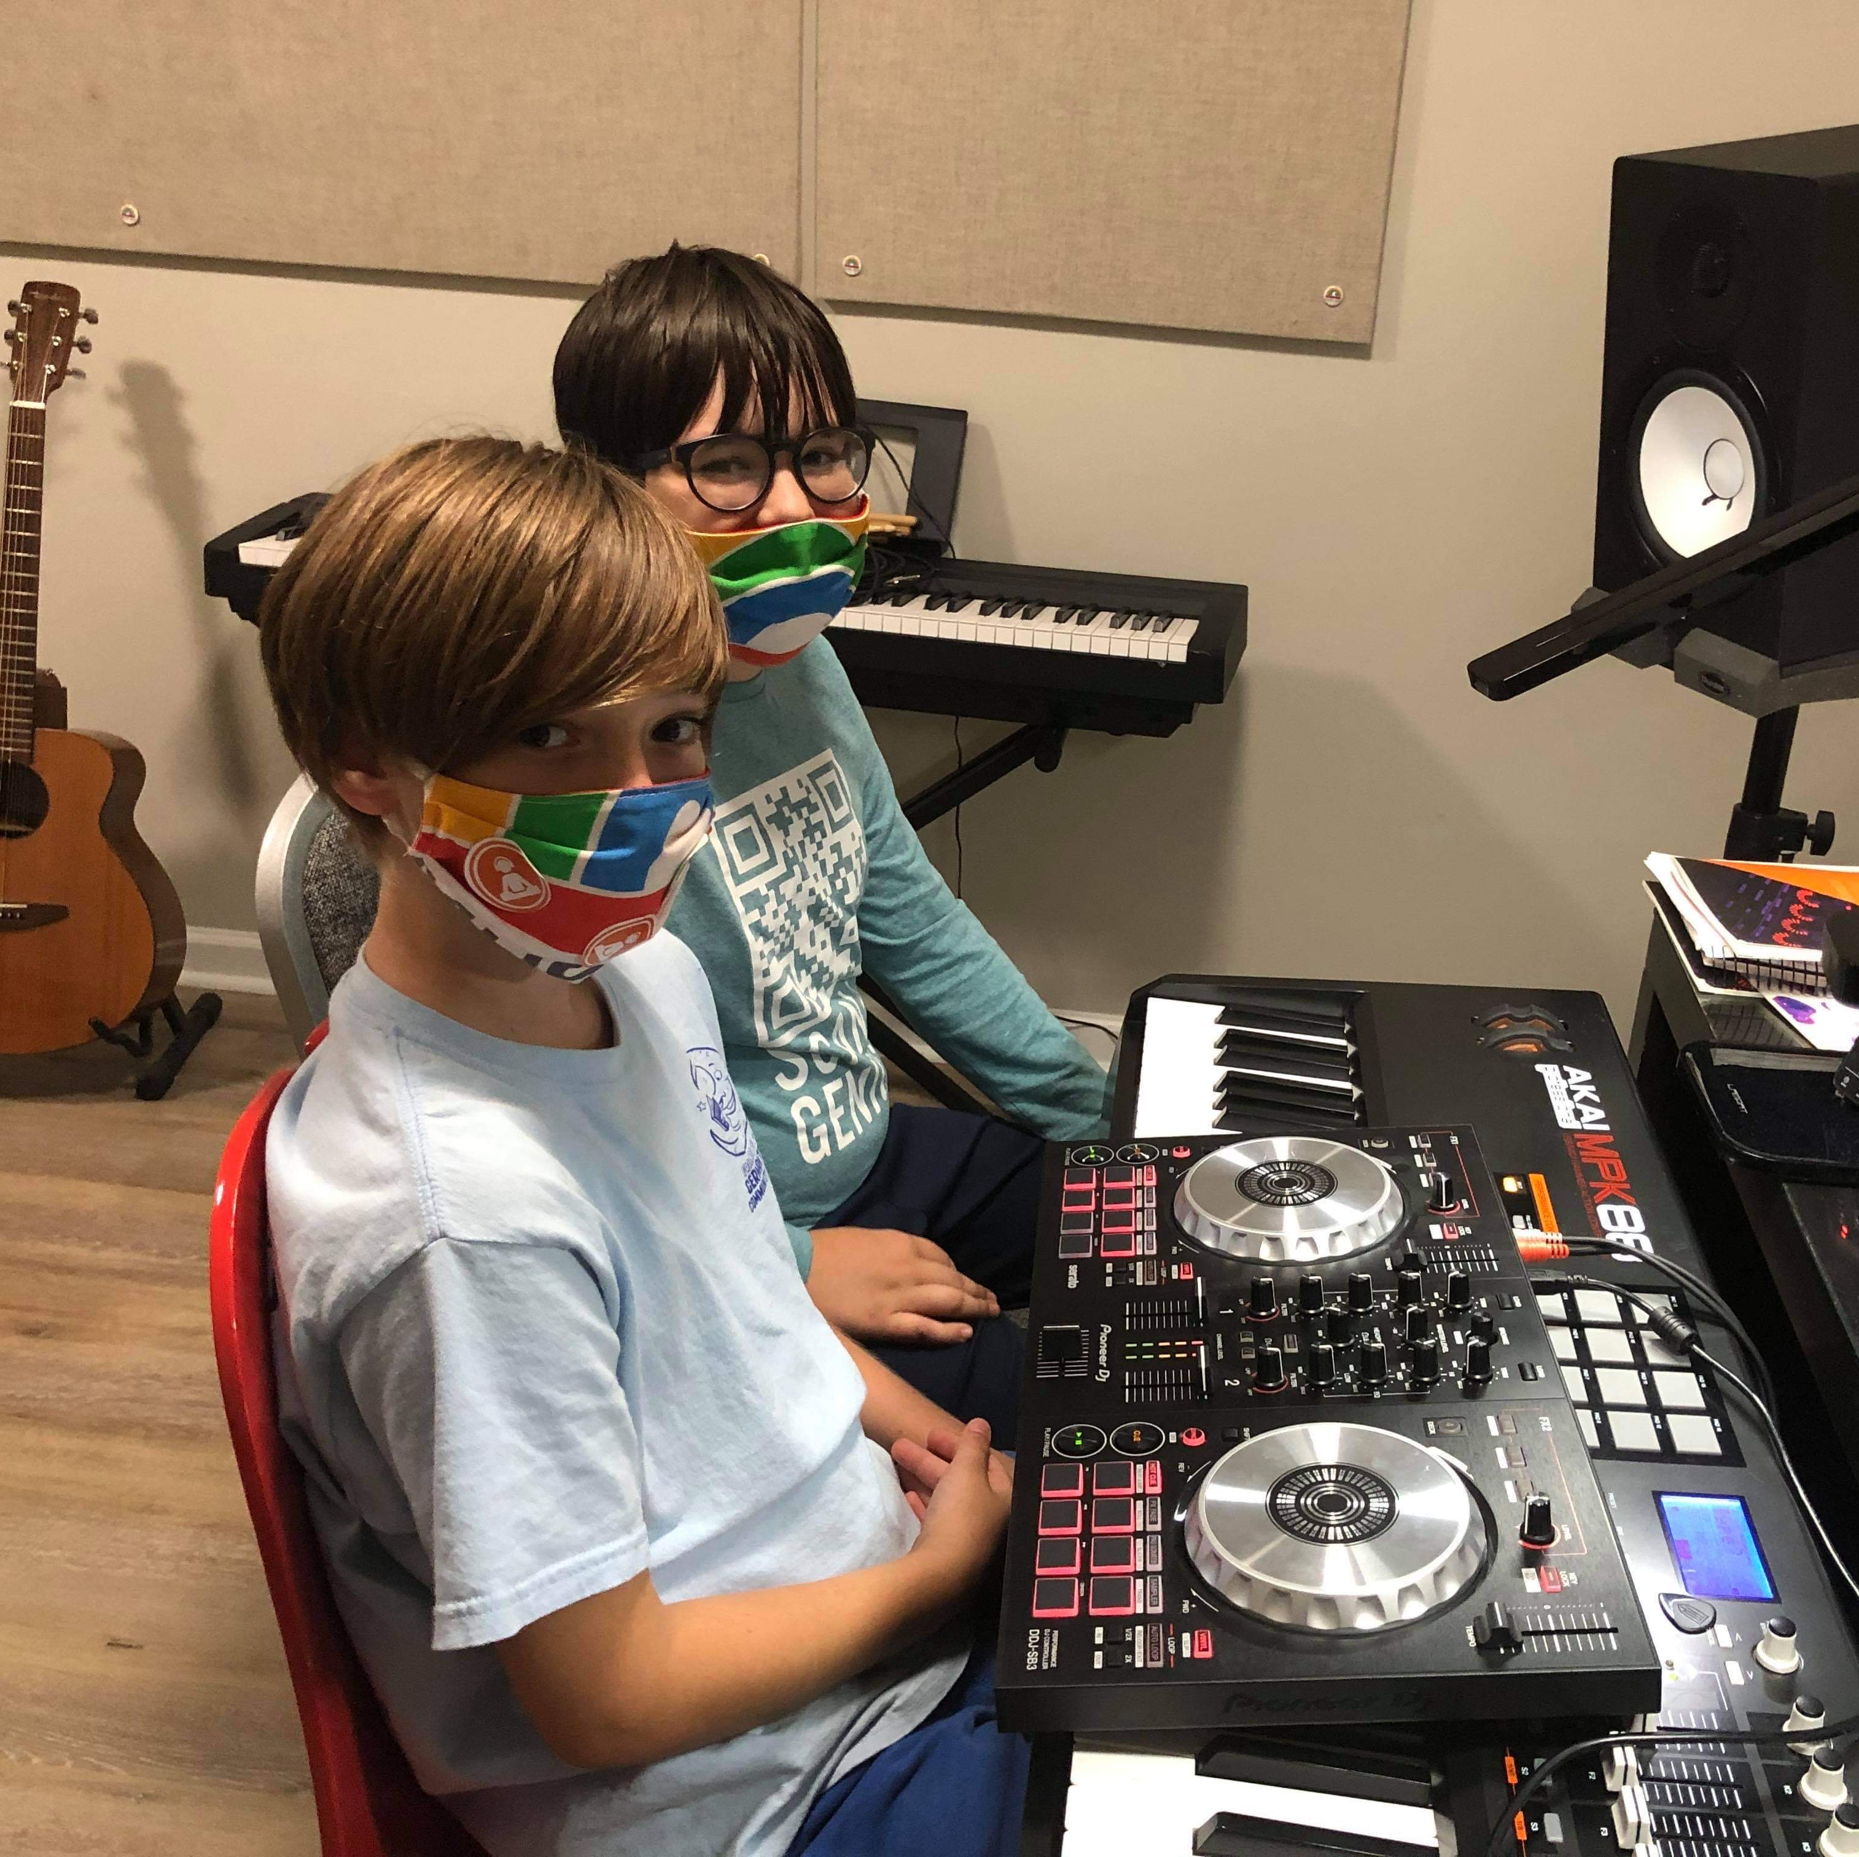
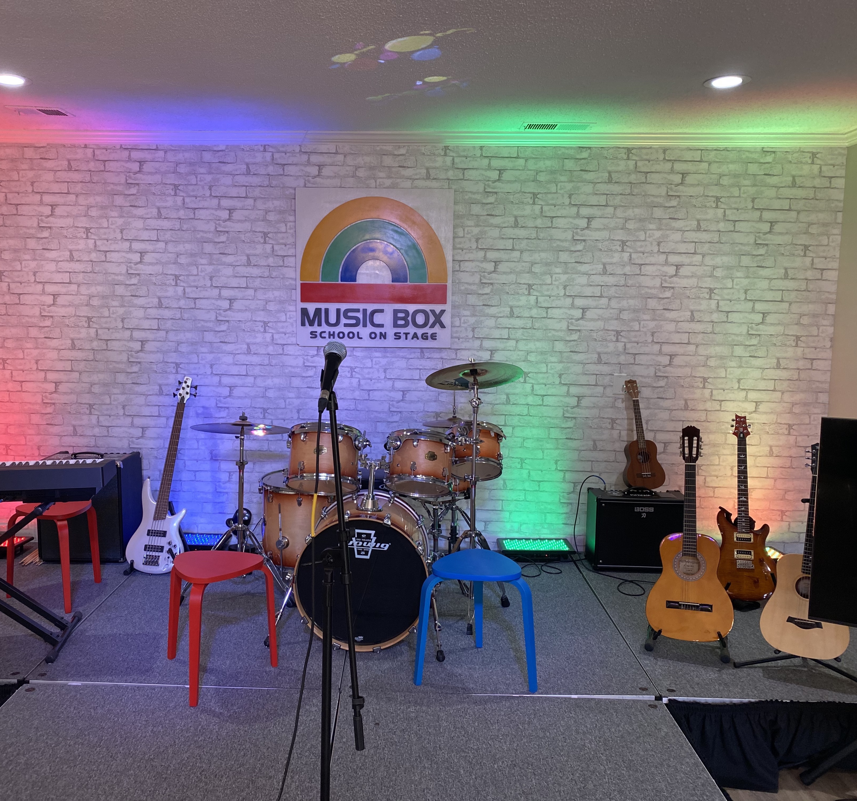
Music Box
7516 Capital Dr. Germantown TN 38138
(901) 626 0973 (text or call) www.musicboxinc.com
info@musicboxinc.com
GMSD employees and students receive 10% off lesson tuition for 3 months or 10% of camp tuition (with code “GMSD”)
We teach guitar, piano, drums, bass, ukulele and voice. Kids and adults. In-person and on-line. In English and Spanish
Free trial lessons and school tours. No contract requirement

Slide 118

Special services discounts

Slide 119

Southern pro pressure washing
(901)-355-2695
ALL GMSD employees will receive 10% off their services from Southern Pro Pressure Washing.
You must mention that you are a GMSD employee.
Take a look at their website to see their great work and services:
https://southernpropressurewashing.com

Slide 120

Herndon brothers lawn care
901-517-4305
ALL GMSD Employees will receive 20% off for a single service.
Must show GMSD ID badge to receive offer.
View their website to see their great work and services they provide!
https://herndonbrotherslawncare.com/

Slide 121

Mcculley roofing & renovations llc.
ALL GMSD employees will receive a free roof upgrade on a full roof replacement.
ALL GMSD employees will receive 20% off any repairs needed on roof work.
Must indicate you’re a GMSD employee to receive these offers.
Contact Chris McCulley today at 901-487-7096 or cmcculley08@yahoo.com

Slide 122

Smith’s plumbing services
6843 Summer Ave, Memphis, TN 38134
ALL GMSD employees will receive 10% off the labor work performed when using Smith’s Plumbing Services.
Mention you’re an employee of GMSD to receive this special offer.
Call today at (901)-290-1110

Slide 123

Inman-murphy termite & pest control
ALL GMSD Employees will receive $150 off the initial treatment cost for termite control.
$50 will be waived for the initial pest control service fee.
Notify the office staff that you are an employee of GMSD to receive this discount.

Slide 124

Alex Ginsburg photographics
Commercial Photography
Positive Image Package
GMSD associates receive a $50 savings....$125 (Reg.$175).
Package includes Business head and shoulder half-hour studio session, custom retouching to make everyone look fantastic, a high-resolution (for printing) & low-resolution digital file (for web and social media posting) from the image of your choice.
Choice of in-studio or on-line proofing options available. Camera shy & apprehensive subjects need to call us first. Sessions are fun and stress free.
Master Photographer with over 30 years experience.
(901)-754-9680
AlexGinsburgPhotographics.com
By appointment Only

Slide 125
Alex Ginsburg photographics
Children and Family Portraits
$50 (value $180.00).
Introductory Special- includes half-hour Studio or studio-garden portrait session plus 1-8x10 Designer Portrait from this session.
Available for single family units (not for extended families) or individual child's portraits (6 mo. or older).
One offer per family. May not be used for Commercial Photography projects.
Master Photographer with over 30 years experience.
(901)-754-9680
AlexGinsburgPhotographics.com
By appointment Only

Slide 126
Alex Ginsburg photographics
Photo-Restoration:
20% off print prices up to $50 savings.
We correct discolored, faded, damaged, and torn photographs and artwork. Perhaps your own image needs professional enhancements and printing. We are here for you. No worry restoration--We're local and your original art or photograph never leaves our studio.
We do not want to risk any additional damage to your original; so, our restoration artists create a new beautiful reproduction of your original that will last for many decades to come.
Free estimates. Call for details.
Master Photographer with over 30 years experience.
(901)-754-9680
AlexGinsburgPhotographics.com
By appointment Only

Slide 127

Gateway tires & service center
ALL GMSD Teachers are eligible for a 10% educator’s discount at all Gateway Tire locations.
Must show GMSD ID badge to receive this offer.

Slide 128

Jiffy lube
ALL Educators are eligible to receive 15% off select services through their “Affinity Discount”
Must have a valid teacher ID
See specifics of this offer below:
https://www.jiffylubesocal.com/oil-change-coupons/affinity-discount/

Slide 129

Advance auto parts
ALL GMSD employees are eligible to receive anywhere from 10-20% off select parts.
Visit your local Advance Auto Parts to find out the great deals available to you.
You must have your GMSD ID badge as proof of working in education.

Slide 130

Spark printing
3895 S Perkins Rd #3, Memphis, TN 38118
ALL GMSD teachers will receive 10% off their printing services.
Must show your GMSD ID badge to receive this offer.

Slide 131

Hotels.com
ALL educators can receive 10% off their hotel stays when they verify their ID with Hotels.com.

Slide 132

General motors
All educators can take advantage of the GM Educator Discount.
The program is available at all GM Dealerships across the country.
Click the following link to find out more about this program and see which vehicles are eligible:
Click Here

Slide 133

Retail discounts

Slide 134

The art project
2092 Trimble Pl, Memphis, TN 38104
ALL GMSD teachers will receive a discount of 10% retail products.
Must show your GMSD ID badge to receive this offer.

Slide 135

canon
Canon offers discounts on select cameras and accessories to teachers, department heads, and administrators from any school or university.
Call 866-50-CANON or email highereducation@cusa.canon.com (source).

Slide 136

Novel bookstore
387 Perkins Extd, Memphis, TN 38117
ALL GMSD teachers will receive 20% off their classroom purchases.
Must show your GMSD ID badge to receive this offer.

Slide 137

ableton
Teachers can get up to 40% off Ableton Live 10 Standard or Suite, plus discounts on Push and Live orders. Proof of employment must be verified online (source).
https://www.ableton.com/en/shop/education/

Slide 138
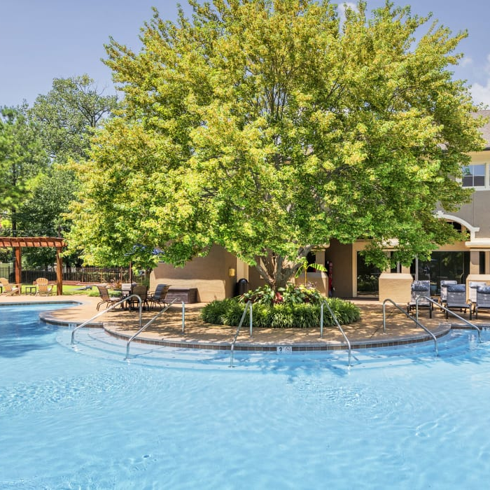
Estates at river pointe
REDUCED APPLICATION FEES $100
$315 SAVINGS (USUAL: $65 FOR APPLICATION, $150 DEPOSIT, $200 NON-REFUNDABLE PROCESSING FEE)
Must show valid teacher ID
https://www.estatesatriverpointe.com/

Slide 139

Fedex office
The National Educators Discount Program from FedEx offers teachers 15% off almost all products and services at all participating FedEx Office locations nationwide.
Learn More Here: http://www.fedex.com/

Slide 140

Staples educator discount
Download the app to start receiving educator discounts.
5% of every purchase someone makes can go directly to your classroom reward’s account
Automatically receive a $5 gift reward added to your classroom rewards account.

Slide 141

Hobby lobby
ALL GMSD Employees will receive 10% off when they pay with school check or credit.

Slide 142

Pencils.com
Pencils.com is proud to offer teachers, administrators and other school officials a 10% discount on all orders.
You will need a Pencils.com account to use the Educator Discount. If you are not already registered with Pencils.com, please create an account using the same email address as your Educator Discount application.

Slide 143

Half price books
Half Price Books gives teachers 10% off with its Educator’s Discount Card.
Apply for an educator discount card by clicking here.

Slide 144

joanns
Save 15% on every purchase when you have your teacher reward card.
Enroll for your discount card here.

Slide 145

Banana republic
All teachers will receive 15% off full-priced merchandise/
Must show your teacher ID badge to receive this offer.
Offer valid in-store purchases only.

Slide 146

loft
All teachers will receive a 15% discount for in-store purchases.
Must show your teacher ID badge to receive discount.
Sign up for additional teacher discount perks.

Slide 147

j. crew
All teachers can receive a 15% discount for online purchases.
You will have to sign-up with your teacher email address in order to receive this offer.

Slide 148

Barnes & noble
Save 20% off publisher’s list price on all purchases for classroom use.
Discounts of up to 25% off the publisher’s list price during Educator Appreciation Days.
Sign Up For Free

Slide 149

The container store
Teachers can receive a discount through their Organized Teacher Discount Program.
*This current discount program is being reformatted and will launch later this year (2021).

