Slide 1
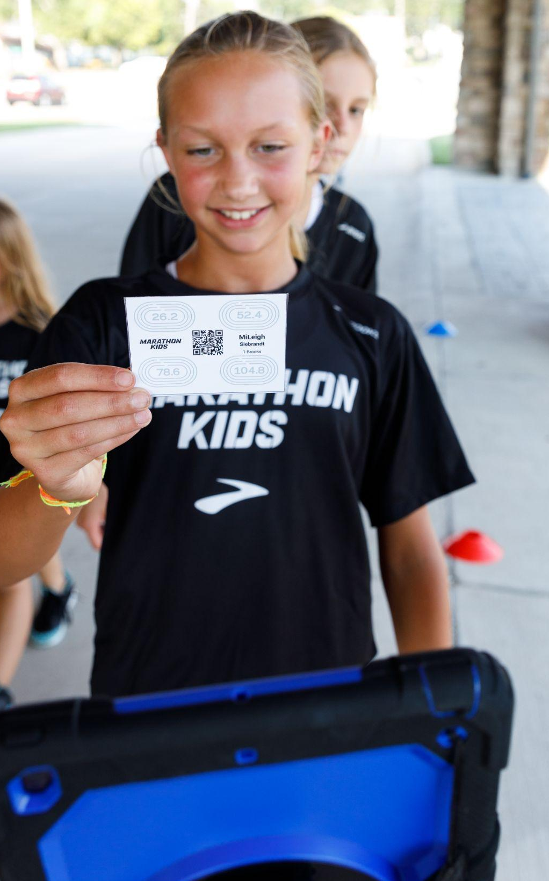
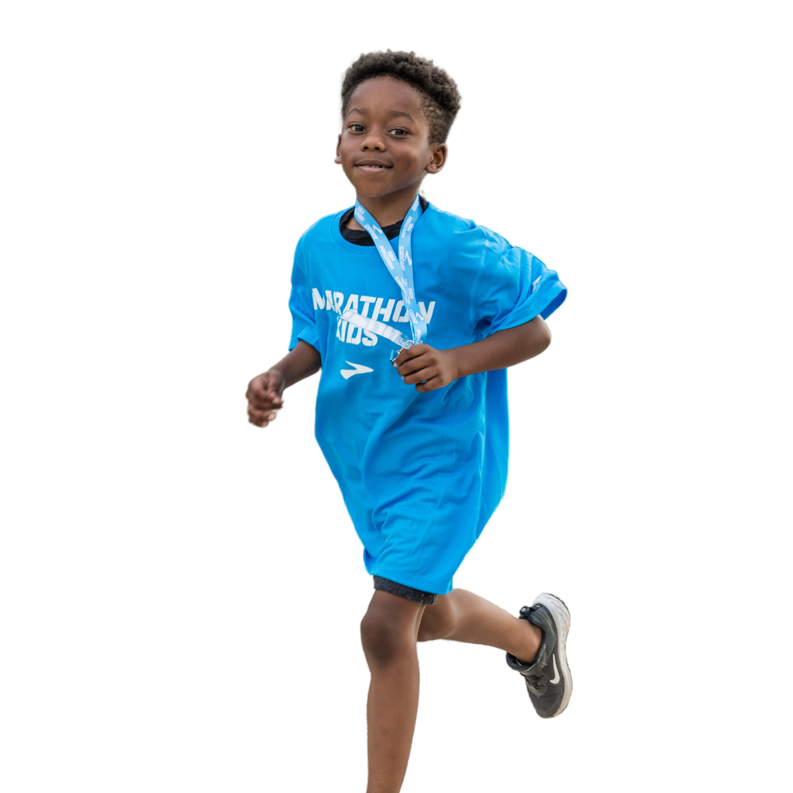
A fun and simple youth running program for anyone.
Let’s get started!
FREE!

Slide 2
Notes:
Play video!

Slide 3
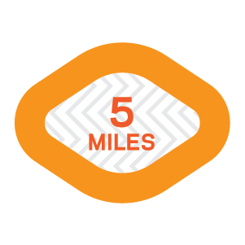
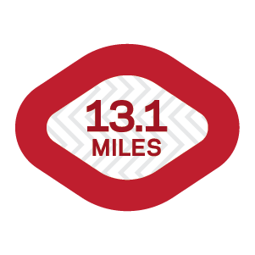
Learn about the free program
Kids build physical and mental endurance
Notes:
The what --
Marathon Kids is a program that utilizes running and goal-setting to provide kids with a positive physical activity experience.
We provide the digital platform to help track student effort, while YOU bring the fun, energy, and encouragement to motivate kids.
The program is implemented in all types of schools and community organizations across the US.

Slide 4
Ways to Implement Marathon Kids
Before/After School Club
During PE Class
Move-a-thons/
Events
Classroom
Brain Breaks
Recess
Notes:
How you implement Marathon Kids is up to you.
Unlimited number of students can participate!

Slide 5
Digital
Platform
The web account equips you to manage your program and monitor achievements all season long
Notes:
FREE! This platform helps you track laps and minutes of activity!
The digital platform comes in two parts that work together.
The first part is your web account where you manage your account. This is where you add runners, print ID cards, and view the data.. It’s easy to navigate and you can invite others as Supporters to help you manage the club. You will visit your dashboard often to keep the entire club up to date! For this part think laptop/desktop.

Slide 6
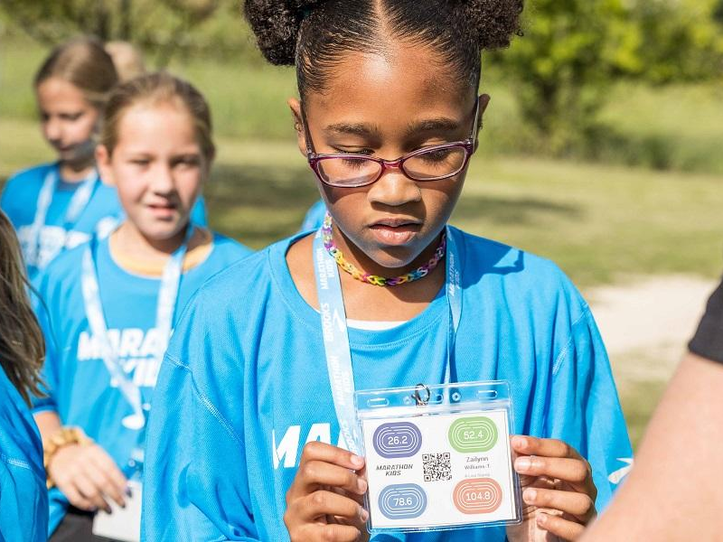
Scanning App
Mobile and Tablet friendly
iOS and Android
No WiFi required
Allows multiple devices
15-second Double Scan Buffer
Notes:
The second piece of the digital platform is the Scanner app. It is solely used to scanner runner ID cards. You can not see your account information here.
It is available on iOS and Android devices -- phones, tablets, iPads and Chromebooks.
No wifi is required to scan participant ID cards.
This means you will login with WiFi but can take the device away from the building to scan ID cards then stop that live session so the data is stored locally on that device to be resubmitted at a later time.

Slide 7
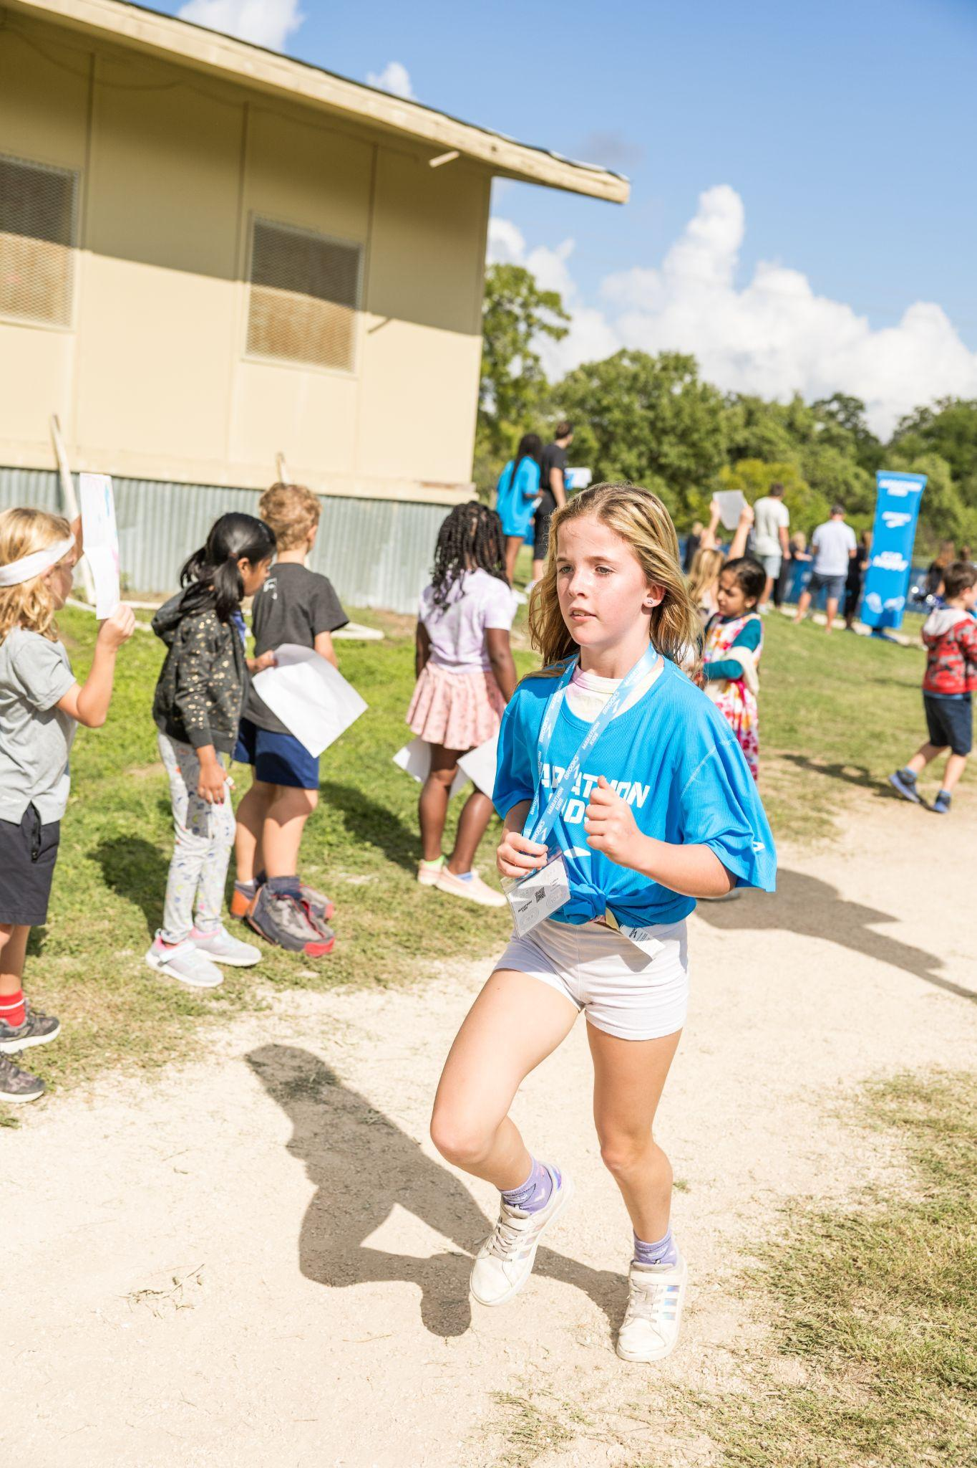
Next Steps: JOIN US!
1. Go to marathonkids.org
2. Click “Log in”, then “Sign Up”
3. Create Coach Account.
TIP: Click the icon for help

Slide 8
Thank You
MARATHON KIDS, INC.
SUPPORT@MARATHONKIDS.ORG
WWW.MARATHONKIDS.ORG

