Slide 1
HEAT RELATED ILLNESSES

Slide 3
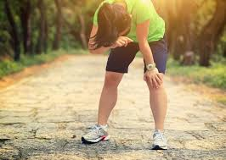
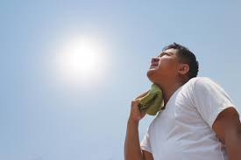
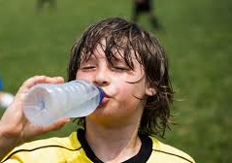
Heat Related Illnesses
Heat Cramps
Heat Exhaustion
Heat Stroke

Slide 4
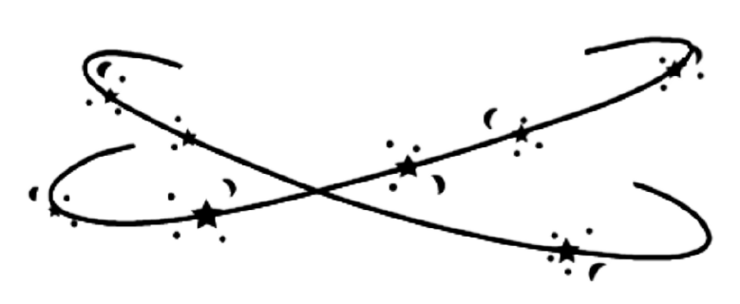
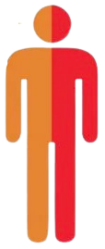
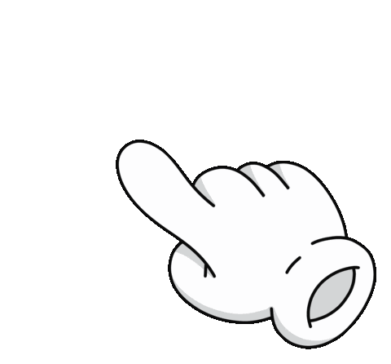
Heat cramps
DEFINITION
The rapid loss of water and salt in the body due to sweating. This process cause muscles to cramp during exercise
VIDEO
SYMPTOMS
TREATMENT
Stop and rest from activity
Drink small amounts of water slowly
Stretch and massage the muscle
EXCESSIVE SWEATING
MUSCLE CRAMPS
HEADACHES

Slide 5
Heat EXHAUSTION
DEFINITION
The process of the body shutting down due to excessive fluid loss due to overexertion in hot temps
VIDEO
SYMPTOMS
TREATMENT
EXCESSIVE SWEATING
Get to a cool place and rest
Slowly sip water
Loosen clothing and apply wet cool towel
Call 9-1-1 if person refuses treatment or loses consciousness
FAINT/DIZZY
MUSCLE CRAMPS
COLD/CLAMMY
NAUSEA OR VOMITING
RAPID WEAK PULSE

Slide 6
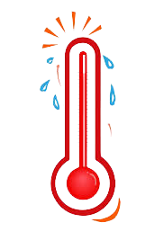
Heat STROKE
DEFINITION
Heat stroke is the process of the body's cooling system shutting down. The body can no longer cool itself. It is life threatening.
VIDEO
TREATMENT
SYMPTOMS
MAY LOSE CONSCIOUSNESS
CALL 9-1-1 immediately
Move to a cool location and cool the body with rats, ice packs, or fans
Monitor breathing
Lay the victim down
NO SWEATING
BODY TEMP ABOVE 103
RED, HOT DRY SKIN
RAPID, STRONG PULSE
THROBBING HEADACHE
NAUSEA OR VOMITING

Slide 7
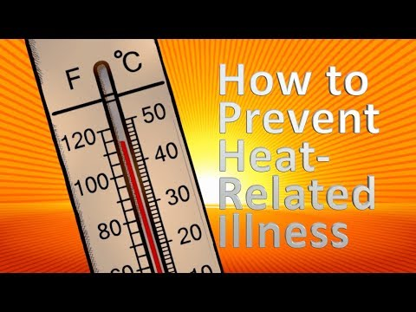

Slide 11
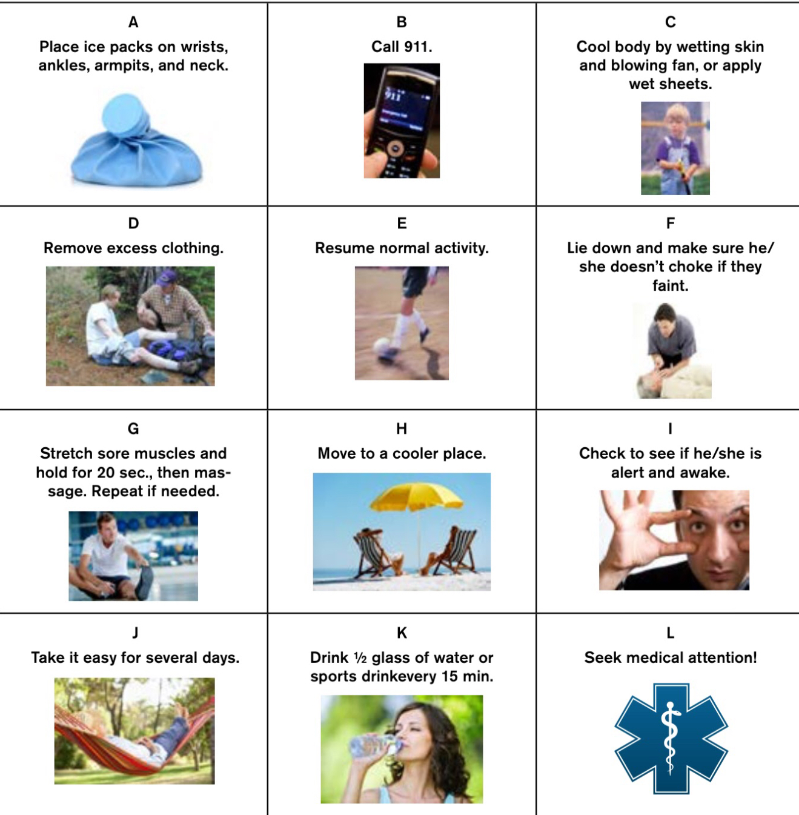
DIAGNOSIS
Delete the heat illnesses that are not correct for this scenario.
Heat cramps
Heat exhaustion
Heat STROKE
Use the RED “X” to eliminate the treatments that would NOT help in this scenario. Select the X and make copy for each wrong treatment. Place the X on the wrong answers.

Slide 12
DIAGNOSIS
Delete the heat illnesses that are not correct for this scenario.
Heat cramps
Heat exhaustion
Heat STROKE
Use the RED “X” to eliminate the treatments that would NOT help in this scenario. Select the X and make copy for each wrong treatment. Place the X on the wrong answers.

Slide 13
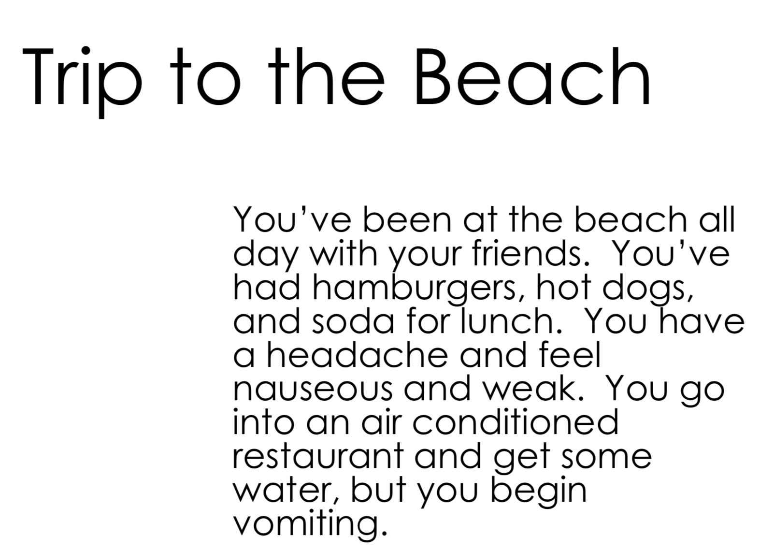
DIAGNOSIS
Delete the heat illnesses that are not correct for this scenario.
Heat cramps
Heat exhaustion
Heat STROKE
Use the RED “X” to eliminate the treatments that would NOT help in this scenario. Select the X and make copy for each wrong treatment. Place the X on the wrong answers.

Slide 14
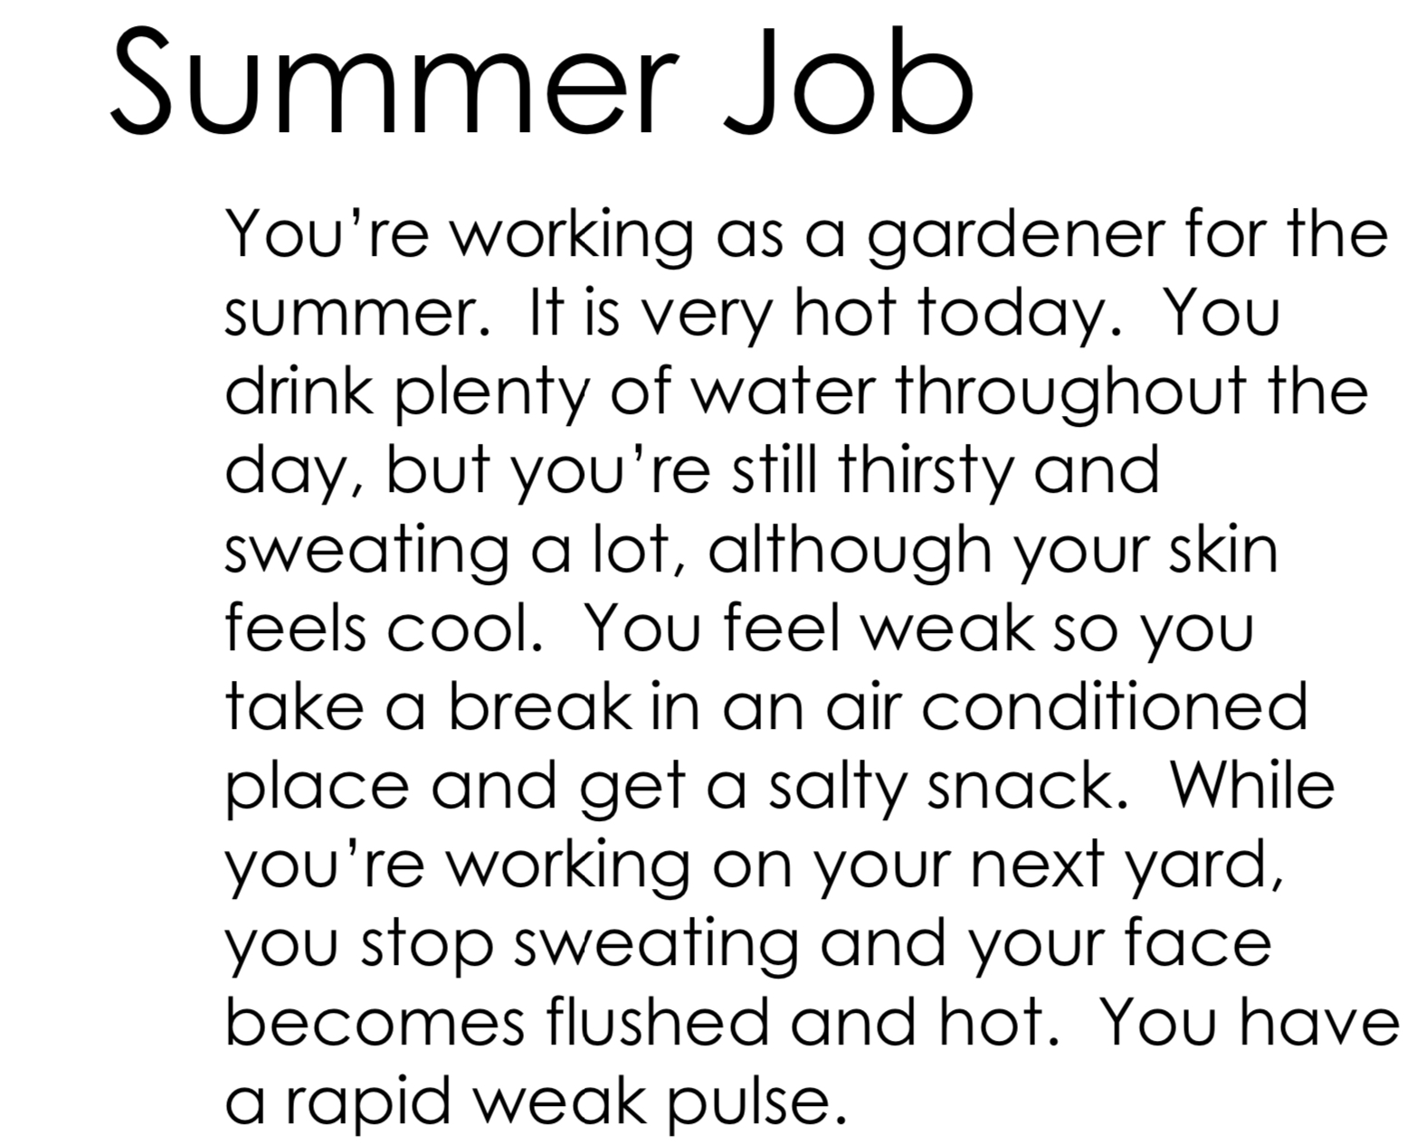
DIAGNOSIS
Delete the heat illnesses that are not correct for this scenario.
Heat cramps
Heat exhaustion
Heat STROKE
Use the RED “X” to eliminate the treatments that would NOT help in this scenario. Select the X and make copy for each wrong treatment. Place the X on the wrong answers.

Slide 15
DIAGNOSIS
Delete the heat illnesses that are not correct for this scenario.
Heat cramps
Heat exhaustion
Heat STROKE
Use the RED “X” to eliminate the treatments that would NOT help in this scenario. Select the X and make copy for each wrong treatment. Place the X on the wrong answers.

Slide 16
DIAGNOSIS
Delete the heat illnesses that are not correct for this scenario.
Heat cramps
Heat exhaustion
Heat STROKE
Use the RED “X” to eliminate the treatments that would NOT help in this scenario. Select the X and make copy for each wrong treatment. Place the X on the wrong answers.

Slide 17
DIAGNOSIS
Delete the heat illnesses that are not correct for this scenario.
Heat cramps
Heat exhaustion
Heat STROKE
Use the RED “X” to eliminate the treatments that would NOT help in this scenario. Select the X and make copy for each wrong treatment. Place the X on the wrong answers.

Slide 18
DIAGNOSIS
Delete the heat illnesses that are not correct for this scenario.
Heat cramps
Heat exhaustion
Heat STROKE
Use the RED “X” to eliminate the treatments that would NOT help in this scenario. Select the X and make copy for each wrong treatment. Place the X on the wrong answers.

Slide 19
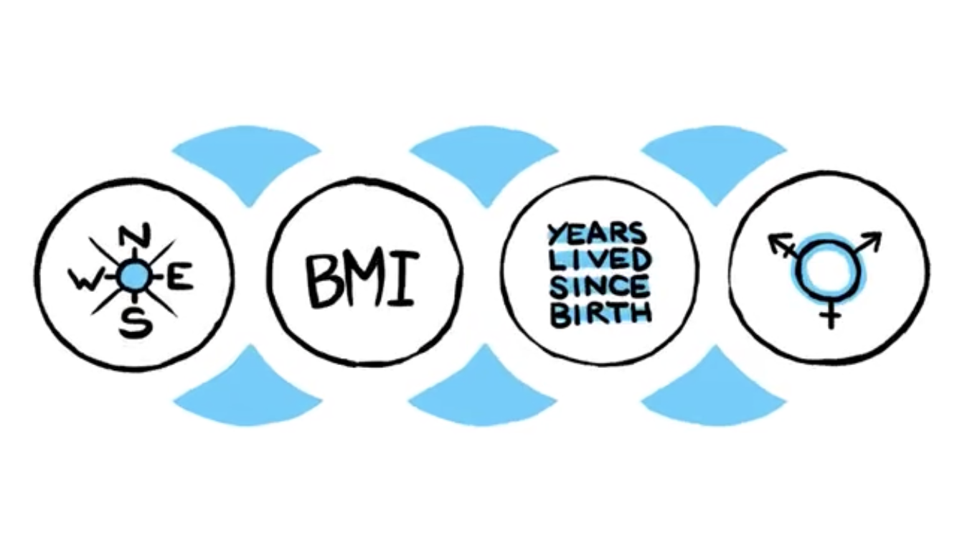
HYDRATION
PERIOD 1
PERIOD 2
PERIOD 3
PERIOD 4
PERIOD 6

Slide 20
HOW MUCH WATEr DO I NEED?
How much fluid do you need on a daily basis when you are at home? While some of this depends on your level of physical activity, a general rule of thumb for ounces of fluids used in a day-to-day activities is your weight divided by 2.
Calculate Your Fluid Needs
Use this formula to figure out your at home daily fluid needs:
Weight: divided by 2 = ounces of fluid needed daily.

Slide 21
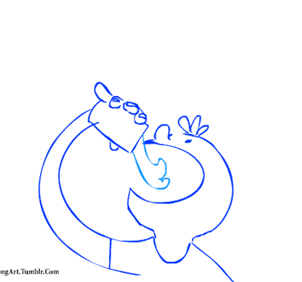
HYdration game plan on a school day
You nEEd to drink your weight in fluids
Weight
Divide the number of ounces you need to consume on a school day
Number of ounces of fluid to drink before the end of the day or on a game day
Before school I need oz of fluids.
During school I will need oz. of fluids
After school I will need oz. of fluids.

