Slide 1
Escape the vape
https://www.youtube.com/watch?v=oXkKFLPbOxo

Slide 2
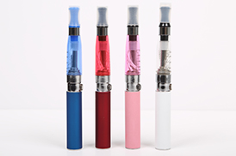
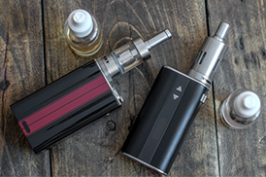
What are e-cigarettes
E-cigarettes are a type of Electronic Nicotine Delivery System (ENDS), that look like futuristic, mechanical cigars or like everyday household devices such as thumb drives, pens, sticks of gum, or erasers. Most of the e-liquids contain highly concentrated nicotine along with other potentially toxic chemicals.

Slide 3
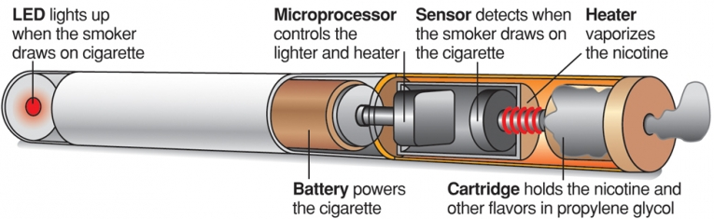
Components of E-Cigarettes
Parts of a typical E-Cigarette
Battery
Microprocessor
Heater/Atomizer
Cartridge/Tank
Image Source: Standard-Examiner
Notes:
So what are the components of an e-cigarette?
All e-cigarettes contain 4 basic parts: a battery, a microprocessor, a heater or atomizer, and a cartridge or tank.
There are many variations on the mechanism, but the basic process is the same: The microprocessor senses when the user inhales on the end of the e-cigarette and, on this cue, instructs the heater/atomizer to vaporize the liquid, which the smoker inhales through the mouthpiece. The vapor is then drawn into the lungs in the same way that a regular cigarette is inhaled.

Slide 4
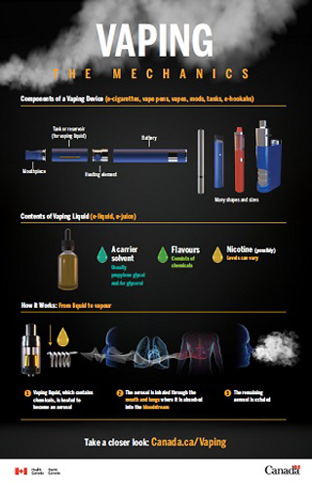
How it Works: From liquid to vapor
Vaping liquid, which contains chemicals, is heated to become an aerosol
The aerosol is inhaled through the mouth and lungs where it is absorbed into the bloodstream
The remaining aerosol is exhaled

Slide 6
Concerns
1. E-cigarettes contain nicotine, a highly addictive chemical that is particularly risky to teens and young adults.
Nicotine can also increase the risk of developing addiction to other drugs and various mental and physical health problems later in life.
The majority of vaping products contain high doses of nicotine.

Slide 7
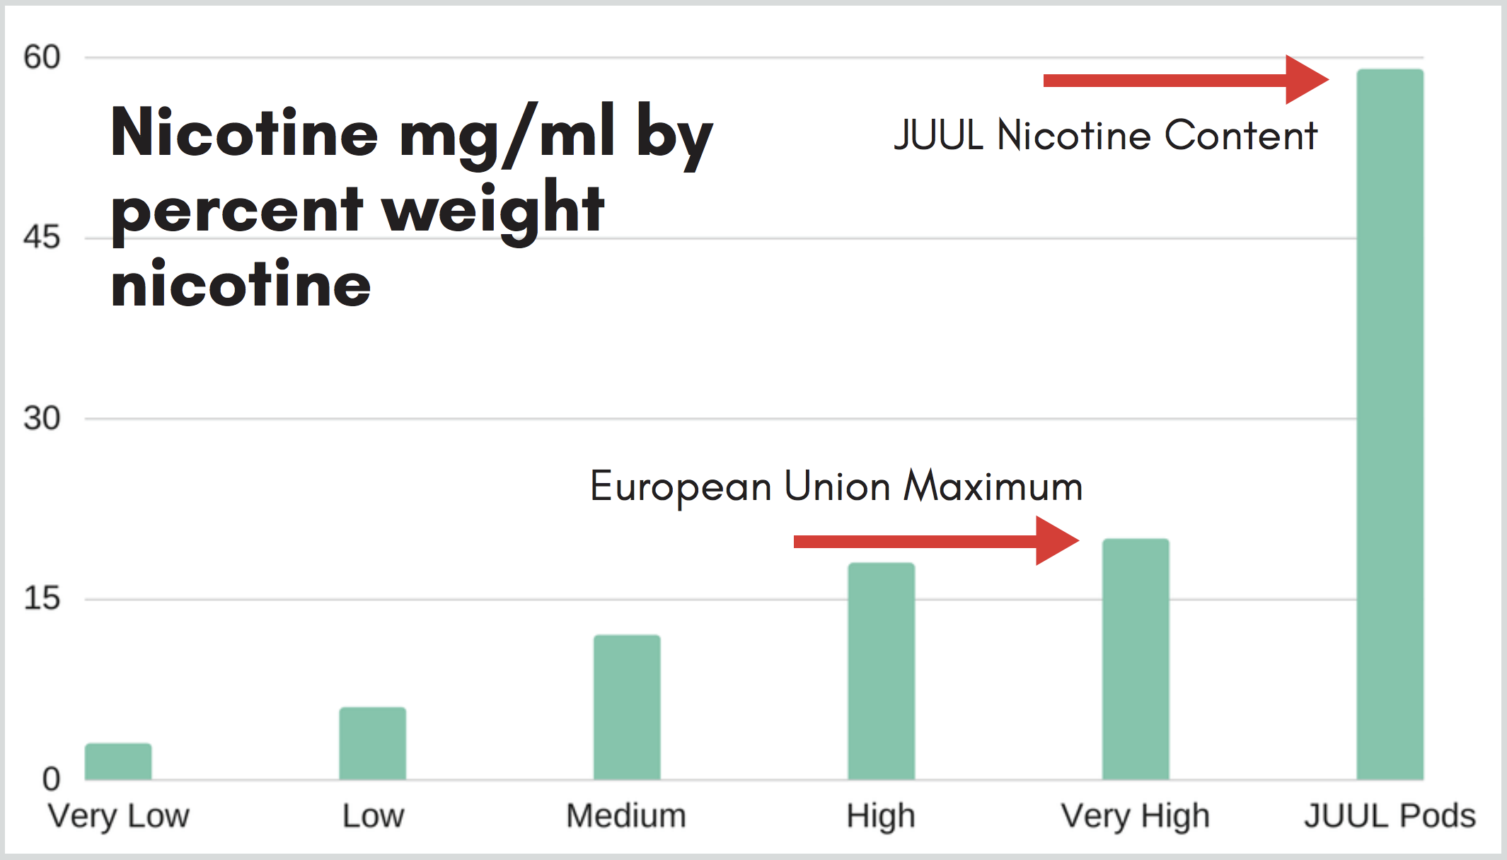
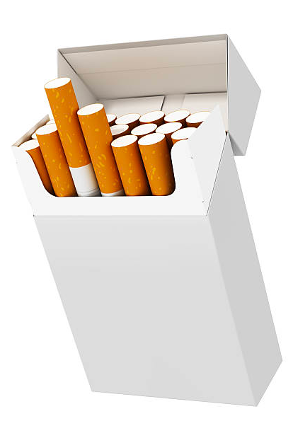
Nicotine content in juul
=
1 JUUL Pod
1 Pack of Cigarettes
https://www.youtube.com/watch?v=1OGI4f6IwnM
Notes:
JUUL Pods have an incredibly high nicotine concentration, which puts each puff from a JUUL on par with the nicotine delivered in a puff from a traditional cigarette. This is not the norm for e-cigarettes. In fact, JUULs are more than double the maximum concentration allowed in the European Union, and the sale of JUUL devices was recently banned in Israel because of their remarkably high nicotine content.
The amount of nicotine in a single JUUL Pod is equal to the amount of nicotine found in an entire pack of cigarettes and includes roughly the same number of “puffs” (200).

Slide 8
Concerns
2. E-cigarettes contain other chemicals that pose a danger to teen's health.
Aerosols from these products have been found to contain various toxic chemicals, heavy metals and ultrafine particles, all of which pose health risks.
E-juice has been proven to effectively prevent immune cells from doing their job.
https://www.youtube.com/watch?v=oHi_zJR7pq0

Slide 9
Concerns
3. Tobacco companies are marketing these products to teens by offering hundreds of kid-friendly flavors
There are laws that prohibit companies from marketing traditional cigarettes to teens but those laws don’t apply to electronic cigarettes.
Juulers Against Juul https://www.youtube.com/watch?v=7EsNG7RcStQ

Slide 10
Vitamin E
4. Damage to the lungs
An unprecedented outbreak of vaping-associated pulmonary injury (VAPI) has sickened up to 450 people and killed as many as eight in 33 states. A current suspect in the outbreak is vitamin E acetate, sometimes used as a vape cartridge additive. It’s a popular new diluent thickener found mostly in illicit market THC vape carts.
All these forms of vitamin E oil go into foot creams, face creams, and other cosmetics as topicals. In some people it can cause rashes.
The cosmetics industry never considered its use for inhalation, at least beyond accidentally getting some lotion in your nose. Its acute inhalation toxicity is not known, and inhaling oil is generally a bad idea.
https://www.msn.com/en-ca/video/news/heres-what-doctors-think-could-be-behind-the-new-vaping-illness/vi-AAHrJ6J

Slide 11
many of the 450 people affected are young people, with an average age of 19.
One of the most shocking stories was of 18-year-old Simah Herman, who posted a picture of herself online after waking up from a medically induced coma.
After receiving treatment for pneumonia and lung failure, she wants to warn others against using vapes and e-cigarettes.
Simah's story, and that of other vape users, have raised questions about how safe vaping is and how well regulated the industry is.
https://www.youtube.com/watch?v=Q4pT1-QWvQU

Slide 12
concerns
5. The spread of e-cigarettes and other vaping devices may be re-normalizing smoking behavior.
The increase in popularity of nicotine devices and their widespread availability is reversing the progress made over decades of intense global, national, and local efforts to reduce cigarette smoking, especially among young people.

Slide 13
Smoking Risks Addiction/Dependence
Teens and young adults who vape are almost 4 times as likely as their non-vaping peers to begin smoking traditional cigarettes
Dependence develops when the body adapts to repeated exposure to vaping. When a person stops vaping, he or she can experience withdrawal symptoms
https://twitter.com/KnowTheRealCost/status/1095321680707272706

Slide 14
Cancer and Respiratory effects Injuries and Poisoning
There is some concern that vaping can increase coughing and wheezing in teens and may exacerbate asthma.
Exposure to e-liquids from drinking, either on purpose or by accident, eye or skin contact, or injection can result in seizures, brain injury due to lack of oxygen, vomiting, problems related to lactic acid buildup in the body or death.
https://www.youtube.com/watch?v=-wRx6-bsbSQ

Slide 15
E-Cigarette Explosions
Vape devices, especially those with poor quality batteries, or that have been stored improperly or modified by the user, can explode resulting in burns and other injuries.
In 2019, a 24-year-old man from Texas died when his vape pen's battery blew up sending shards of metal into his face and neck and severing an artery

Slide 16
SAAVE Stop Addicting adolescents to Vaping and E-Cigarettes Canada
The group Stop Addicting Adolescents to Vaping and E-cigarettes consists of university and high school students, professors of medicine, physicians and community members. It is calling for much stricter regulation of vaping. Specifically, it calls on all levels of government:
To require that vaping device and e-juice sales be sold only from behind a pharmacy counter and only to adults;
To prevent internet sales;
To ban all flavours, except tobacco;
To ban vaping everywhere that smoking of tobacco cigarettes is banned;
To ban all advertising of vaping devices and accessories;
To require all devices and e-juice to be sold in plain packaging;
To regulate the e-liquids strictly to reduce toxins, and to ensure that the true amount of nicotine is reported and all other toxic elements are described on the label;
To control the manufacture of the actual devices to ensure safety.
https://globalnews.ca/video/rd/1441623107807/?jwsource=cl https://www.youtube.com/watch?v=vwcJC_xLhfc&t=1s

Slide 17
Burning Questions
1. How accessible are Vapes?
2. Is Vaping A Concern?
3. Does the government have a responsibility to better Regulate E-Cigarettes?
4. What can Students do to help those addicted to Vaping?
5. What can the school do to help those addicted to vaping?

Slide 18
Related Articles
https://www.cnn.com/2018/05/17/health/case-study-teen-vaping-wet-lung/index.html
https://globalnews.ca/news/3990600/delta-teen-vaping-regulations/
https://vancouversun.com/news/local-news/teen-baseball-player-14-in-delta-dies-of-serious-injuries
https://www.deseretnews.com/article/900040111/park-city-9th-grader-hospitalized-after-smoking-thc-from-vape-pen-school-officials-say.html
https://globalnews.ca/video/4518654/the-growing-addiction-and-attraction-to-vaping-among-teens
https://www.sciencenewsforstudents.org/article/concerns-explode-over-new-health-risks-vaping
https://e-cigarettes.surgeongeneral.gov/knowtherisks.html
https://www.youtube.com/watch?v=EmjVU_jZYV0

