Slide 1
Driving Record Information

Slide 2
The Pennsylvania Point System
The purpose of the point system is to help to improve driving habits and to ensure safe driving. Points are added to a driving record, when a driver is found guilty of certain driving violations. PennDOT begins to take corrective action when, a driving record reaches six (6) or more points.
When a driving record reaches six (6) or more points for the first time, the driver will receive a written notice to take a written special point examination. When the driving record is reduced below six (6) points and reaches six (6) or more points for a second time, the driver will have to attend a Departmental hearing.
Further accumulations of six (6) or more points will result in additional departmental hearings and/or suspensions to your driving privilege.
In addition to these requirements, the driving privilege of a person under the age of 18 will be suspended if that person accumulates six (6) or more points or is convicted of driving 26 mph or more over the posted speed limit. The first suspension will be for a period of 90 days. Any additional occurrences will result in a suspension of 120 days.

Slide 3
Vehicle Code Description # of Points
1512 Violation of restriction on driver's license - wearing glasses, etc. 2
1571 Violation concerning license 3
3102 Failure to obey authorized persons directing traffic 2
3112(a)(3)(i) or (ii) . Failure to stop for a red light 3
3114(a)(1) Failure to stop for a flashing red light 3
3302 Failure to yield half of roadway to oncoming vehicle 3
3303 Improper passing, overtaken driver to maintain speed; passing driver to pull in at safe distance 3 ______________________________________
3304 Improper passing on the right 3
3305 Improper passing on the left, clear distance ahead 3
3306(a)(1) Improper passing on a hill 4 Passing
3306(a)(2) Improper passing at a railroad crossing or intersection. 3
3306(a)(3) Improper passing at a bridge or tunnel 3
3307 Improper passing in a no-passing zone 3_______________________________________
3310 Following too closely 3
3321 Failure to yield to driver on the right at intersection 3
3322 Failure to yield to oncoming driver when making left turn 3
3323(b) Failure to stop for stop sign 3
3323(c) Failure to yield at yield sign 3

Slide 4
Vehicle Code Description # of Points
3324 Failure to yield when entering or crossing roadway between intersections 3
3332 Improper turning around - illegal U-turns 3
3341(a) Failure to obey signal indicating approach of train 2
3341(b) Failure to comply with crossing gate or barrier 30-day suspension and 4
3342(b) or (e) Failure to stop at railroad crossings 4
3344 Failure to stop when entering from alley, driveway or building 3
3345(a) Failure to stop for school bus with flashing red lights 60-day suspension and 5
3361 Driving too fast for conditions (if violation occurs in an active work zone and in
conjunction with an accident, 15-day suspension and 2
3362 Exceeding maximum speed (Miles over Speed Limit): 6 to 10 ____________________________________________
11 to 15 (if violation occurs in an active work zone, 15-day suspension) and 3
16 to 25 (if violation occurs in an active work zone, 15-day suspension) and 4
26 to 30 (if violation occurs in an active work zone, 15-day suspension) and 5
3 1 and over Departmental Hearing and Sanctions provided under Section 1538(d) and 5
(if violation occurs in an active work zone, 15-day suspension) Speeding
3365(b) Exceeding special speed limit in school zone 3
3365(c) Exceeding special speed limit for trucks on downgrades 3________________________________________________
3542(a) Failure to yield to pedestrian in crosswalk 2
3547(a) Failure to yield to pedestrian on sidewalk when entering from a driveway or alley 3
3549(a) Failure to yield to blind pedestrians 3
3702 Improper backing 3
3714(a) Careless driving 3
3745 Leaving scene of accident involving property damage only 4

Slide 5
Point Removal
Three (3) points are removed from a driving record for every 12 consecutive months in which a person is not under suspension or revocation or has not committed any violation, which results in the assignment of points or the suspension or revocation of the driving privilege.
Once a driving record is reduced to zero and remains at zero points for 12 consecutive months, any further accumulation of points is treated as the first accumulation of points.

Slide 6
SUSPENSIONS AND REVOCATIONS
Your driving privilege will be suspended or revoked, if you are convicted of any one of the following
traffic violations (this is only a partial listing)
If your driving privilege is going to be suspended or revoked, a written notice will be mailed to you listing the date when the suspension/revocation will begin. Your driver's license and/or learnerʼs permit must be returned to the Bureau of Driver Licensing by the effective date of suspension listed on the notice, or the state police and local police will be notified to pick up the driverʼs license.
• Operating a vehicle while under the influence of drugs or alcohol.
• Felony involving a vehicle.
• Homicide by vehicle.
• Reckless driving.
• Racing on highways.
• Fleeing from a police officer.
• Driving when your driverʼs license is already suspended or revoked.
• Driving without lights to avoid identification.
• Failure to stop when you are driving a vehicle involved in a crash (hit-and-run offense).
• Second or any additional offense of driving without a valid driverʼs license within a 5-year period.
• Failure to stop for a school bus with its red lights flashing and stop arm extended (60-day suspension).
• Failure to comply with a railroad crossing gate or barrier (30-day suspension

Slide 7
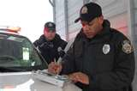
SUSPENSIONS AND REVOCATIONS
No credit toward serving the suspension or revocation shall be earned until the driver's license/learnerʼs permit is surrendered to PennDOT.
In addition to serving the suspension or revocation, proof of payment for any fines and costs owed, proof of insurance (financial responsibility), and a restoration fee must be paid before your driving privilege will be restored.
After your driving privilege is restored, your driving record will show five (5) points, regardless of the number of points that appeared on your record before your driving privilege was suspended, except in the cases of:
• Underage drinking.
• A 15-day suspension resulting from a hearing for the second accumulation of six (6) points.
• Suspension for failing to respond to a citation.

Slide 8
DRIVING WITHOUT INSURANCE
According to Pennsylvania state law, you must maintain automobile liability insurance on your registered vehicle at all times.
If PennDOT finds your vehicle was not covered by insurance for a period of 31 days or longer, your registration will be suspended for three (3) months. In addition, if you operated or permitted the operation of your vehicle without insurance, your driving privilege will also be suspended for a period of three (3) months.
In order to have your driving privilege and registration restored, you must submit the following:
Proof your vehicle is currently insured.
The required restoration fees.

Slide 9
WHAT TO DO IF YOU ARE STOPPED BY THE POLICE
You will know a police officer wants you to pull over when he or she activates the flashing red and blue lights on top of the police vehicle. In some instances, an unmarked police vehicle may be equipped with a flashing red light only.
For your safety and the safety of others, police recommend you do the following:
1. Activate your turn signal and drive as close as safely possible to the right edge of the road, stop, and park your vehicle safely away from traffic.
2. Turn on your vehicleʼs interior light as soon as you stop and before the officer approaches, if it is nighttime.
3. Limit your movements and the movements of your passengers - do not reach for anything in the vehicle.
4. Alert the officer immediately, if your are transporting any type of firearm.
5 . Place your hands on the steering wheel, and ask any passengers to have their hands in view.
6. Keep your vehicle doors closed as the officer approaches, and stay inside your vehicle, unless the officer asks you to get out.
Keep your seat belt fastened until the officer has seen you are appropriately restrained.
Wait until the officer asks you to retrieve your driverʼs license, registration and insurance cards.
Do not hand the officer your wallet - just the requested items.
Always be polite. The officer will tell you what you did wrong. You may receive only a warning or you may be cited for a traffic violation.
If you disagree with the citation, you are entitled to a court hearing where you can present your arguments. It is not in your best interest to argue with the officer at the scene. If you believe you have not been treated in a professional manner, you should contact the appropriate police department at a time following the traffic stop, and ask for a supervisor.

Slide 10
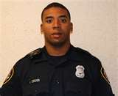
WHAT TO DO IF YOU ARE STOPPED BY THE POLICE
Remember, police lights can be both red and blue and could be red only on unmarked police vehicles. You may also see flashing white lights used in addition to these lights.
If the vehicle is flashing only blue lights, then it is not a police officer.
If you see flashing red and blue lights or flashing red lights only and you are still not certain the person pulling you over is actually a police officer, you may drive to the nearest well-lit, populated area, but acknowledge you understand the request to stop by turning on your flashers and driving at a reduced speed. You may ask the officer for identification, and should do so if the individual who has stopped you is not in uniform or has an unmarked vehicle. Most officers in unmarked vehicles are wearing police uniforms, and police officers always possess a photo ID card and a badge.

Slide 11
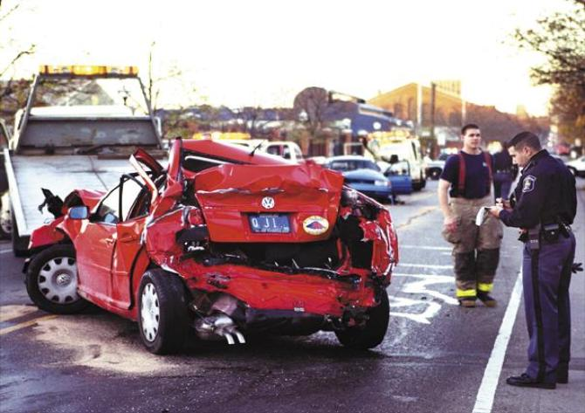
CRASHES
Do not stop at a crash unless you are involved or if emergency help has not yet arrived. Keep your attention on your driving and keep moving, watching for people who might be on or near the road.
Do not block the way for police, firefighters, ambulances, tow trucks and other rescue vehicles.
If you are in a crash, you should do the following:
1. Stop your vehicle at or near the crash scene. If you can, move your vehicle off of the road so you do not block
traffic.
2. Call the police, if anyone is hurt or dies. If the drivers of the vehicles are hurt and cannot call the police, then
witnesses at or near the crash scene must call for help.
3. Call the police, if any vehicle needs to be towed.
4. Get the information listed below from the other driver(s) involved in the crash:
• Names and addresses • Telephone numbers
• Registration numbers • Insurance company names and policy numbers
5. Get the names and addresses of other individuals involved in the crash and any witnesses of the crash.
6. If the crash involves a parked vehicle or damage to property, stop immediately, and try to find the owner. If you
cannot find the owner, leave a note in a place where it can be seen and call the police. The note should include
the date and time of the crash, your name and a telephone number where you can be reached.
7. If the police do not investigate a crash and someone has died
or been injured or if a vehicle must be towed, send a
Driver's Accident Report Form (AA-600) within five (5) days to:
PA Department of Transportation
Bureau of Highway Safety & Traffic Engineering
P.O. Box 2047
Harrisburg, PA 17105-2047

Slide 12
FLEEING OR ELUDING POLICE
Each year, there are about 450 crashes caused when a driver attempts to flee or elude police, resulting in 40 to 50 major injuries or fatalities on Pennsylvania roadways.
If a driver is convicted of fleeing or attempting to elude police, the penalty is a one year suspension of the driving privilege, a fine of $500, plus court costs and other fees, and could include time in jail.

Slide 13
DRIVING UNDER THE INFLUENCE OF ALCOHOL OR A CONTROLLED SUBSTANCE
WHAT CONSTITUTES A DUI (DRIVING UNDER THE INFLUENCE)?
The penalties for driving while under the influence of alcohol or drugs are severe. In Pennsylvania, if you are of legal drinking age (21 or older), you are considered to be driving "while under the influence" if your blood alcohol level is .08 or higher. But, you also may be convicted of DUI at lower BAC levels, if you are stopped by police for driving erratically (too slow, too fast, straddling your lane, making wide turns, stopping for no reason, failing to obey traffic signs and signals, etc.).
If you are under age 21, Pennsylvania's laws do not permit you to drive with any measurable alcohol in your system. If you are under 21, you are considered to be driving under the influence if your blood alcohol level is .02 or greater.

Slide 14
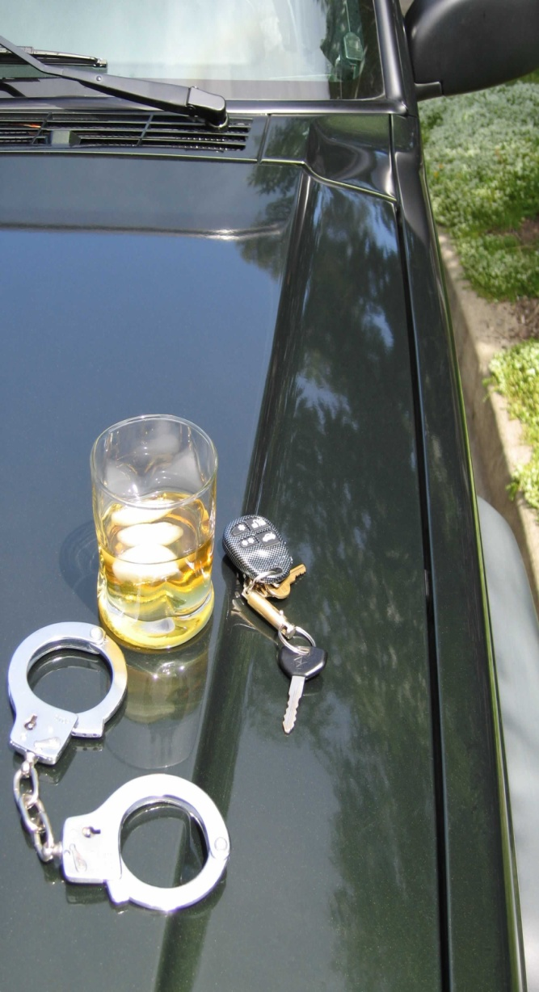
Severe Penalties
TABLE 1 - GENERAL IMPAIRMENT: .08 TO .099 BLOOD ALCOHOL CONCENTRATION
(Note: These penalties apply to drivers of legal drinking age.)
Penalty First Offense Second Offense Third Offense
Sentence 6 months probation 5 days to 6 months in prison 10 days to 2 years in prison
Fine $300 $300 - $2,500 $500 - $5,000
License No action 12-month suspension 12-month suspension
TABLE 2 - HIGH RATE: .10 TO .159 BLOOD ALCOHOL CONCENTRATION
(Note: This table also applies to drivers under age 21 with a BAC of .02 or more; commercial vehicle drivers with
a BAC of .04 or more; school bus drivers with a BAC of .02 or more; and drivers with BAC of .08 to .099 and who
are involved in a crash resulting in serious bodily injury, death or vehicle or property damage.)
Penalty First Offense Second Offense Third Offense
Sentence 2 days to 6 months in prison 30 days to 6 months in prison 90 days to 5 years in prison
Fine $500 - $5,000 $750 - $5,000 $1,500 - $10,000
License 12-month suspension 12-month suspension 18-month suspension
(occupational limited license after 60-day suspension)
TABLE 3 - HIGHEST RATE: .16 BLOOD ALCOHOL CONCENTRATION AND UP
(Note: This table also applies to drivers who refuse chemical testing at any BAC level and drivers convicted of
driving under the influence of Schedule I, II or III substances that are not medically prescribed, a combination
of another drug and alcohol or substances such as inhalants.)
Penalty First Offense Second Offense Third Offense
Sentence 3 days to 6 months in prison 90 days to 5 years in prison 1 year to 5 years in prison
Fine $1,000 - $5,000 $1,500 $2,500 minimum
License 12-month suspension 18-month suspension 18-month suspension (occupational limited license after 60-day suspension)
If your penalty includes a maximum probation or prison time of six (6) months (you are a first-time offender at any
level or a second-time offender in the “General Impairment” or “High Rate”), your DUI crime has been charged
as an ungraded misdemeanor. The charge of ungraded misdemeanor means if you contest the case, you are not
entitled to a jury trial.
For a first offense at the high and highest rates of impairment, you may be accepted into the Accelerated
Rehabilitative Disposition (ARD) program.

Slide 15
Accelerated Rehabilitative Disposition (ARD)
For a first offense at the high and highest rates of impairment, you may be accepted into the Accelerated
Rehabilitative Disposition (ARD) program.
If you are accepted into the ARD program you will:
• Lose your license for up to 90 days for ARD.
• Remain under court supervision for six (6) months.
• Pay a fine of between $300 and $5,000 in addition to related fees and other costs.
• Undergo alcohol and drug evaluation.
• Undergo alcohol and drug rehabilitation treatment, if necessary.
• Participate in 12 hours of Alcohol Highway Safety School.

Slide 16
ZERO TOLERANCE LAW (UNDER 21 DUI)
The Zero Tolerance law establishes serious consequences for those under 21, who drive with any measurable amount of alcohol in their blood.
The law reduced the Blood Alcohol Content (BAC) from .08 to .02 for minors (under 21) charged with Driving Under the Influence.

Slide 17
WHY ZERO TOLERANCE?
Traffic crashes are the number one (1) cause of death for teenagers in the United States.
Driving involves multiple tasks, the demands of which change continually. To drive safely, you must be alert, make decisions based on ever-changing information present in the environment and be able to maneuver based on these decisions. Drinking alcohol impairs a wide range of skills necessary for carrying out these tasks.
If you are under 21 and are convicted of DUI for the first time, you will go to jail for a term ranging from two (2) days to six (6) months, your license will be suspended for a full year, and you will pay a fine of $500 to $5,000.

Slide 18
UNDERAGE DRINKING
If you are under age 21, it is against the law to buy alcohol, consume alcohol, have alcohol in your possession or have alcohol in the vehicle you are driving. Even if you are not driving, your driving privilege will be suspended.
If you are under 21 years of age and are convicted of lying about your age to obtain alcohol, carrying a false ID card or purchasing, consuming, possessing or transporting alcohol. In addition, if you are underage and are arrested and detained for blood, breath and/or urine testing, parental consent to conduct these tests is not required, but the police will notify your parents of the arrest.

Slide 19
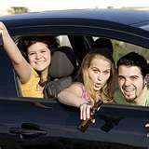
UNDERAGE DRINKING
The minimum penalties for underage drinking are as follows:
• A fine of up to $500 plus court costs.
• A 90-day suspension for the first offense.
• A one (1) year suspension for the second offense.
• A two (2) year suspension for the third and subsequent offenses
If you do not have a driver's license, you will be ineligible to apply for a learner's permit for the time period of the suspension. If you are under 16 years of age, your suspension will not begin until your 16th birthday, provided you acknowledge your suspension, and it is received any time prior to your 16th birthday.
Adults, even parents, who are convicted of knowingly and intentionally supplying minors with alcohol are subject to a fine of at least $1,000 for the first offense and $2,500 for each additional offense and face up to one year in jail.
Adults are even liable for guests who drink in their homes. If, for example, you had 17 teenagers in your home for a party and they were drinking alcohol, the party could cost you $41,000. Thatʼs $1,000 for the first teenage drinker and $2,500 for each of the other 16 drinkers.
http://www.youtube.com/watch?v=NOI3ZNidp5A&feature=related

