Slide 1
Driver Theory
Learner’s Permit
And
Driver’s License
Presented by Mr. Gravine

Slide 2
Non-Commercial Learner’s Permit Info
This presentation will provide the necessary information you need to know about obtaining a Pennsylvania learner’s permit and license

Slide 3
Applying For A Learner’s Permit
You must obtain a learner’s permit before you operate a motor vehicle in Pa. You will need to take and pass the Vision, Knowledge Test and Road Test to get your license.
When you are 16 years old or older, you need to follow the following steps in order to get you permit.
Complete the application found in your manual. (Use Black or Blue ink)
Your Medical Provider must complete the backside of your application. (No earlier than six months prior to your 16th birthday)

Slide 4
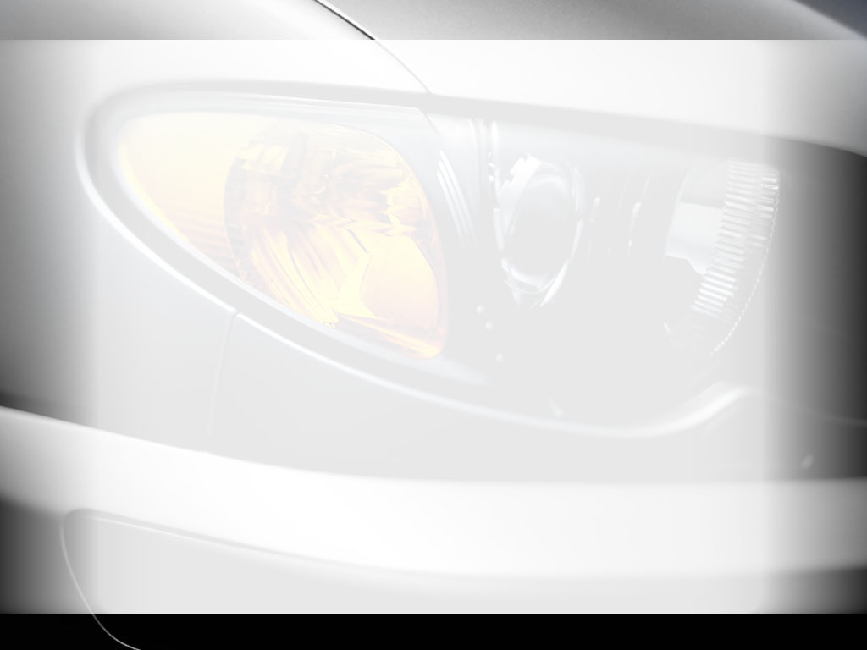
Applying For A Learner’s Permit
After studying the manual bring these items listed to the Driver License Center when you are ready to take the knowledge Test.
Your completed application
Proof of date of birth and identification (Birth Certificate must be original)
Your Social Security Card
Check or money order payable to the PennDOT for the correct amount. (Check or Money Order)Cash, Credit or Debit Cards are not accepted.

Slide 5
Applying For A Learner’s Permit
Driver License Center Hours :
Dunmore: Wed 12:00pm - 7:45pm Fri
8:30am - 4:15pm
Sat
8:30am - 4:15pm
Wilkes Barre: Tues. , Wed., Sat. 8:30-4:15

Slide 6
Applying For A Learner’s Permit
At the Driving Center, your vision will be tested. If you wear glasses or contacts bring them with you.
You will take the Knowledge Test on signs, laws and driving rules pertaining to your manual.
Knowledge Test consist of 18 questions in which you must score 15 correct or better to receive your permit.
After you pass, the examiner will give you your permit in which it is valid for 1 year.
If you fail the Knowledge Test, the examiner will return your application. You may only take the knowledge test one time on any given day.

Slide 7
Applying For A Learner’s Permit
If you are under the age of 18 you are required to complete at least 65 hours of BTW skill building before you go for your license.
A licensed driver who is at least 21 years of age or a spouse, guardian or parent who is at least 18 years of age and who holds a valid driver’s license and is sitting in the front seat.
Driver’s under the age of 18 cannot have more people than seatbelt.
After waiting the mandatory 6 months have a signed certificate of 65 hour BTW, then you can take the road test.
If you permit expires or you do not pass the road test after 3 tries you will need to fill out an application of extension.

Slide 8
Pennsylvania Driver’s License
Like the learner’s permit there are so limitations.
You may not drive between the hours of 11pm-5am
However if you work for charitable service or fire company you can
You may not carry more passengers than seatbelts
You can only have 1 person in the car in first 6 months.
You will receive a mandatory 90 day suspension if you accumulate 6 or more points or are convicted of driving 26 mph over the posted speed limit

Slide 9
Pennsylvania Driver’s License
You may get you Senior (regular )driver’s license after you have held you junior license for 1 year and have met the following.
Have passed a driving training course approved by Pa Dept Edu.
Have not been in a crash for which you are partially or fully responsible for 1 year
Have not been convicted of any traffic violation for 1 year
Have the consent of your parent or guardian who is at least 18
Your junior license automatically changes when you turn 18

Slide 10
Road Test
Appointments must be made.
You may schedule your test on @ www.dmv.state.pa.us
Call 1800-423-5542
When you go, you will need:
A valid permit
The completed 65 hour completion certificate
Valid registration card for the vehicle you plan to drive
Proof of insurance
The valid driver’s license of a person who is 21 years or parent or guardian who is 18.
* Before the test, examiner will check vehicle for inspection and to see if vehicle meets safety standards.

Slide 11
Road Test
You will fail the road test if you drive dangerously, violate the law, cause a crash, fail to follow examiners instructions or make too many errors.
The examiner may ask you to do prior to the road test.
Use your vehicle controls
Use horn, lights, etc.
Parallel Park
Park vehicle midway between to uprights in a space that is 24 feet long and 8 feet wide. Your vehicle must be in the space. You cannot make any contact with the uprights or hit the curb.
You have 3 attempts to park

Slide 12
Road Test
If you pass the road test:
You will receive a temporary driver’s license. You will receive a permanent license in the mail within 15 days.
If you fail the road test:
If you are under 18 you must wait 7 days before you can take the test again.
You have 3 chances to take the test
After the third failure you must reapply for learner’s permit

Slide 13
Good Luck!
Text area

