Slide 1
Drinking and Driving VS. Texting Which is more dangerous?
Leaving school, meet you in 10 :-)
Don’t forget about tonight!
Driver Theory

Slide 2
The Facts
What do you think?
Motor vehicle crashes in the U.S. were the leading cause of death among 16- to 24-year-olds. PennDOT data shows there were 22,712 16- to 20-year-olds who were involved in reportable crashes in 2013, which resulted in 27 fatalities. So with nearly one-quarter of those fatalities involving intoxicated teen drivers, it’s hard to imagine that cell phone distractions could be worse than driving under the influence.
OMG, did u know texting is more dangerous than drinking and driving (:-O

Slide 3
Texting While Driving
Drive Safe Riverside
http://www.youtube.com/watch?v=zbFJWDqc0C4&feature=related
http://www.youtube.com/watch?v=vOTbAbKoL28&feature=related

Slide 4
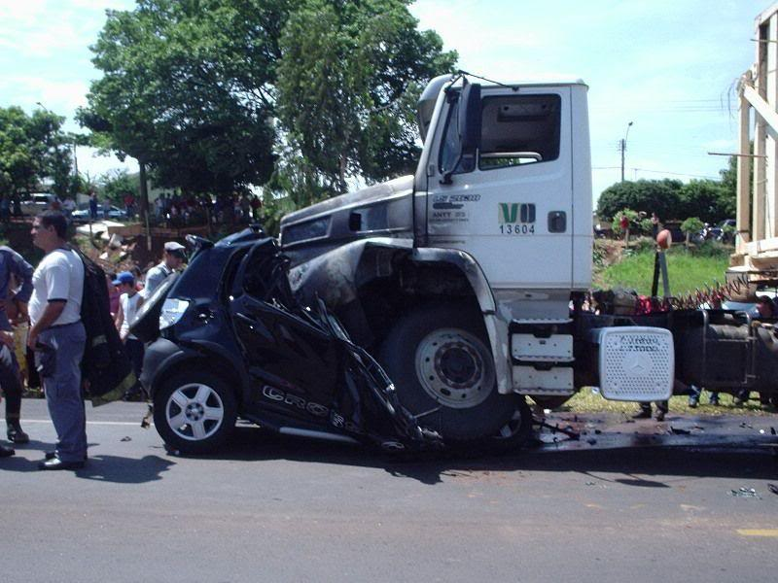
TWD
Don’t Text and Drive
https://www.youtube.com/watch?v=t7911kgJJZc

