Slide 1
Children’s Visual Health and the role of Screenings
Lindsay M. Elkins, OD, FAAO
Southern College of Optometry
lelkins@sco.edu

Slide 2
Introduction / Disclosures
No Financial Disclosures

Slide 3
Purpose of Vision Screenings
Provides a risk assessment for Visual Disorders
80% of learning is Visual
American Optometric Associations estimates 25% of school children have a visual disorder and only 1/3rd of children have had an eye exam or screening before entering school
Vision disability is the most prevalent disabling condition among children (8)

Slide 4
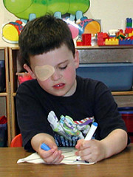
Vision Screening Rationale
Amblyopia: “Lazy Eye”
2-5% of Pre-School age children
Vision is reduced in one or both eyes due to
Eye turn (Strabismus)
Uncorrected and/or Uncorrected Refractive Error
Vision Reduction can become permanent
Treatment is more successful in the young
Photo credit: National Eye Institute
https://www.google.com/search?site=imghp&tbm=isch&source=hp&biw=1350&bih=608&q=amblyopia&oq=amblyopia&gs_l=img.3..0l10.24142.25334.0.26919.9.9.0.0.0.0.119.759.8j1.9.0....0...1ac.1.64.img..0.9.754.S0F4nZxd4WQ#q=amblyopia&tbm=isch&tbs=sur:fm&imgrc=kJ9seJ_fo0XBfM%3A
Notes:
There are a whole host of visual impairments that can affect learning, but I’ll go through the most common ones that come up when touting the need for vision screenings. Amblyopia is often asymptomatic as it generally affects one eye. Children are unaware of symptoms.

Slide 5
Amblyopia Continued
Early Treatment of Amblyopia results in improved visual outcomes
Lead to U.S. Preventative Services Task Force 2017 recommendation for vision screenings to be performed at least once in children aged 3-5 years
https://www.uspreventiveservicestaskforce.org/uspstf/recommendation/vision-in-children-ages-6-months-to-5-years-screening

Slide 6
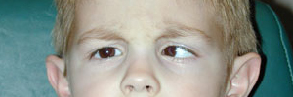
Strabismus
“Eye Turn”
Can result in Amblyopia
3-4% of Pre-school age children
Photo credit: Sandra Brown, M.D. - University of Michigan Kellogg Eye Center
Notes:
These eye turns can be due to uncorrected refractive error and can lead to amblyopia; often more subtle than this presentation.

Slide 7
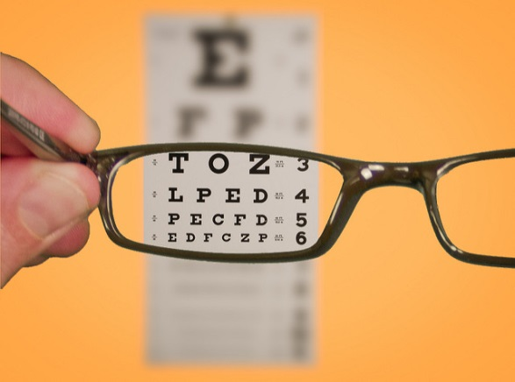
Refractive Error:
15- 20% of pre-school-age children
Myopia (nearsightedness)
Hyperopia (farsightedness)
Astigmatism
www.SeniorLiving.Org
Notes:
Children may not know how to express their symptoms if they are aware, or they may not realize how they function is abnormal if it has always been “normal” for them; especially if only one eye is affected

Slide 8
Why Screenings in School? The National Survey of Children’s Health (2016–2017) https://preventblindness.org/wp-content/uploads/2020/07/Snapshot-Report-2020condensedF.pdf
61% of children five years and younger have never had a vision screening by a healthcare professional
Equity issue
Notes:
These are part of the rational for providing vision screenings in the Tennessee State Guidelines, though we’ll see that screening follow up is still an issue
Cite as: National Center for Children’s Vision and Eye Health at Prevent Blindness. 2020. Children’s Vision and Eye Health: A Snapshot of Current National Issues (2nd ed.). Chicago, IL: National Center for Children’s Vision and Eye Health at Prevent Blindness.

Slide 9
Why Screenings in School? The National Survey of Children’s Health (2016–2017) https://preventblindness.org/wp-content/uploads/2020/07/Snapshot-Report-2020condensedF.pdf
Disparities in vision testing:
Children 17 years or younger with the following demographics were more likely to have received vision testing:
private health insurance
consistent health insurance within the last year
a medical home or consistent health care provider
being non-Hispanic and living in a home where English is the primary language.
College educated adults in home
Higher household income
Notes:
These are part of the rational for providing vision screenings in the Tennessee State Guidelines, though we’ll see that screening follow up is still an issue
Cite as: National Center for Children’s Vision and Eye Health at Prevent Blindness. 2020. Children’s Vision and Eye Health: A Snapshot of Current National Issues (2nd ed.). Chicago, IL: National Center for Children’s Vision and Eye Health at Prevent Blindness.

Slide 10
Why Screenings in School? The National Survey of Children’s Health (2016–2017) https://preventblindness.org/wp-content/uploads/2020/07/Snapshot-Report-2020condensedF.pdf
Periodic vision screening during the school years is important for school-aged children because refractive errors, such as myopia, and other visual disorders may emerge for the first time throughout these years.
The Bright Futures/American Academy of Pediatrics Periodicity Schedule recommends vision screening at ages 8, 10, 12, and 15 years.
Notes:
These are part of the rational for providing vision screenings in the Tennessee State Guidelines, though we’ll see that screening follow up is still an issue
Cite as: National Center for Children’s Vision and Eye Health at Prevent Blindness. 2020. Children’s Vision and Eye Health: A Snapshot of Current National Issues (2nd ed.). Chicago, IL: National Center for Children’s Vision and Eye Health at Prevent Blindness.

Slide 11
Vision Screening by Pediatricians
American Academy of Pediatrics recommends vision assessments between 3-5 years of age
Pediatricians can bill/collect money for vision screenings
Ohio study: 5% of 3-6 year olds were screened, some states better
60% of parents considered child’s pediatrician their main source of information about eye health and diseases

Slide 12
Coordinated School Health Initiative
Low rate of screenings and comprehensive eye exams (Optometrist or Ophthalmologist) supports rational for incorporating screenings in Coordinated School Health Initiative

Slide 13
Screening Follow Ups?
Average 30-40% from various sources, including SCO program (10)
We do not contact failures due to risk of conflict of interest
Notes:
Failure to follow up after screenings was a rationale for providing vision screenings in schools, but it is still a challenge even after school based screenings.

Slide 14
Current Tennessee Vision Screening Guidelines FINAL_Health_screening_Guidelines_2022.pdf (tn.gov)
Notes:
These guidelines were revised in May 2015, and most recently August 2022 to make screenings encouraged. I was the vision care representative in 2015. Coordinated School health specialists as well as other specialty health care experts from all over TN were part of the revision committee.

Slide 15
TN Guidelines
All students in grades: Pre-K, K, 2, 4, 6, and 8 are encouraged to receive vision screenings. One year of high school is optional. New to school or suspected vision problem should also be screened (1)

Slide 16
TN Vision Screening Requirement
Personnel: trained school personnel, volunteers, or outside agencies
Screening should include:
Distance and Near Visual Acuities
Color Perception once
Functional testing: Muscle Balance, Depth Perception, Ocular Motor

Slide 17
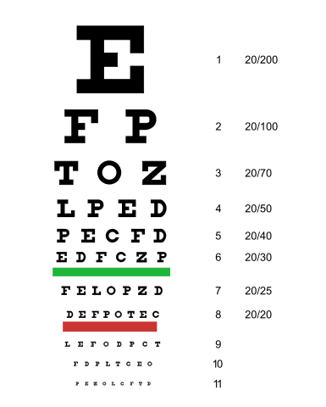
TN Vision Screening Requirements
Equipment:
Eye Chart:
(reduced version for near)
Sloan/Snellen
(20 or 10 feet)
Requires Verbalization
Letter recognition
Photo credit: Jeff Dahl, en.wikipedia.org

Slide 18
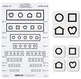
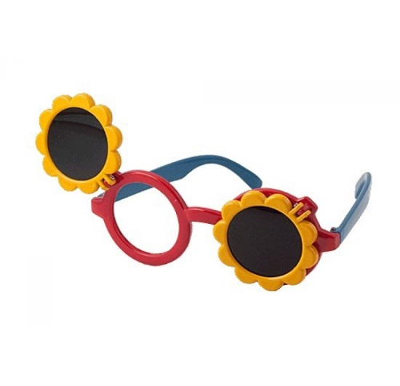
Eye Charts for Preschoolers/Non-Verbal
HOTV
Lea Symbols
Allows matching
Flip charts available
Photos: Good-lite company: www.good-lite.com

Slide 19
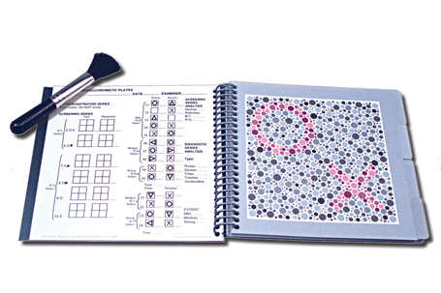
Color Perception
8% of men and 0.5 % of women have some degree of color deficiency, and 1 in 7 females are carriers of the color deficiency gene
One time screening
Equipment:
Pseudoisochromatic Plates
Photo: www.bernell.com
Notes:
We selected 2nd grade as the children are young enough to catch things early, but old enough to reliably and relatively efficiently perform the test. Newly added as a minimum requirement as it was noted that many classrooms use white boards now with colored dry erase markers and a deficit may affect learning now more than previously. Mostly we find red/green color vision deficits, which are generally congenital and run in the family, but making the teacher aware can allow for proper accommodations if needed. We use the HRR test, one eye is tested at a time as you can have a defect in one eye and not the other. This can be used for children as well as adults. They use the paint brush instrument to trace what shapes they see in the picture. They do not actually have to verbalize what they see. There are many other similar tests as well as online apps that I know some schools use, however the instructions were lacking and validity/calibration often difficult to determine.

Slide 20
Color Perception
Equipment: Pseudoisochromatic Plates
NOTE: Pseudoisochromatic plates in mechanical vision testers are not acceptable for use.
It is acceptable to use the Eye Handbook color testing application which is free for iPad and Android tablets.
Photo: www.bernell.com
Notes:
We selected 2nd grade as the children are young enough to catch things early, but old enough to reliably and relatively efficiently perform the test. Newly added as a minimum requirement as it was noted that many classrooms use white boards now with colored dry erase markers and a deficit may affect learning now more than previously. Mostly we find red/green color vision deficits, which are generally congenital and run in the family, but making the teacher aware can allow for proper accommodations if needed. We use the HRR test, one eye is tested at a time as you can have a defect in one eye and not the other. This can be used for children as well as adults. They use the paint brush instrument to trace what shapes they see in the picture. They do not actually have to verbalize what they see. There are many other similar tests as well as online apps that I know some schools use, however the instructions were lacking and validity/calibration often difficult to determine.

Slide 21
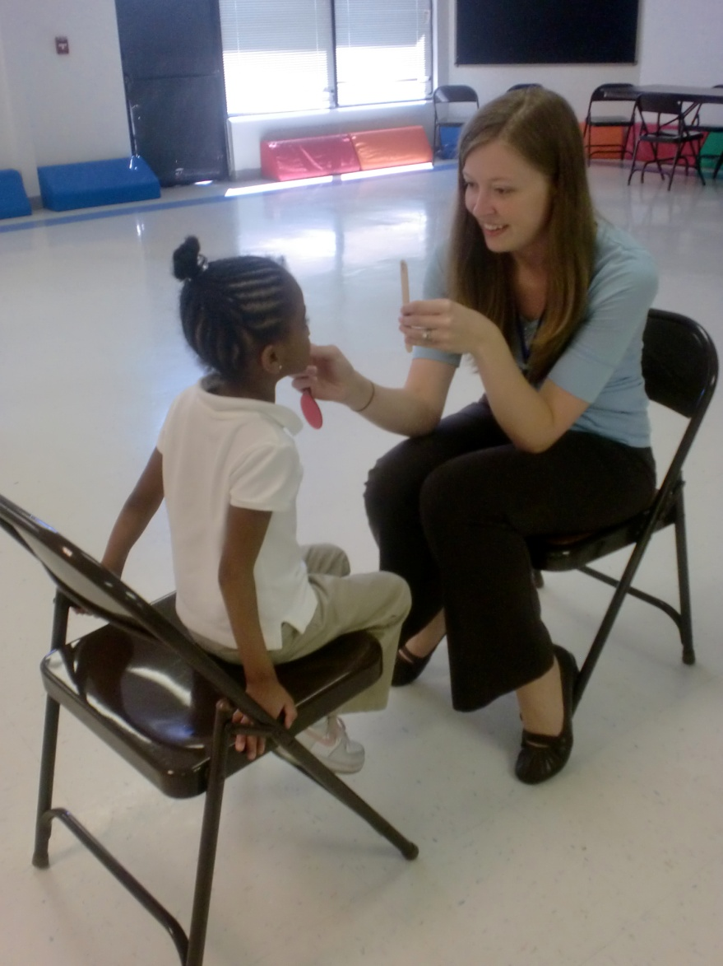
Optional: Muscle Balance
How well the eyes work together when focusing on an object
Cover Test
Takes substantial
training

Slide 22
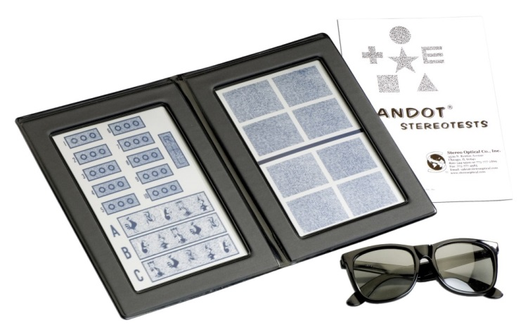
Optional: Depth Perception
Randot Stereo Acuity
(+) time constraint in
screening environment
Smile 2 (PASS Test 2)
Photo credit: Good-Lite Stereo Smile, Medshop.com; Randot Stereo Test: BiB Ophthalmic Instruments
Notes:
Eyes must work well together for depth perception to occur; important with sports, driving, etc…

Slide 23
Optional: Ocular Motor Testing
How well eyes track objects or move quickly and accurately between objects
Follow a light or small object
Basic: Can eyes move together in all directions
Pursuits: accurately follow an object
Saccades: jump accurately between two objects
Reading Implications
Powerful for Concussion assessments

Slide 24
Mechanical Vision Testers and Best Practices
Instrument based testing is allowed in TN guidelines
National Expert Panel sponsored by Prevent Blindness, published in Optometry and Vision Science
Intended for pre-school screenings conducted by lay screeners, school nurses/other public health figures, and in primary care settings
Notes:
TN does allow the use of certain mechanical testing units for screenings. How does this all fit with best practices? The most recent study on best practices for preschoolers was sponsored by Prevent Blindness America which established a National Expert Panel. They specifically geared their study for best practices for screenings conducted by non-eye care professionals

Slide 25
National Expert Panel Recommended Practices
Recognition Visual Acuity
Monocular VA’s HOTV or LEA
With crowding bars or single line crowded
Test distance 5ft (1.5m)
Occlusion (adhesive patch, surgical tape, or Good-Lite opaque occlude glasses)
Image: Cotter S
Notes:
Their recommendations for recognition acuity are very similar to the TN guide, using LEA symbols or HOTV, however using a type with single lines instead of the whole chart, and for occlusion using these special glasses or an adhesive patch

Slide 26
NEP’s Recommended Practices
Instrument-based/ Autorefraction
Screening for refractive error alone is often successful in identifying children with constant strabismus
American Academy of Pediatrics stated instrument-based can be used as alternative to VA screening in 3-5yo
Retinomax, SureSight and Spot Vision Screener
*SureSight no longer sold by WelchAllyn
Notes:
The National Expert panel also verified the ability to use certain mechanical testing devices. These generally only assess refractive error, but that has been shown to be helpful in identifying constant strabismus, which we mentioned is a risk factor for amblyopia in addition to uncorrected refractive error. The AAP also stated instrument based testing can be used as an alternative to the wall chart in 3-5 year olds. Specifically these brands are mentioned by all parties.

Slide 27
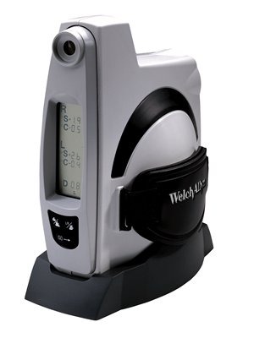
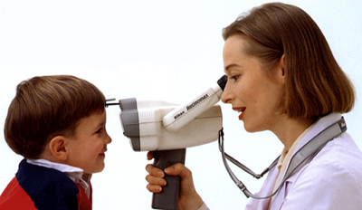
Retinomax
SureSight

Slide 28
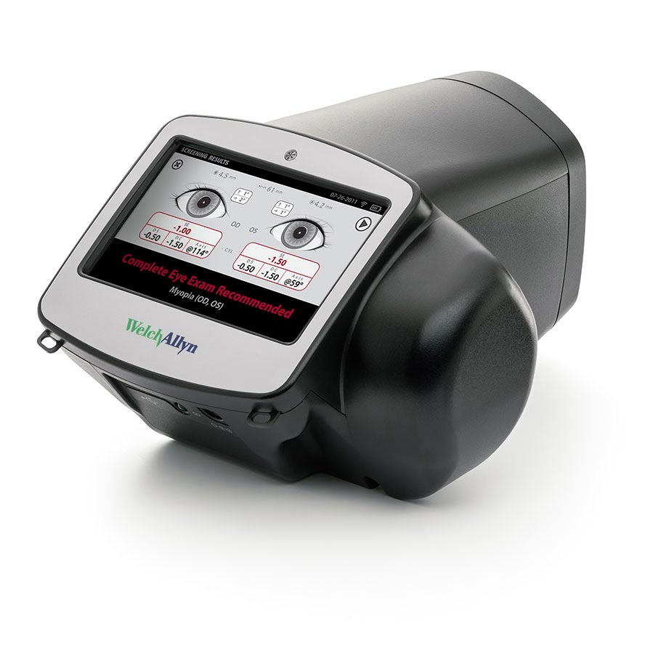
WelchAllyn Vision Screener

Slide 29
FAQ’s
Can mechanical screeners be used in lieu of vision charts? What is best practice? What if a student fails the mechanical screen?
What’s the difference in refractive and non-refractive errors?
Why is the recommended screening distance 10 ft? If a district is still using Snellen charts, is it ok to test at 20 feet or should we screen at 10 ft?
What age(s)/grade(s) do you recommend muscle balance screening?
What age(s)/grade(s) do you recommend color perception testing?
Is it acceptable to print a color perception testing booklet?
Is the tumbling E an appropriate chart for screening?

Slide 30
Post Screening Referrals
Failed Screening needs follow-up care
TN guidelines: School Nurse responsibility
Mostly Paperwork sent home with student
Attempt to notify at least 3 times using different methods each time
Requires substantial time to implement and document

Slide 31
Referral Advice for Parents
Refer the student to an Eye Care Professional
Resource list can be given
Avoid making any recommendation to a specific individual or specific class of practitioner (ophthalmologist or optometrist)
Take Results to the appointment with an eye care professional
Have results from eye exam returned to school

Slide 32
Access to Care/ ACA
Pediatric Vision benefit of a yearly eye exam is an essential health benefit under the Affordable Care Act
For Marketplace plans to be in compliance with ACA they must provide for a yearly eye exam with a materials (glasses) benefit for every patient under the age of 19
TN guidelines state in instances of financial barrier, school funds may be used to provide services
Greater barrier; public education on necessity, transportation
Notes:
There are still many families that may have opted to not purchase a market place plan, using a private exchange may not have the same benefits, or if they opted to take the penalty there still may be uninsured children that resources have to be found in the community

Slide 33
Additional Resources TN Guide
State, county or municipality revenues
Local county department of social services for Medicaid assistance
Lions Club for refractions, glasses, eye examinations
PTA/other service organization
Local County Physically impaired children’s program
Health Insurance Plans
Vision Service Plan (VSP) program available through the National Association of School Nurses or local Boys and Girls Club

Slide 34
What do We Do? SCO: Active Consent

Slide 35
Modified Clinical Technique
Devised from the Orinda Study (1959)
Upper middle-class, mostly caucasian
Acuity: Distance and Near
Retinoscopy
Cover Test: Distance and Near
Ophthalmoscopy (internal eye health assessment)
Color Perception: Second Grade

Slide 36
Set Up- Near

Slide 37
Set- Up: Ret and Direct

Slide 40
Vision Screening Procedure | Referral Criteria
Distance/Near Visual Acuities | 5 y.o. and younger: 20/40 or worse
 | 6 y.o. and older: 20/40 or worse
 | All Children greater than 2 lines difference between eyes
Distance/Near Cover Test | Any Tropia
 | >4 esophoria, >8 exophoria
 | > 2 hyperphoria
Retinoscopy | Myopia: >-0.50 with reduced acuity
 | Hyperopia: >+1.50
 | Astigmatism: >1.00
Direct Ophthalmoscopy | Lesions of the optic nerve, retina, macula
 | .7 or larger C/D ratio
 | .2 C/D ratio difference between eyes
 | .2 C/D ratio difference vertical vs Horizontal
 | No Red Reflex present
Stereopsis | 5 y.o. and younger: worse than 250 sec arc
 | 6 y.o. and older: worse than 70 sec arc
Notes:
We are reviewing our criteria and will be adjusting the acuity requirements to reflect new research indicating that a cut-off of 20/40 or worse is more sensitive for catching preschoolers with issues earlier. Please note that the acuity cut offs are not 20/20, emphasizing that passing a screening does not mean you have perfect vision. Any time more stringent criteria is used it should increase sensitivity (catch more problems), but also likely increase false positives (refer people that may not ultimately have a problem). Ideally any test would be very specific as well as sensitive, however recognition acuity alone is a subjective test; it relies on the child’s abilities. Cover test, retinoscopy and direct ophthalmoscopy are objective tests, however they rely on the skill of the examiner and are not quick teach tests that you can quickly show a lay person volunteer, which is why they are not routinely performed on most screenings.

Slide 41
Where Are we Serving?
Mostly Shelby County and Municipal Schools
Arlington
Bartlett
Collierville
Germantown
Millington
Lakeland

Slide 42
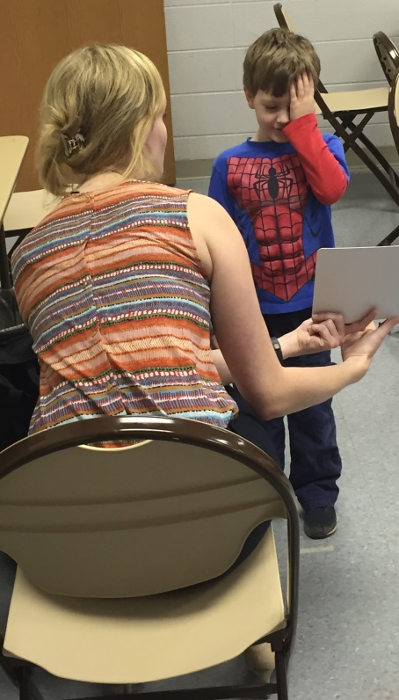
5 Year SCO Review of Screening Data
39, 585 children screened from 2008-2013
Ages 3-16
Average Fail rate: 24.3%

Slide 43
Failure Causation
Elkins, Harville. Longitudinal Review of School Vision Screening Failure and Causation. AAO Poster 2013.

Slide 44
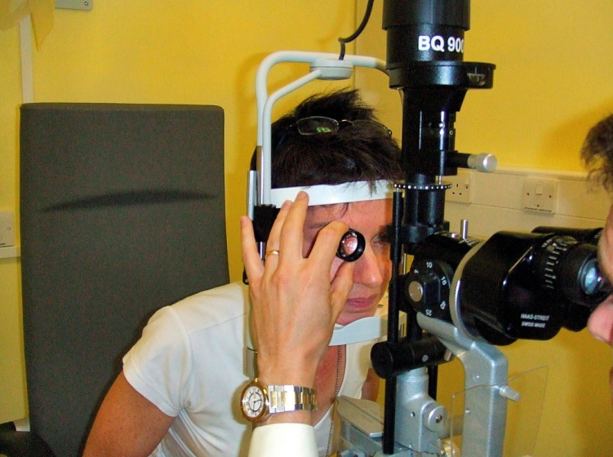
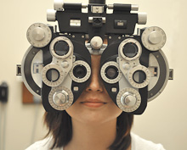
Screening Vs. Comprehensive Eye Exam
Only an Optometrist or Ophthalmologist can conduct a comprehensive Eye Exam
Licensed to make definitive diagnosis and prescribe treatment
Specialty equipment and procedures that are not part of screenings can be utilized in office

Slide 45
Comprehensive Exam Includes
Patient and Family History
Visual Acuity
Preliminary testing can include: depth perception, color vision, peripheral vision, pupil response to light
Eye focusing, eye teaming, and eye movement abilities
Eye Health Examination which may include dilating the pupil
Additional testing as needed

Slide 46
Frequency of Exam: AOA Recommendations
Patient Age | Exam Interval
 | Asymptomatic/Risk Free | At Risk
Birth -24 months | At 6 months of age | At 6 months or as recommended
2-5 years | 3 years of age | 3 or as recommended
6-18 years | Before 1st grade, then every 2 years | Annually or as recommended
18-60 years | Every 2 years | Every 1-2 years or as recommended
61 and older | Annually | Annually or as recommended

Slide 47
Comprehensive Eye Exams: 5 year review (n=39,)585
Notes:
Parent survey indicated that 40.1% of all children, 49% of those that failed, and 38.3% that passed had received a comprehensive eye exam

Slide 48
Age of First Exam
# of
Children
Child’s Age
Age of first eye exam was answered by 1,475 (n) parents. Five years old was the most common age indicated for first exam. Only 26% had an exam before age 5.

Slide 49
Reason for First Eye exam

Slide 50
SCO Parent Survey: Why No Comprehensive Exam? (n=1,105)

Slide 51
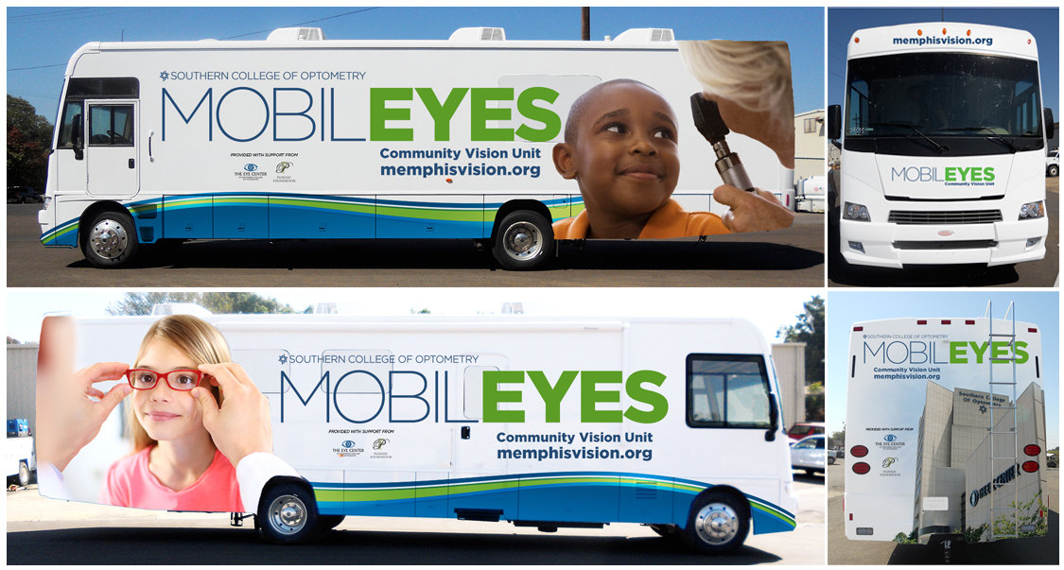
Addressing Barriers: MobilEyes
Notes:
In an effort to address the barriers of transportation, as well as financial burdens for those without insurance. Provides full eye exams to community partners. Utilizes insurance when available, grants to provide exam/materials when needed.

Slide 52
References
Tennessee School Health Screening Guidelines, Tennessee Department of Education and Tennessee Department of Health, Revised August 2022
Simons K. Preschool vision screening: rationale, methodology and outcome. Surv Ophthalmol 1996;41:3-30.
Donahue et al. Preschool Vision Screening: What should We be Detecting and How Should We Report it? Uniform Guidelines for Reporting Results of Preschool Vision Screening Studies. Journal of AAPOS 2003;7(5) 314-316.
CSH Background and History. https://www.tn.gov/education/article/csh-background-and-history. Accessed 5/16/2016
Limitations of Vision Screening Programs. http://www.aoa.org/patients-and-public/caring-for-your-vision/comprehensive-eye-and-vision-examination. Accessed 5/10/2016
Tennessee Department of Education Office of Coordinated School Health. Annual Report. 2014-2015
Beck, M. New Outlook on ColorBlindness. The Wall Street Journal online. 11/6/2012. http://www.wsj.com
Press, L. et al. The Need for Comprehensive Eye and Vision Examinations in Children: A Public Health Care and Educational Crisis.
Marsh-Tootle, W. et al. Exploring Preschool Vision Screening in Primary Care Offices in Alabama. Optometry and Vision Science. 2012; 89:1521-1531
Su, Z. et al. Identifying barriers to follow-up eye care for children after failed vision screening in a primary care setting. Journal of AAPOS. 2013; 17:385-390
Shalhoub, J. A comprehensive Guide to Pediatric Vision Screenings. Grand Rounds Presentation, April 2016.
Norlin, C. et al. Delivery of Well-Child Care: A Look Inside the Door. Academic Pediatrics. 2011;11:18-26
https://nationalcenter.preventblindness.org/vision-screening-guidelines-by-age/#1587738141566-8622dd11-25a0

