Slide 1
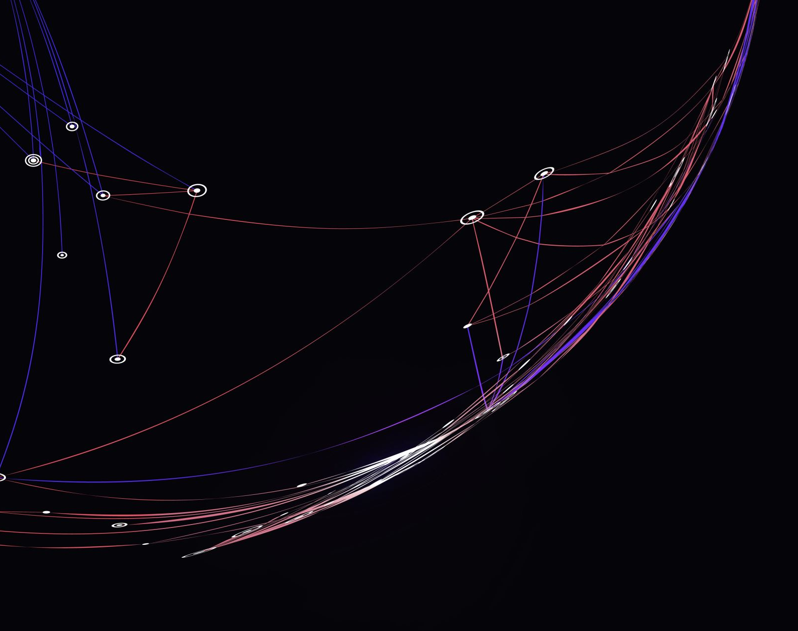
Brain Breaks
Resources from CSH Supervisor
Andrew Martin
Andrew.martin@gmsdk12.org

Slide 2
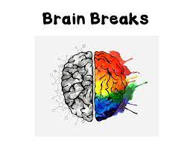
Why use Brain Breaks?
Better behavior
Increased productivity
Enhanced comprehension
Creative thinking
Increased time on task
Increase cognitive functions
Enhances educational outcomes

Slide 3
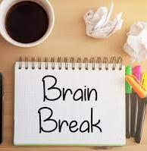
When to use Brain Breaks?
Start the day!
-Students enter the school building with different feelings, attitudes and energy levels. A great brain break is a good way to put everyone on a great path to a successful day of learning.
After lunch
-Students can refocus and get their energy right after taking in a meal. Students can use the fuel from lunch and energized brain break to keep their mind on task for learning.

Slide 4
When to use Brain Breaks continued?
After recess
-Refocus students after a bout of recess. Students will probably come back from recess with a lot of energy and their minds on everything other than learning. Take this moment to get everyone back on track.
After PE class
-PE class brings a lot of joy and excitement out of students. Their energy levels are still running high. Utilize an effective brain break to bring students back to a state of focus and concentrated energy.
End the day!
-Send students home with a relaxed and focused mindset. Students can focus on the lessons and materials learned from the day.

Slide 5
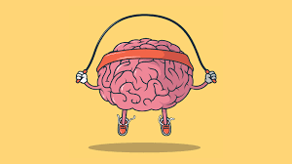
Resources to use for Brain Breaks
Go Noodle Platform
Sworkit Platform
Darebee Platform
Popsugar Fitness Platform
Fitness Blender Platform

Slide 6
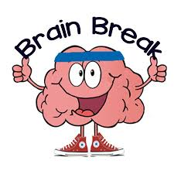
CSH Resources
The following resources are found on the CSH website: The Phys Ed Express
This or That videos
Would You Rather videos
Netflex videos
Superhero videos

Slide 7
This or That
This or That page: https://www.thephysedexpress.com/this-or-that.html
Students will participate in a fun exercise video that has a specific theme.
Students are shown two choices and must select their preference.
Students perform an exercise based off their selection.

Slide 8
Would You Rather
Would You Rather page: https://www.thephysedexpress.com/would-you-rather-fitness.html
Students will be given a choice to decide what they would rather do.
Based off their selection, students will perform a specific exercise.
Students can select from a variety of themes from this library of videos.

Slide 9
Netflex
Netflex page: https://www.thephysedexpress.com/netflex.html
The Netflex page consists of a variety of exercise videos based on categories.
The options are as follows: Workouts, Kid’s Videos , PE & Health, Dance, Inclusive, Yoga, Pre-School, Interactive Fitness Games, Teens, Martial Arts, Brain Breaks, Music, Mindfulness, and Sports.

Slide 10
Superhero Videos
Superhero page: https://www.thephysedexpress.com/superhero-videos.html
Choose from a variety of Superhero themed exercise videos to enhance your brain breaks.

Slide 11
Additional Resources
Chase Series Videos
Fortnite Dances
Scavenger Hunts
Tik Tok Dance Challenges

